Slide 1
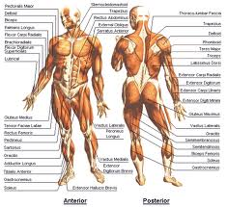
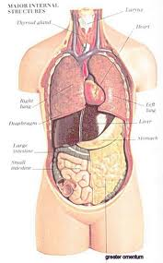
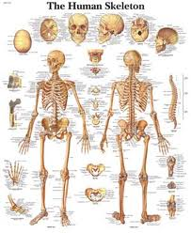
Human Body System Project
Isaac Kim
P.4

Slide 2
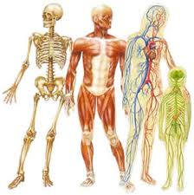
Table of Contents
Digestive System
Circulatory System
Respiratory System
Excretory System
Immune System
Endocrine System
Reproductive System
Nervous System
Senses
Muscular System
Skeletal System

Slide 3
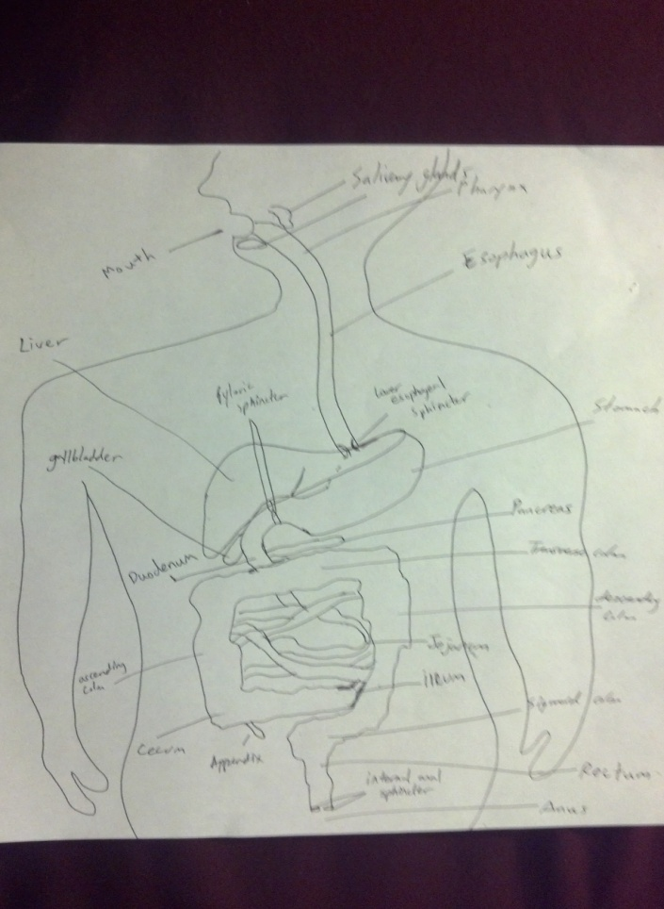
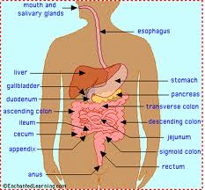
Digestive System
Function: To convert food into energy needed to survive and package the residues for waste disposal.

Slide 4
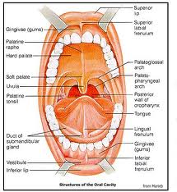
Digestive Organs
Mouth- the beginning of the digestive tract. Chewing breaks down food into smaller pieces so they can be easily digested. Saliva secreted from the glands breaks it down even more to a form which the body can easily digest and absorb.

Slide 5
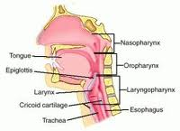
Digestive Organs
Pharynx- the common passage way for both food and air. The upper portion is connected to esophagus, the lower portion is connected to the trachea.

Slide 6
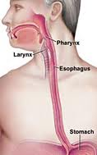
Digestive Organs
Esophagus- receives food from the mouth and delivers it to the stomach using peristalsis.

Slide 7
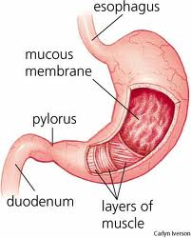
Digestive Organs
Stomach- a hallow organ that contains the food while it is being mixed with enzymes that continues to digest the food. It secretes strong acids and powerful enzymes to break down the food. When it’s done, it releases the food into the small intestine.

Slide 8
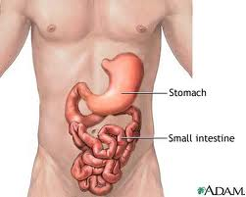
Digestive Organs
Small Intestine- 3 parts: the duodenum, jejunum, and ileum. Duodenum is responsible for continuous breaking-down process, while jejunum and ileum are responsible for absorbing nutrients into the blood stream.

Slide 9
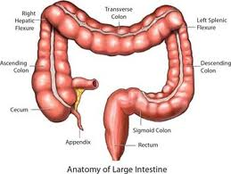
Digestive Organs
Large Intestine- consists of the cecum, the ascending (right) colon, the transverse (across) colon, the descending (left) colon, and the sigmoid colon, which connects to the rectum. It uses peristalsis to move the feces through the colons. The cecum, ascending, transverse, and descending colons remove water and absorb vitamins synthesized by bacteria in the food debris. Lastly, the sigmoid colon empties the content into the rectum.

Slide 10
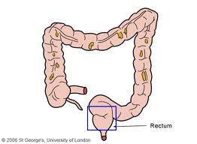
Digestive Organs
Rectum- connects the colon to the anus. It holds on to the feces until the evacuation happens. It also sends a message to the brain to see if the contents are ready to be released or not.

Slide 11
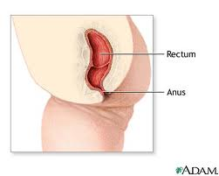
Digestive Organs
Anus- the last part of the digestive tract. It holds and releases the contents out of the body.

Slide 12
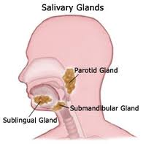
Digestive Organs (Accessory)
Salivary Glands- secretes saliva containing enzymes and other digestive molecules to help break down the food. The saliva lubricates, binds, and solubilizes food, so it can be digested easily. Also, it starts starch digestion.

Slide 13
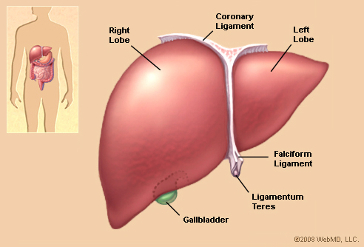
Digestive Organs (Accessory)
Liver- filters the blood coming from the digestive tract, before passing it to the rest of the body. The liver also detoxifies chemicals and metabolizes drugs. As it does so, the liver secretes bile that ends up back in the intestines. The liver also makes proteins important for blood clotting and other functions.

Slide 14
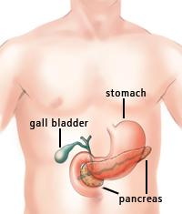
Digestive Organs (Accessory)
Pancreas- produces enzymes to help digestion. It also creates and releases hormones (insulin, glucagon) directly into the bloodstream.

Slide 15
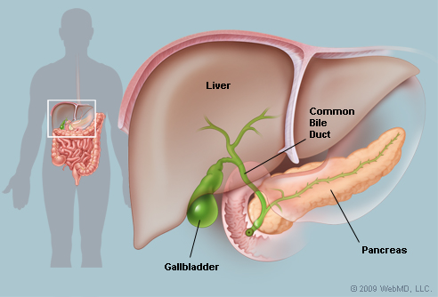
Digestive Organs (Accessory)
Gallbladder- stores bile produced by the liver. It releases stored bile into the small intestine to help digestion.

Slide 16
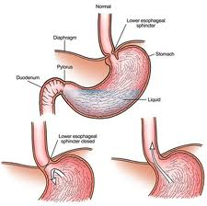
Digestive Organs
Sphincters- prevents any contents from going back to where it came from, and allows them to move on to next digestive organ.

Slide 17
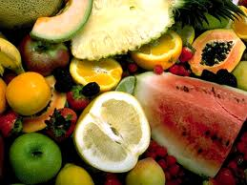
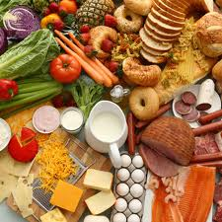
Why break down large food molecules?
The foods humans eat are not necessarily usable in their current form. They have to be broken down in order for organs to digest them.
Often, the original ingested molecules are too large to be absorbed by the body. Thus, they must be broken down to absorbable forms.

Slide 18
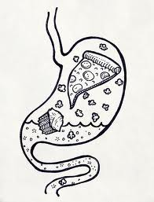
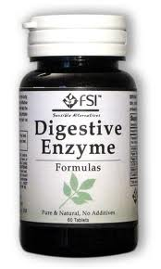
Why use so much enzymes?
Digestion could still occur without any enzymes. However, the rate of the digestion would be much slower than the one with the enzymes.
Enzymes are catalysts.

Slide 19
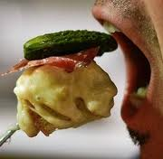
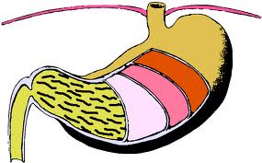
Physical Digestion
Mastication- biting, slicing and grinding with the teeth.
Churning of the stomach- agitation created by the turbulence in the stomach.
Emulsification- duodenum receives bile salts which dissolves insoluble lipids.

Slide 20
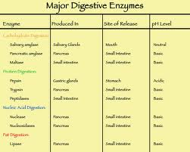
Chemical Digestion
Chemical Digestion is accomplished by digestive enzymes.
Digestive enzymes such as Nuclease, Protease, Collagenase, Lipase, Amylase, Elastase, Trypsin, and Chymotrypsin break down large molecules like proteins, carbohydrates, and etc.
These enzymes speed up the overall reaction speed.

Slide 21
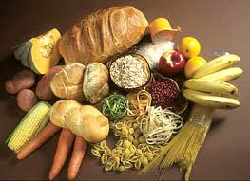
Carbohydrate
Carbohydrates are digested immediately starting from the mouth by salivary amylase.
As carbohydrates reach the stomach, amylase still breaks them down to oligosaccharides.
When they reach the small intestine, pancreatic enzymes break down oligosaccharides into monosaccharides.

Slide 22
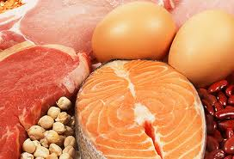
Protein
Protein digestion begins in the stomach.
Enzymes called pepsins break down the protein molecules in the stomach.
Pepsins break proteins into shorter polypeptides.
When the protein molecules reach the small intestine, the pancreatic enzymes trypsin and chymotrypsin break down the polypeptides into oligopeptides.
Protein digestion is complete when the carboxypeptidase, dipeptidase and amino peptidase enzymes transform oligopeptides into individual amino acids.

Slide 23
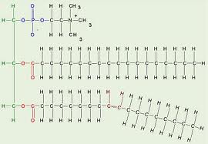
Lipid
Not easily digested since it has water-repellent nature.
Lingual lipase starts breaking down fat in the mouth.
Not much digestion in the stomach.
Most of the digestion is done in the small intestine where pancreatic lipase and bile from gallbladder break down fats into free fatty acids.

Slide 24
DRAWING!!
I must say… This is a great drawing.

Slide 25
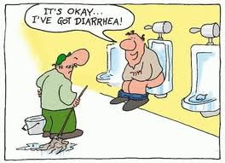
Disorders
Diarrhea
Diarrhea is defined as a watery stool, or an increased frequency in stool, or both as compared to the normal amount of stool passed by the individual.
Many people have diarrhea once or twice a year, while other might have them often because of chronic diseases.
Over the counter meds- PeptoBismol, etc, and drinking fluids frequently.

Slide 26
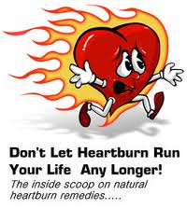
Disorders
Heartburn
Chronic heartburn is a digestive disorder called gastro esophageal reflux disease (GERD).
GERD is caused by gastric acid that flows from the stomach and into the esophagus.
A burning feeling in the chest just behind the breastbone that occurs after eating and lasts a few minutes to several hours.
20% of the general population experience heartburns at least once a week.
Change the eating style.
Take antacids and other medications.

Slide 27
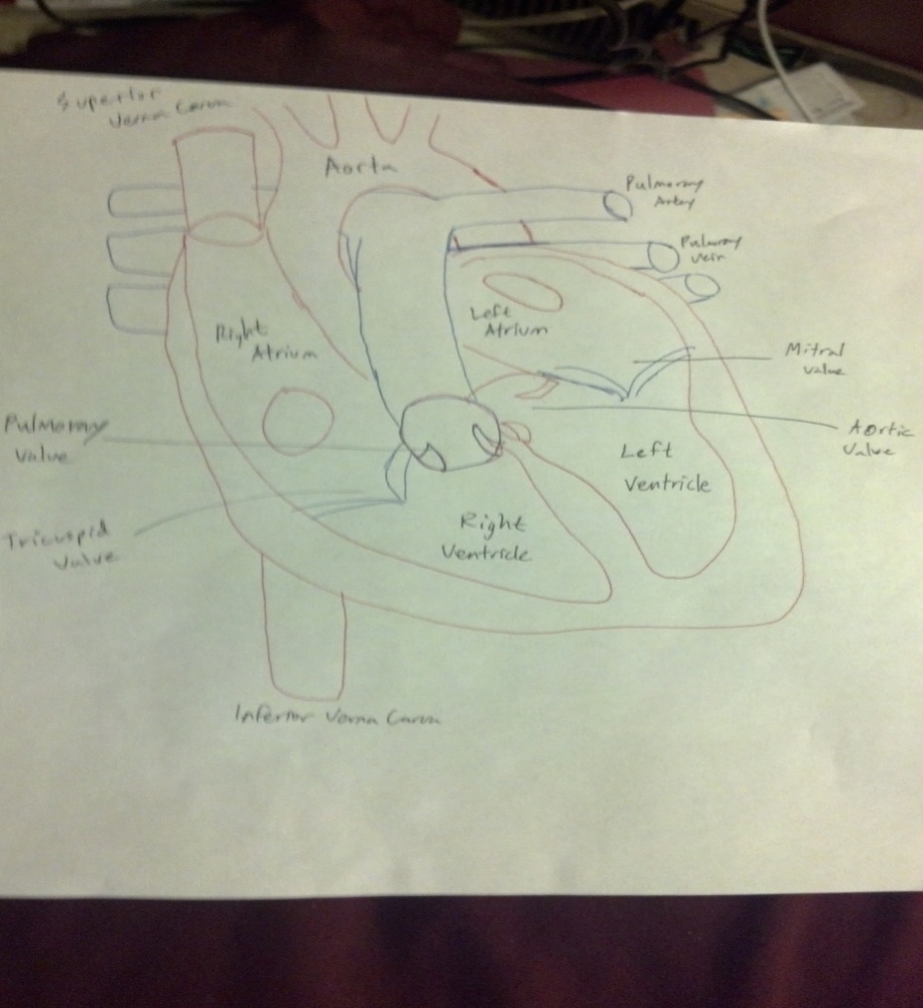
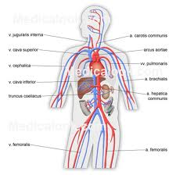
Circulatory System
Function: to transport materials such as nutrients, wastes, hormones, white blood cells, etc.

Slide 28
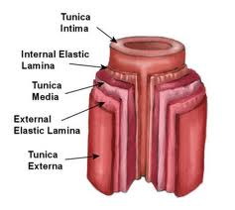
Arteries
Arteries are made of thick walls which make them able to resist high pressure that exist near the heart.
All of the major organs in the body have their own special kind of arteries which are uniquely structured to supplying that organ with the supplies it needs.
Arteries are the blood vessels that carry blood away from the heart. They are responsible for carrying oxygen and other important nutrients out to the body.

Slide 29
Capillaries
Smallest blood vessels in the body.
Responsible for delivering nutrients and oxygen to the tissues.
They are so small that people can’t see them without a microscope.
Their wall thickness is about two cells thick so the blood cells inside travel in a single line.

Slide 30
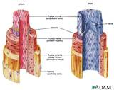
Veins
The main function of veins is to carry blood from the body back to the heart.
Veins are very stretchy, and can distend to several times their normal diameter.
The stretchiness lets them act as blood warehouses if the flow of blood slows down.
This property can help lower the impact of increasing blood pressure.

Slide 31
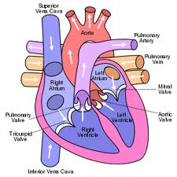
The Route
Superior and ending part of inferior vena cava + coronary sinus -> right atrium -> tricuspid valve -> right ventricle -> pulmonary valve -> pulmonary trunk and pulmonary artery -> lungs -> pulmonary vein -> left atrium -> mitral (bicuspid)valve -> left ventricle -> aortic valve -> aorta -> systemic circulation -> back to the top
Valves: prevents the back flow of the circulation.

Slide 32
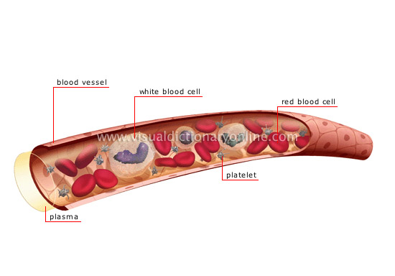
The Blood
Contains platelets, plasma, white blood cells, and red blood cells.
Erythrocytes, also called red blood cells, are blood cells that transport oxygen and contain pigments (hemoglobin); red blood cells are the most numerous.
Leukocytes, also called white blood cells, are blood cells that plays an essential role in the body’s defenses (destruction of infectious agents, production of antibodies).
Platelets causes blood to coagulate.
Plasma is liquid part of the blood consisting water, minerals and other nutrients to circulate in the blood.

Slide 33
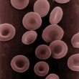
Erythrocytes
They are biconcave discs, having a depressed center on both sides.
These depressed centers allow the cells to have more cell membrane surface which can be exposed to diffusing oxygen while transiting the lungs.
This structure also allows them to be more flexible when negotiating tight passages.

Slide 34
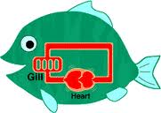
Closed Circulatory System
Blood is pumped through a closed system of arteries, veins, and capillaries.
One of the simplest types of closed circulatory systems is found in annelids such as the earthworm.
Earthworms have two main blood vessels, dorsal and a ventral, which carry blood towards the head or the tail, respectively.

Slide 35
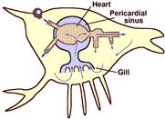
Open Circulatory System
Instead of a heart there are blood vessels that act as pumps to force the blood along.
Arthropods and mollusks have an open circulatory system.
Insects can get by with this type system because they have numerous openings in their bodies that allow the "blood" to come into contact with air.

Slide 36
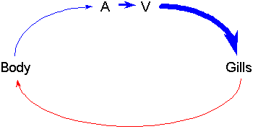
Fish
Fish have two-chambered heart with one atrium and one ventricle.
Blood gets oxygenated going through the gills and becomes deoxygenated after going through the body and the heart.

Slide 37
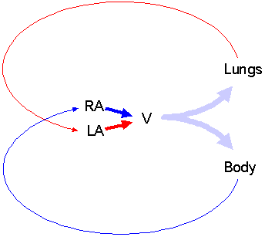
Amphibians
Amphibians have a 3-chambered heart with two atria and one ventricle.
Blood flows from lungs to the left atrium, and from the body to the right atrium. Then, they are combined in a single ventricle.

Slide 38
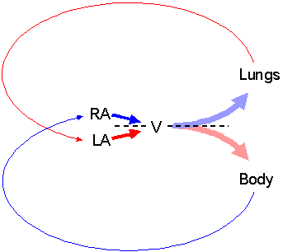
Reptiles
They have the same system as the amphibians except the ventricle is structured differently.
In reptiles, the ventricle of the heart is partially divided reducing the mixing of the blood.

Slide 39
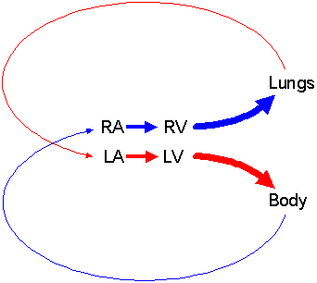
Mammals
Birds and mammals have a four-chambered heart which acts as two separate pumps.
After going through the body, the blood is pumped into the lungs then back to the heart which eventually pumps out back to the body.
The high rate of oxygen-rich blood flow through the body enables birds and mammals to maintain high activity levels.

Slide 40
Disorders
Atherosclerosis- plaques build up in the walls of the arteries, causing them to become narrower and harden.
Pain, change in skin color, sores, ulcers, difficult moving, heart attack, and stroke.
Clinical manifestations of atherosclerosis will occur in 2 of 3 men and 1 in 2 women after age 40.
Lifestyle changes and drug therapy are the mainstays of treatment for atherosclerosis.

Slide 41
Disorders
Congestive Heart Failure- Develops when the heart’s pumping ability diminishes due to blockages or restriction of blood flow.
Weakened heart can’t sufficiently pump blood to the cells.
Difficult doing everyday activities.
5 million Americans. 550,000 diagnosed every year. More common in old people.
Change in lifestyle, medications, and surgery.

Slide 42
Sources
http://my.clevelandclinic.org/anatomy/digestive_system/hic_the_structure_and_function_of_the_digestive_system.aspx
http://my.clevelandclinic.org/anatomy/digestive_system/hic_the_structure_and_function_of_the_digestive_system.aspx
http://www.webmd.com/heartburn-gerd/default.htm
http://faculty.clintoncc.suny.edu/faculty/michael.gregory/files/bio%20102/bio%20102%20lectures/circulatory%20system/circulat.htm
http://www2.gsu.edu/~bioasx/closeopen.html
http://biology.about.com/od/organsystems/a/circulatorysystem.htm
http://www.bettermedicine.com/article/atherosclerosis-1
http://circ.ahajournals.org/content/119/3/480.full
http://circ.ahajournals.org/content/119/3/480.full
Google pictures

Slide 43
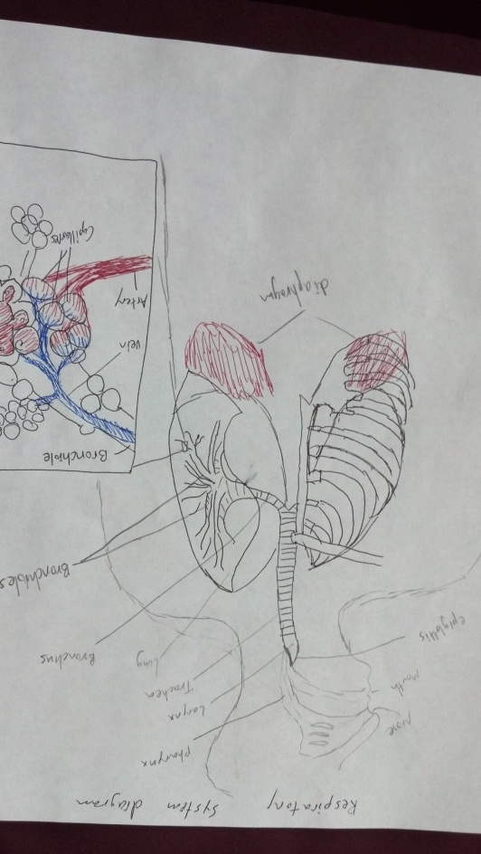
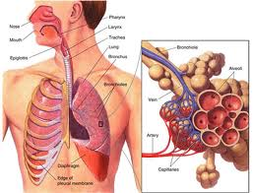
Respiratory System
Function: to supply the blood with oxygen in order for the blood to deliver oxygen to all parts of the body.

Slide 44
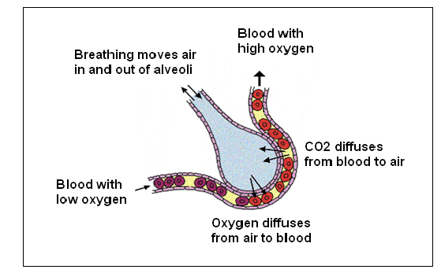
Alveoli
Walls has dense network of capillaries for efficient gas exchange.
Millions of alveoli provide a large surface area for large gas exchange.
Moist walls to speed up diffusion.
Thin walls to speed up diffusion.
Elastic walls to increase ventilation.

Slide 45
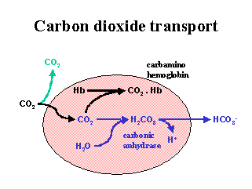
Transportation of CO2 and O2
Oxygen is carried in blood: 98.5% bound to hemoglobin, 1.5% in plasma. Goes from Lungs to the body.
Carbon dioxide is transported from the body to the lungs as: 60% bicarbonate(CO2+H20) in blood, 30% carbaminohemoglobin (CO2+hemoglobin), 10% in plasma.

Slide 46
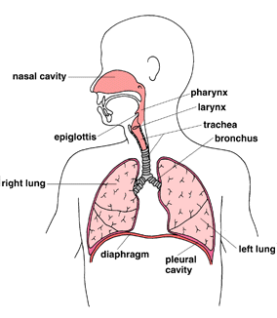
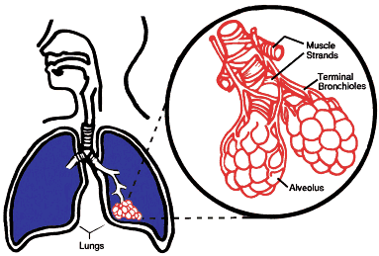
Pathway of air
Nasal cavities (or oral cavity) -> pharynx -> trachea -> primary bronchi (right & left) -> secondary bronchi -> tertiary bronchi -> bronchioles -> alveoli (site of gas exchange)-> red blood cells (hemoglobin)

Slide 47
Inhalation
The process of taking the air into the lungs.
Air pressure must be lower inside of the lungs compared to the atmosphere outside.
Internal intercostal relax, and external intercostal contract to increase the volume of the thoracic cavity
Diaphragm help by bulging downward, giving more space for the thoracic cavity.
Air flows from high pressure to lower pressure.
Increase in volume, decreases the pressure, thus air flow into the lungs.

Slide 48
Exhalation
The process of expelling the air out of the lungs.
Lungs must have higher air pressure compared to the outside atmosphere.
External intercostal relax and bring the rib cages inwards, and diaphragm bulge upward, decreasing the volume of the thoracic cavity.
Diaphragm is necessary to breathe.

Slide 49
Sources
http://www.fi.edu/learn/heart/systems/respiration.html
http://ibbiology.wetpaint.com/page/Describe+the+features+of+alveoli+that+adapt+them+to+gas+exchange
http://people.eku.edu/ritchisong/301notes6.htm
http://wiki.answers.com/Q/What_happens_during_inhalation_and_exhalation

Slide 50
Excretory System
Function: to get rid of waste, eliminate useless products, eradicate chemical build-ups, maintain chemical concentrations.

Slide 51
Nitrogenous wastes
Nitrogenous wastes of animals are excreted in form of ammonia, urea, or uric acid.
Cells use amino acids to construct proteins, energy, fat, and carbohydrates.
When the amino acids are removed, the nitrogen containing compounds become toxic and are removed by the excretory system.

Slide 52
Ammonia
Formed immediately after the amino acid is removed.
Soluble in water and very toxic.
Aquatic animals such as bony fishes, aquatic invertebrates, and amphibians excrete ammonia since it is easily eliminated in water.

Slide 53
Urea
Terrestrial amphibians and mammals excrete nitrogenous wastes in the form of urea.
It is less toxic than ammonia and can be moderately concentrated to conserve water.
Urea is produced in the liver.
Requires more energy to produce then ammonia.

Slide 54
Uric Acid
Insects, reptiles, birds, and some dogs (Dalmatians) excrete uric acid.
It is not very toxic and is not very soluble in water.
It can accumulate in eggs without damaging the embryos.
The synthesis of uric acid requires more energy than urea synthesis.

Slide 55
Nephron
Removes excess water and waste.
Returns substances like sodium, potassium, or phosphorus whenever they run low.
Two main parts: the glomerulus and the tubule.
Glomerulus – filters the blood.
Tubule- a tiny tube where the wastes, extra fluid and other recyclable substances like sodium and potassium filtered out from the glomerulus pass through.
There are many parts to the tubule and the blood flows through all parts to be filtered. (Bowman’s capsule, Proximal convoluted tubule, descending limb of Henle, Loop of Henle, ascending limb of Henle, Distal convoluted tuble, and the collecting duct.

Slide 56
Filtration
Urine formation begins with the process of filtration.
As blood courses through the glomeruli, much of its fluid, containing both useful chemicals and dissolved waste materials, soaks out of the blood the blood through the membranes where it is filtered.

Slide 57
Reabsorption
the movement of substances out of the renal tubules back into the blood capillaries located around the tubules.
substances reabsorbed are water, glucose and other nutrients, and sodium (Na+) and other ions.

Slide 58
Secretion
Secretion is the process by which substances move into the distal and collecting tubules from blood in the capillaries around these tubules .

Slide 59
Excretion
Process of excreting waste out of the body.
Main excretory system in human body is the urinary system.
Skin is also an organ that excretes water, salts, and other wastes (sweating).

Slide 60
Disorders
Kidney stones- stones made of minerals and acid salts inside the kidneys.
Pain of a kidney stone typically starts in your side or back, just below your ribs, and moves to your lower abdomen and groin.
3 million Americans get this every year.
Drinking water and pain medicine helps. If necessary, doctors can surgically remove them.

Slide 61
Disorders
Nephritis- inflammation of the nephrons.
Can lead to kidney failure, increase or decrease the urine output, have blood in the urine, and cause Fever.
40,000 Americans die from it every year.
Limiting salt and fluid in the diet can improve swelling and high blood pressure.
Limiting protein consumption can help control the buildup of waste products.
Dialysis
Corticosteroids or stronger anti-inflammatory medications.

Slide 62
Sources
http://library.thinkquest.org/07aug/01618/excretory.html
http://faculty.clintoncc.suny.edu/faculty/michael.gregory/files/bio%20102/bio%20102%20lectures/excretory%20system/excretor.htm
http://www.mayoclinic.com/health/kidney-stones/DS00282
http://www.nlm.nih.gov/medlineplus/ency/article/000464.htm

Slide 63
Immune System
Function: to protect the body and fight against harmful bacteria, viruses, and other parasites.

Slide 64
Major Organs
Skin- boundary between germs and the body. It acts as a protective barrier.
Bone marrow- all cells involved in immune system derived from the bone marrow.
Thymus- responsible for maturing thymocytes to T-cells. T-cells detect foreign cells that are harmful.
Spleen- filters blood, houses T-cells, and other specialized cells.
Lymph node- filters lymph, houses specialized cells.

Slide 65
Recognition of pathogens
Innate immunity- provides immediate response to presence of pathogens. No immunological memory. Exp: inflammation, fever, coughing, etc.
Adaptive immunity- creates immunological memory after initial response to a pathogen.
Vaccination- helps enhance adaptive immunity. Once the disease is recognized, the body fights it off next time.
Antigens- (non-self molecules)causes production of one or more antibodies.
Anitbodies- immunoglobins used to recognize and neutralize antigens.

Slide 66
Active vs. Passive
Active- occurs when the person is exposed to a live pathogen, develops the disease, and becomes immune.
Examples- Vaccination, cold, and other common diseases.
Passive- transfers humoral immunity in the from of antibodies from one to another.
Examples- Pregnancy and injection of antibodies.
Active immunity requires pathogens to invade while passive does not. They both can naturally and artificially occur.

Slide 67
Humoral vs. Cell Mediated
Cell mediated- a response that can allow cells of our immune system (T cells) to recognize which cells in our bodies are virally infected.
Humoral- a response by certain cells of the immune system (B cells) which have the ability to make antibodies.

Slide 68
B-lymphocytes and T-lymphocytes
B- produced in the bone marrow, releases antibodies to neutralize infected cells. Contains different antibodies for different antigens.
T- produced in the bone marrow, matured in thymus. Kills the infected cell (Cyto toxic).
Some T- lymphocytes are helper cells.
B lymphocytes are antibody-mediated, and T-lymphocytes are cell-mediated.

Slide 69
Antibiotics
Antibiotics are used to kill bacteria and its growth.
Antibiotics work by interrupting metabolic pathways in prokaryotic cells.
Viruses cannot be killed because they lack in metabolic pathways. Viruses hack eukaryotic cells and use their metabolic pathways to reproduce.

Slide 70
Disorders- Allergy
Caused by the immune system reacting to normally harmless substance from the environment.
The reaction results in inflammatory response.
Allergy is very common.
Can be treated by drugs, growth, etc.

Slide 71
Disorders- HIV/AIDS
AIDS is a chronic, potentially life-threatening condition caused by the human immunodeficiency virus (HIV).
Symptoms: Soaking night sweats, Shaking chills or fever higher than 100 F (38 C), Cough and shortness of breath, Chronic diarrhea, Persistent white spots or unusual lesions on your tongue or in your mouth, Headaches, Persistent, unexplained fatigue ,Blurred and distorted vision, Weight loss, Skin rashes or bumps.
Fairly common disease. 33.4 million people have HIV, 60 million people have had AIDS since 2000.
No cure. There are drug therapies to slow down the progression.

Slide 72
Sources
http://hepatitis.about.com/od/overview/ig/Organs-of-the-Immune-System/Immune-System.htm
http://en.wikipedia.org/wiki/Immune_system
http://www.infoplease.com/ce6/sci/A0858765.html
http://www.madsci.org/posts/archives/1999-10/939304480.Im.r.html
http://users.rcn.com/jkimball.ma.ultranet/BiologyPages/B/B_and_Tcells.html
http://www.differencebetween.com/difference-between-t-lymphocytes-and-b-lymphocytes/
http://ibbiology.wetpaint.com/page/Explain+why+antibiotics+are+effective+against+bacteria+but+not+against+viruses
http://en.wikipedia.org/wiki/Allergy
http://www.mayoclinic.com/health/hiv-aids/DS00005

Slide 73
Endocrine System
Function- to secrete hormones directly into the bloodstream.
Homeostasis- maintain the body’s normal conditions (pH, temperature, hormones, heart rate, etc).
Hormones are messengers which coordinate and control activities through out the body and homeostasis controls the amount of hormone used so it doesn’t get out of control.

Slide 74
Negative Feedback
Glands within the endocrine system that stimulate the release of a hormone from another gland are eventually shut off.
Hormone imbalance is avoided by negative feedback mechanism.
An example: When the body has enough thyroid hormone in the blood, T4 "feeds back" to the hypothalamus and pituitary and causes a decrease in secretion of TRH and TSH.

Slide 75
Endocrine glands
Endocrine glands produce one of the most important hormone- insulin.
Insulin helps glucose intakes buy transferring it from the blood to the cells

Slide 76
Type I and Type II Diabetes
Type I- pancreas little or no insulin, and the body’s immune system destroy the pancreatic cells that produce insulin.
Type II- the body does not produce enough insulin to fit its needs.
Symptoms- sugar in urine, extreme thirst, frequent urination, lethargy, increased appetite, sweet smelled sweat.
Incidence rates of both forms have increased in the past 30 years.
Inject insulin, drug treatment

Slide 77
Hyperthyroidism
The thyroid gland produces too much thyroid hormone.
Symptoms- may feel nervous, moody, weak, or tired, lose weight, be sweaty, lose hair, and have trouble breathing.
The incidence of hyperthyroidism is less than 1%
Treatments include radioactive iodine and antithyroid medicine, and surgical removal of the thyroid gland.

Slide 78
Sources
http://www.merckmanuals.com/home/hormonal_and_metabolic_disorders/biology_of_the_endocrine_system/endocrine_function.html
http://www.hormone.org/Endo101/page3.cfm
http://www.jdrf.org/index.cfm?page_id=103442#types&mkwid=sQ5bULZoO&pcrid=16575034910
http://www.webmd.com/a-to-z-guides/hyperthyroidism-topic-overview
Google pictures

Slide 79
Reproductive System
Function- to procreate and continue the survival of the species. Genes are transferred from one individual to the other.

Slide 80
Sexual Reproduction vs. Asexual Reproduction
Sexual- a male and a female sex cells fertilize to form a unique being.
Asexual- an organism clones itself.
Hydras, sponges, and planarians are examples of animals that reproduce by asexual reproduction.

Slide 81
Spermatogenesis
Rounded immature sperm cells undergo successive mitotic and meiotic divisions (spermatocytogenesis) and a metamorphic change (spermiogenesis) to produce spermatozoa.
During spermatocytogenesis primitive cells called spermatogonia proliferate by mitosis. Mitosis ends when a B spermatogonium yields two primary spermatocytes.
Spermiogenesis involves nuclear condensation, formation of the acrosomal cap, and development of a tail.

Slide 82
Oogenesis
Oogonial transformation into oocytes (oocytogenesis) is completed either before or shortly after birth.
Oogenesis is the process in which the primary oocyte turns to an ovum undergoing meiosis.
Primay oocyte undergo meiosis I to produce secondary oocyte and the first polar body.
The haploid secondary oocyte undergo meiosis II to produce ootid and a polar body. The first polar body undergo meiosis II as well producing 2 polar bodies.
Three polar bodies eventually degenerate and the ootid eventually becomes the ovum.

Slide 83
Menstrual cycle vs. Estrous cycle
Humans and the great apes follow menstrual cycle while rest of the mammals follow the estrous cycle.
An estrous cycle is the period from one ovulation to the next.
Most mammals reabsorb their uterine lining if they go through a fertility cycle without becoming pregnant, but humans shed the lining of her uterus.
Animals following estrous cycle get sexually active during the estrous phase while animals following the menstrual cycle can be sexual anytime.

Slide 84
Menstrual Cycle
Menstrual cycle- 28days
Uterine cycle- shedding of endometrium to prepare for a new egg.
Ovarian cycle- (follicular phase)follicle stimulating hormones(FSH) stimulate the linings of uterus to grow. The follicles release estrogen to create a new endometrium.
Ovarian cycle- (luteal phase) ovaries form the corpus luteum and release progesterone to facilitate uterus for implantation of the blastocyst.
If there is no fertilization, menstruation occurs and the egg is lost.
Negative feedback mech- menstrual cycle is regulated by fertilization and certain amount of hormones.

Slide 85
Development
During development, the fertilized egg divides into different cells which results in different organs and organ systems. These systems come together to form an organism.

Slide 86
Cleavage, gastrulation and Organogenesis
The early cell divisions of the fertilized egg are called cleavage.
The fertilized egg divides into two daughter cells called blastomeres.
These blastomeres then divide into eight, sixteen, and so on.
Eventually, these cells form a multicellular embryo.
The embryo then rearranges itself to a solid ball of blastopores called morula.
Then the morula rearranges itself to a single layered cell with fluid-filled central cavity to form a blastula.
During gastrulation, blastula at a point of blastopore starts folding in resulting in a gastrula, a double-layer cup of cells.

Slide 87
Cleavage, gastrulation and Organogenesis
Gastrula contains three layers in most animals- endoderm, mesoderm, and ectoderm.
These layers go through organogenesis to from different organs and organ systems.
Endoderm- the inner layer which differentiate into the cells lining the digestive and respiratory systems, the liver, gallbladder, and pancreas.
Mesoderm- the middle layer which differentiate into muscles, blood, blood vessels, heart, spleen, reproductive organs, and kidneys.
Ectoderm- the most outer layer which differentiate into brain, spinal cord, epidermis, and other outer structures.

Slide 88
Ovarian Cancer
Ovarian cancer occurs when cells in the ovary grow and divide uncontrollably.
Symptoms may include general abdominal discomfort and/or pain, nausea, diarrhea, constipation and frequent urination, loss of appetite, feeling of fullness even after a light meal, weight gain or loss with no known reason, abnormal bleeding from the vagina may occur as a late symptom.
One in every 67 female have ovarian cancer.
Treatments include surgery, chemotherapy, and radiation.

Slide 89
Testicular Cancer
More than 90% of cancers of the testicle develop in special cells known as germ cells which produce sperm cells.
Most testicular cancer contain different cancerous tumors.
Testicular cancer is not common; a man's lifetime chance of getting it is about 1 in 270.
Symptoms may include painless or uncomfortable lump in their testicle.
Treatments include chemotherapy and surgery.

Slide 90
Sources
http://www.livestrong.com/article/37137-reproductive-system-functions/
http://www.biotopics.co.uk/genes1/asexual_and_sexual_reproduction.html
http://www.uwyo.edu/wjm/repro/spermat.htm
http://wiki.answers.com/Q/What_is_oogenesis
http://www.helium.com/items/1992565-difference-between-menstrual-and-estrous-cycles
http://www.netwellness.org/healthtopics/pregnancy/pregmenstrualcycle.cfm
http://wiki.answers.com/Q/Is_menstrual_cycle_a_feedback_mechanism
http://www.sumanasinc.com/webcontent/animations/content/ovarianuterine.html
http://www.biologyreference.com/Co-Dn/Development.html#b
http://www.idph.state.il.us/about/womenshealth/factsheets/ovarian.htm
http://www.idph.state.il.us/cancer/factsheets/testicular.htm

Slide 91
Nervous System
The function of the nervous system is to coordinate and send signals from one cell to another and from one part of the body to others.

Slide 92
Central Nervous System
CNS serve as the main "processing center" for the entire nervous system, and control all the workings of the body.
Composes of the brain and the spinal cord.
Spinal cord- conducts sensory information from the peripheral nervous system and motor information from the brain to our body.
Brain- receives sensory input from the spinal cord as well as from its own nerves and processes its various sensory inputs and initiates appropriate/coordinated motor outputs.

Slide 93
Peripheral Nervous System
Sensory Nervous cells- send information to the CNS from internal organs or from external stimuli.
Motor nervous system cells- send information from the CNS to organs, muscles, and glands. It divides into somatic and automatic nervous system.
Somatic Nervous System- controls skeletal muscle as well as external sensory organs such as the skin. This system is voluntary- controlled consciously.
Automatic Nervous System- controls involuntary muscles, such as smooth and cardiac muscle. It is divided into parasympathetic and sympathetic divisions.
Parasympathetic-controls activities that conserve energy expenditures.
Sympathetic- controls activities that increase energy expenditures.

Slide 94
Neuron Structure

Slide 95
Simple Reflex Arc
The simple reflex is a type of behavior that protects higher forms of animal life and has survival value.
It is a spinal event, but the brain still receives the sensory input.
An example would be moving the finger away after touching something hot.
Sequence: stimulus-> nerve ending-> sensory neurons-> spinal cord-> synapse-> interneuron-> synapse-> motor neuron-> nerve ending-> response.

Slide 96
The Brain
Cerebral hemispheres- contains grey matter which perform high level functions.
Sensations are interpreted, movements are made, memories are stored and retrieved, and judgments are made.
Diencephalon- contains left and right thalamus which relays the sensory and motor information to cerebrum.
It also contains hypothalamus which functions to regulate involuntary functions such as water balance, appetite, and temperature.
Brain stem- contains the midbrain which functions to control the reflex tracking movements of the head, neck, and eyes based on stimuli received from the eyes and ears.
It also contains pons and medulla oblongata which controls heart rate, breathing, and blood pressure.
Cerebellum coordinates movement, balance, and coordination.

Slide 97
Nerve Impulse
In the beginning, Na+ is on the outside, K+ is on the inside of the neuron’s membrane. Na+/K+ pumps creates polarized membrane potential also called the resting potential.
When a stimulus reaches a resting neuron, the gated ion channels on the resting neuron's membrane open and allow the Na+ to go into the cell. As this happens, neurons become depolarized. However if the stimulus goes above the threshold level, more gated ion channels open and allow more Na+ inside the cell.
After the inside of the cell becomes full with Na+, the gated ion channels on the inside of the membrane open to allow the K+ to move to the outside of the membrane. This allows repolarization with ions in the opposite positions of the beginning.
The refractory period begins as ion channels pump K+ ions back inside and Na+ ions outside. The neuron can’t respond to any stimuli during this period.

Slide 98
Neurotransmitters
Neurotransmitters carry information across synapses from one neuron to the other.
Axon terminals release neurotransmitters from a pump that is received by receptors on the dendrites of another neuron.
Several neurotransmitters play a role in the way we behave, learn, the way we feel, and sleep.

Slide 99
Parkinson’s Disease
Parkinson's disease is a degenerative disease of the nervous system.
Symptoms include tremor, stiffness in muscles and joints, slowness in initiating movement, poor balance and other movements.
One in every 500 people get Parkinson’s.
It is incurable but the progression would be slowed down by drug treatment.

Slide 100
Huntington’s Disease
Huntington’s Disease is a hereditary disease that causes nerve cells to degenerate.
Symptoms: changes in behavior, irritability, forgetfulness, paranoia, loss of judgment and speech impairments.
More than 15,000 Americans have HD. At least 150,000 others have a 50 percent risk of developing the disease and their relatives have slight chance of getting it.
There is no cure, only drug treatments which slows down the disease progression.

Slide 101
Sources
http://library.thinkquest.org/2935/Natures_Best/Nat_Best_Low_Level/Nervous_page.L.html
http://users.rcn.com/jkimball.ma.ultranet/BiologyPages/C/CNS.html
http://biology.about.com/od/organsystems/a/aa061804a.htm
http://answers.yahoo.com/question/index?qid=20080220021930AAwjDYM
http://www.getbodysmart.com/ap/nervoussystem/cns/brain/adultorganization/tutorial.html
http://www.dummies.com/how-to/content/understanding-the-transmission-of-nerve-impulses.html
Google pictures
http://allpsych.com/psychology101/neurotransmitters.html
http://www.netdoctor.co.uk/diseases/facts/parkinson.htm
http://www.medicinenet.com/huntington_disease/article.htm

Slide 102
Senses
The function of the senses system is to give the body the ability to detect the external environment.

Slide 103
Sensory Receptors
Mechanoreceptors- detect changes in pressure, position, and acceleration. Located on the nose, skin, and ear.
Thermoreceptors- detect hot or cold temperatures. Located on the skin.
Chemoreceptors- detect ions and molecules Located on the nose.
Photoreceptors- detect light. Located on the eyes.
Pain receptors- detect severe heat, pressure, and chemicals that harm the body. Located on the skin.

Slide 104
Rhodopsin
A biological pigment of the retina that is responsible for both the formation of the photoreceptor cells and the first events in the perception of light.
Rhodopsin allows photoreceptor cells to signal to each other and the brain about light entering the retina.

Slide 105
Sources
http://faculty.clintoncc.suny.edu/faculty/michael.gregory/files/bio%20102/bio%20102%20lectures/sensory%20systems/sensory.htm
http://en.wikipedia.org/wiki/Rhodopsin

Slide 106
Muscular System
Muscles maintain our posture, allow us to move, breath, circulate our blood, and even close our eyes.

Slide 107
Three Types of Muscle Tissue
Cardiac muscle- makes up the wall of the heart. It is striated and involuntary.
Smooth muscle- muscles contained in structures which we do not have control over such as blood vessels, stomach and intestine, urethra, uterus, internal muscles of the eye. It is unstriated and involuntary.
Skeletal muscle- muscles attached to our skeletons and allows us to move our bodies. It is striated and voluntary.

Slide 108
Skeletal Muscle Contraction
1. A nervous impulse arrives at the neuromuscular junction, which causes a release of a chemical called Acetylcholine. The presence of acetylcholine causes depolarization of the motor end causing Ca+ to be released from sarcoplasmic reticulum.
2. Ca+ binds to Troponin, changing its shape and so moving Tropomyosin from the active site of the Actin. The Myosin filaments can now attach to the Actin, forming a cross-bridge.
3. The breakdown of ATP releases energy which enables the Myosin to pull the Actin filaments inwards and so shortening the muscle.
4. The Myosin detaches from the Actin and the cross-bridge is broken when an ATP molecule binds to the Myosin head. When the ATP is then broken down the Myosin head can again attach to an Actin binding site further along the Actin filament and repeat the process.
5. This repeated pulling of the Actin over the myosin causes muscle contraction.

Slide 109
Myotonic Muscular Dystrophy
A group of genetic, degenerative diseases primarily affecting voluntary muscles.
Symptoms- generalized weakness and muscle wasting first affecting the face, lower legs, forearms, hands and neck, with delayed relaxation of muscles after contraction common
Myotonic dystrophy affects at least 1 in 8,000 people worldwide.
It can be treated with quinine, phenytoin and other similar anticonvulsant drugs.

Slide 110
Muscle Cramp
Muscles involuntarily contract and cannot relax.
Symptoms- hardening of the muscle, twitching, sharp pain.
Very common. If you didn’t experience this, you are not a human.
Can be treated and prevented with balanced diet and stretching.

Slide 111
Sources
http://www.anatomy.tv/StudyGuides/StudyGuide.aspx?guideid=5&nextID=6&maxID=0&customer=primal
http://www.teachpe.com/anatomy/sliding_filament.php
http://www.mdausa.org/disease/dm.html
http://www.medindia.net/patients/patientinfo/myotonicdystrophy_treatment.htm
http://www.medicinenet.com/script/main/art.asp?articlekey=47633
Google pictures

Slide 112
Skeletal System
Functions to support, protect, assist in movement, store minerals, produce blood cells, and store energy.

Slide 113
Human Movement
Bones- fit together at joints, allowing movements.
Ligaments- connect bones together.
Tendons- attach muscles to bones.
Muscles- move bones by extending or flexing a joint.
Nerves- control the contraction and relaxation of muscles.

Slide 114
Exoskeleton
Turtles use dentine, arthropods, fungi, and bacteria use chitin, diatoms uses silica, and mollusks use calcium carbonate to make exoskeleton.
Exoskeletons are rigid.
Some organisms with open exoskeleton can grow with it, while organisms with true exoskeleton have to shed it and grow new ones.

Slide 115
Endoskeleton
Internal support structure in animals.
Endoskeleton develops within the skin or in the deeper body tissues.
The vertebrate is basically an endoskeleton made up of two types of tissues (bone and cartilage).

Slide 116
Hydrostatic Skeleton
Found in cold-blooded organisms and soft-bodied organisms.
Sea anemones and earthworms do not have a single bone in their bodies. Instead, they are supported by pressure from a liquid which consists mainly of water in their cells and in spaces between their body.
The hydrostatic skeleton allows the earthworm to burrow through the earth.

Slide 117
Sources
http://www.ivy-rose.co.uk/HumanBody/Skeletal/Skeletal_System.php
http://ibbiology.wetpaint.com/page/Outline+the+roles+of+bones,+ligaments,+muscles,+tendons+%26+nerves+in+movement
http://en.wikipedia.org/wiki/Exoskeleton
http://en.wikipedia.org/wiki/Endoskeleton
http://wiki.answers.com/Q/What_is_a_hydrostatic_skeleton
Google pictures

