Slide 1
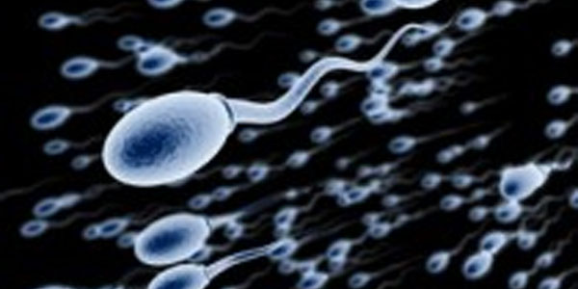
Reproductive system

Slide 2
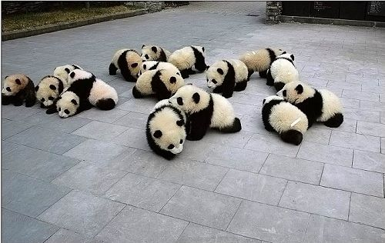
The purpose of the reproductive system is to ensure the perpetuation of the species

Slide 3
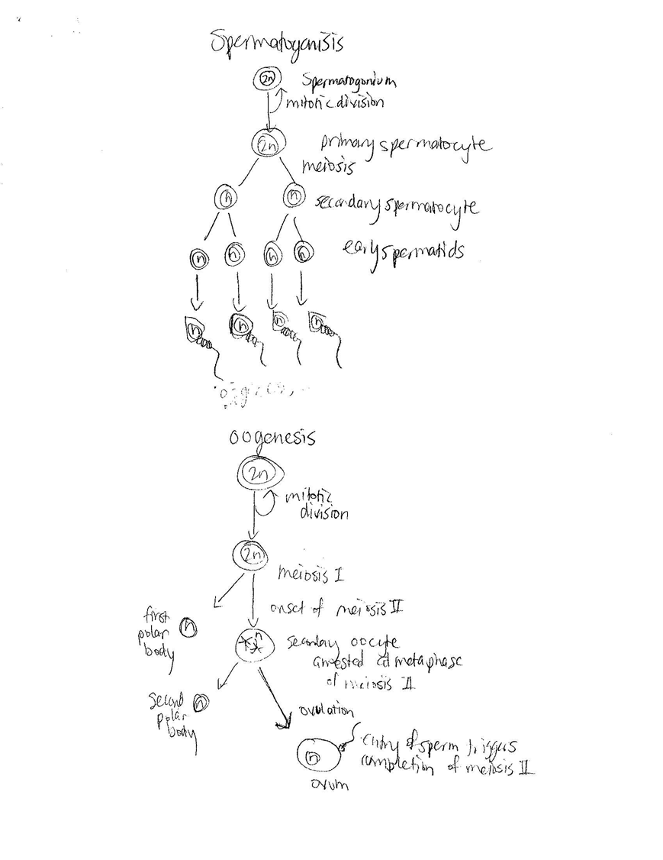
Spermatogenesis is the process, which occurs in the seminiferous tubules, by which male primary sperm cells undergo meiosis, and produce a number of cells termed spermatogonia, from which the primary spermatocytes are derived. Each primary spermatocyte divides into two secondary spermatocytes, and each secondary spermatocyte into two spermatids. These develop into mature spermatozoa, also known as sperm cells. Thus, the primary spermatocyte gives rise to two cells, the secondary spermatocytes, and the two secondary spermatocytes by their subdivision produce four spermatozoa. The
Just like spermatogenesis, oogenesis involves the formation of haploid cells from an original diploid cell, called a primary oocyte, through meiosis. The female ovaries contain the primary oocytes. oogenesis only leads to the production of one final ovum, or egg cell, from each primary oocyte (in contrast to the four sperm that are generated from every spermatogonium). Of the four daughter cells that are produced when the primary oocyte divides meiotically, three come out much smaller than the fourth. These smaller cells, called polar bodies, eventually disintegrate, leaving only the larger ovum as the final product of oogenesis. The unequal division ensures the ovum has enough organelles and cytoplasm to sustain repeated division without much growth following fertilization.

Slide 4
Asexual Reproduction
In asexual reproduction, one individual produces offspring that are genetically identical to itself. These offspring are produced by mitosis. Common forms of asexual reproduction include:
Sexual Reproduction
In sexual reproduction, two individuals produce offspring that have genetic characteristics from both parents. Sexual reproduction introduces new gene combinations in a population. Gametes
In this form of asexual reproduction, an offspring grows out of the body of the parent. Example: hydras Fragmentation
In this type of reproduction, the body of the parent breaks into distinct pieces, each of which is capable of further development Example: planarians
Regeneration
In regeneration, if a piece of a parent is detached, it can grow and develop into a completely new individual. Example: Echinoderms
Budding
Asexual reproduction is advantageous in a table environment, with organisms that are nonmotile or that would otherwise have to waste resources on finding a mate.
In animals, during the process of sexual reproduction two haploid gametes fuse to form a zygote. Gametes are produced by a type of cell division called meiosis.

Slide 5
Estrous Cycle
occurs in most placental mammals
Females are generally only sexually active during the estrous phase of their cycle
Menstrual Cycle
Occurs in humans, chimpanzees, orangutans, rhesus monkeys,
Females can be sexually active at any point in their cycle
No shedding of endometrium. Instead, it is reabsorbed
Endometrium is shed at the end of each cycle if fertilization does not occur.

Slide 6
The ovarian cycle involves changes in the ovaries, and can be further divided into two phases:
Phase 1
The follicular phase (days 1 through 13) is the time from the first day of menstruation until ovulation, when a mature egg is released from the ovary. It's called the follicular phase because growth or maturation of the egg is taking place inside the follicle, a small sac where the egg matures. Ovulation occurs around day 14 of the cycle, in response to a surge of luteinizing hormone (LH) when the egg is released from the ovary. With the increase in circulating hormones, the hypothalamus decreases its flow of GnRH to the anterior pituitary. Therefore, FSH and LH stop being produced. This is called a negative feedback loop.
Phase 2
The luteal phase (days 14 through 28) is the time from when the egg is released (ovulation) until the first day of menstruation. The corpus luteum, a structure that grows in the ovary where the mature egg was released, secretes progesterone which stimulates the thickening of the uterine lining in preparation for the potential zygote.
The uterine cycle involves changes in the uterus. It occurs in tandem with the ovarian cycle, and is divided into two phases:
The proliferative phase (days 5 through 14) is the time after menstruation and before the next ovulation, when the lining of the uterus increases rapidly in thickness .
The secretory phase (days 14 through 28) is the time after ovulation. When an egg is not fertilized, the corpus luteum gradually disappears, estrogen and progesterone levels drop, and the thickened uterine lining is shed. This is the period.

Slide 7
After the egg is fertilized by a sperm, it becomes a diploid zygote. After repeated cleavage as it travels through the fallopian tube, it becomes a morula, a solid ball of cells. As it implants into the endometrium, it has already become a hollow ball of cells called a blastula. When the embryo undergoes gastrulation, it forms three germ layers and becomes a gastrula “a tube within a tube.” The process by which the endoderm, mesoderm, and ectoderm cells differentiate into organ tissues is organogenesis. Internal organs initiate development in humans within the 3rd to 8th weeks in utero.

Slide 8
Disorders of the reproductive system
Cervical cancer is caused by several types of a virus called human papillomaviruses (HPV).
The virus spreads through sexual contact.
Most women's bodies are able to fight HPV infection. But sometimes the virus leads to cancer.
Cervical cancer may not cause any symptoms at first, but later the woman may experience pelvic pain or bleeding. It usually takes several years for normal cells in the cervix to turn into cancer cells.
Prevention with regular pap smears and pelvic exams is key. A vaccine for girls and young women protects against the four types of HPV that cause most cervical cancers.
Among women in the United States aged 14 to 59, investigators found that a total of 26.8 percent of women overall tested positive for one or more strains of HPV
Testicular cancer is a type of potentially life-threatening condition that begins in the testes, the region where sperm is produced.
Symptoms of testicular cancer include a lump or swelling in either testicle, a dull ache in the lower part of the stomach or back, an enlarged and painful testicle.
Treating testicular cancer involves surgically removing the cancerous tumor and using high dose radiation energy to kill the testicular cancer cells. Chemotherapy medications such as cisplatin and bleomycin may also be used to manage testicular cancer.
According to the American Cancer Society, approximately 7600 cases are diagnosed and about 400 men die of the disease each year in the United States.

Slide 9
http://wallpapers.stillmaza.com/2011/08/very-cute-baby-panda-desktop-wallpapers.html
http://junk.home.pl/spermatogenesis-process&page=2
http://biology.about.com/od/basicgenetics/a/aa062708a.htm
http://www.netwellness.org/healthtopics/pregnancy/pregmenstrualcycle.cfm
http://www.webmd.com/baby/guide/understanding-conception
http://www.thefreedictionary.com/morula
http://en.wikipedia.org/wiki/File:Germ_layers.png
http://www.nlm.nih.gov/medlineplus/cervicalcancer.html
http://www.cancer.gov/cancertopics/causes/hpv/hpv-prevalence0308
http://www.livestrong.com/article/90693-diseases-disorders-male-reproductive-system/
http://www.healthcommunities.com/testicular-cancer/overview.shtml

