Slide 1
Skeletal system

Slide 2
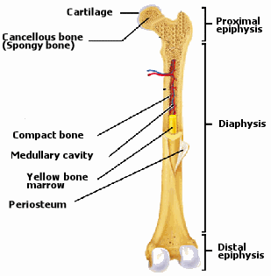
The function of the skeletal system is to support and protect softer tissues, assist in movement, store minerals and adipose cells, and produce blood cells.

Slide 3
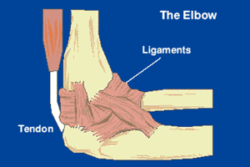
Bones act as the internal support structure for the muscles to pull on and use as levers in simple machines. Tendons are the anchors to which muscles attach themselves to the bones. For instance biceps are attached to both the shoulder joint and the elbow joint by tendons. With arms at the sides and the palms facing forward the biceps contract, pulling on radius and ulna, with the elbow joint acting as a fulcrum in this simple machine

Slide 4
Hydrostatic skeleton
Hydrostatic skeletons consist of fluid-filled closed chambers, found in many cold blooded and soft-bodied animals, as well as those lacking a true coelom. Internal pressures generated by muscle contractions cause movement as well as maintain the shape of the animals, such as the sea anemone and worms.
Exoskeleton
Mollusks, arthropods, and echinoderms have exoskeletons
Exoskeletons grant increased protection from predators and more support for internal organs, as well as more efficient locomotion
Endoskeleton
An endoskeleton is an internalized support system composed of mineralized tissue. Nutrients for growth are supplied by a rich network of blood vessels.
Mollusk and echinoderm exoskeletons are composed of calcium carbonate, whereas those of the phylum arthropoda are made of chitin.
An endoskeleton allows for large body sizes and variety of body forms

Slide 5
Disorders of skeletal system
Scoliosis, a condition in which the spine curves sideways, most often starts in adolescence. While treatment is most often not required, severe cases may require wearing a brace or surgical correction to straighten the curve. Scoliosis affects 6-9% of the U.S. population.
Osteoporosis is a weakening of the bones, caused by not enough calcium. Patients with osteoporosis are susceptible to broken bones. Broken hips are especially dangerous, as risk of death increases in the 12 months following. About half of all women over 50 in the united states are at risk for low bone mass or already have osteoporosis.
Lifestyle habits such as regular exercise, calcium supplements can prevent osteoporosis. Bisphosphonates are the most common medications prescribed for osteoporosis treatment. The doctor will recommend that osteoporosis-sufferers avoid cigarettes, alcohol, and take precautions to avoid falls.

Slide 6
http://www.ivy-rose.co.uk/HumanBody/Skeletal/Skeletal_System.php
http://ehumanbiofield.wikispaces.com/file/view/long-bone.gif/32877167/long-bone.gif
http://www.jeron.je/anglia/learn/sec/science/humans3/tendon.gif
http://www.livestrong.com/article/73265-nine-disorders-skeletal-system/
http://3.bp.blogspot.com/_VCuR8AXOn5Y/SKK7p5Qrd4I/AAAAAAAAAzw/rp5Tk_o1764/s320/scoliosis2.gif
http://3.bp.blogspot.com/_VCuR8AXOn5Y/SKK7p5Qrd4I/AAAAAAAAAzw/rp5Tk_o1764/s320/scoliosis2.gif
http://www.mayoclinic.com/health/osteoporosis-treatment/WO00127
http://www.emc.maricopa.edu/faculty/farabee/biobk/biobookmusskel.html
http://thehappyscientist.com/science-experiment/how-does-butterfly-fly
http://www.kewlwallpapers.com/wallpaper/High-Velocity-Cheetah/

