Slide 1
Excretory system

Slide 2
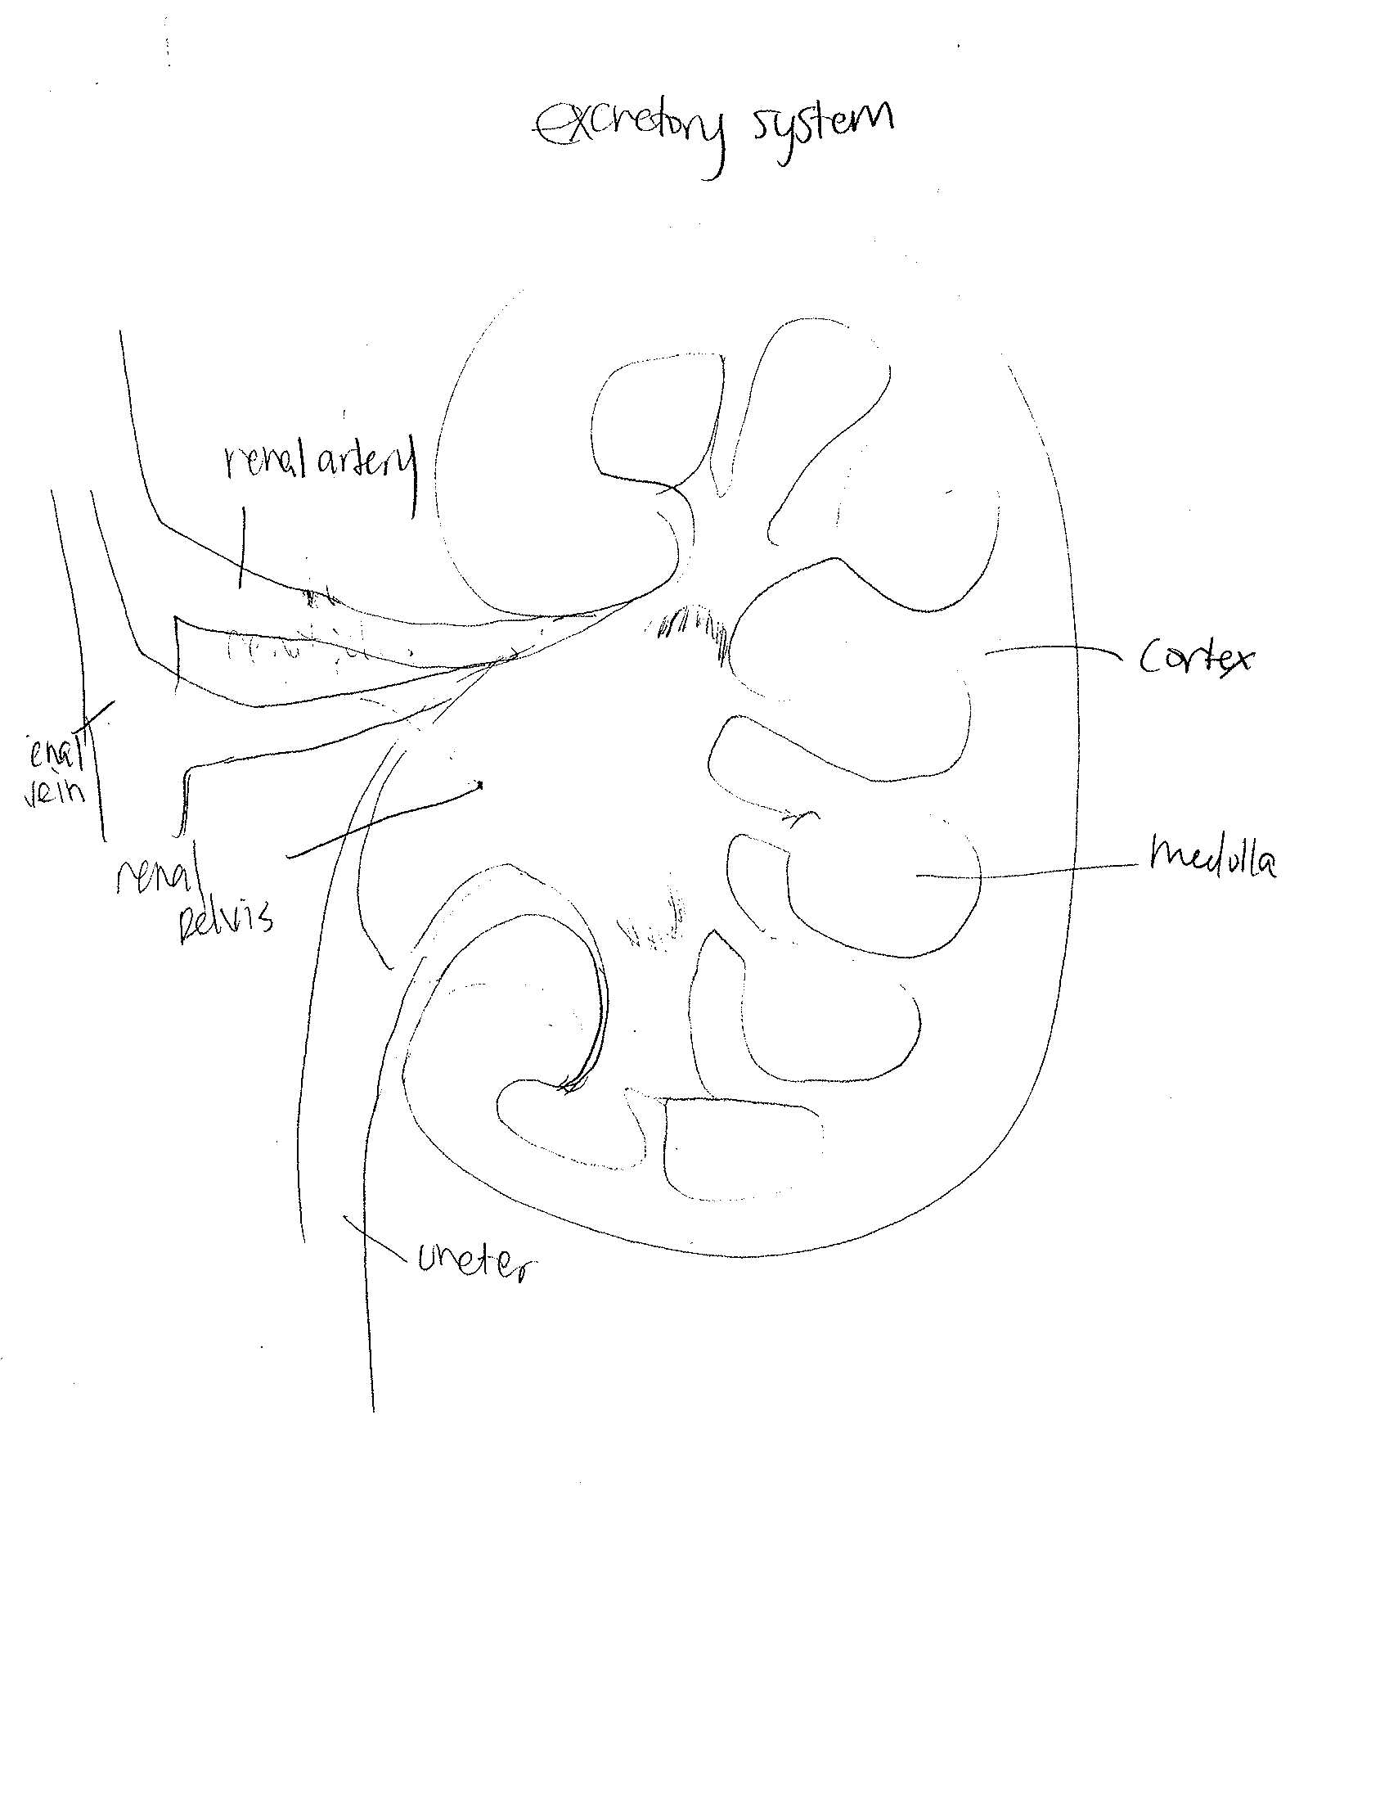
The excretory system functions in ridding the body of nitrogenous wastes. It also regulates the amount of water and ions present in the body fluids.

Slide 3
3 types of nitrogenous wastes
Ammonia
Ammonia is formed immediately after the amino group is removed from an amino acid. This process requires very little energy.
Ammonia is highly soluble in water but very toxic. Aquatic animals such as bony fishes, aquatic invertebrates, and amphibians excrete ammonia
Urea
Urea is produced in the liver by a process that requires more energy to produce than ammonia does.
mammals excrete nitrogenous wastes in the form of urea because it is less toxic than ammonia and can be moderately concentrated to conserve water.
Uric Acid
It is not very toxic and is not very soluble in water. Uric acid requires more energy to synthesis than the synthesis of urea
Insects, reptiles, birds,excrete uric acid.

Slide 4
A nephron is the fundamental structural and functional part of the kidney. It filters the blood, reabsorbing what is required and excreting the rest as urine.
A nephron gets rid of wastes from the body, controls blood volume and pressure, regulates levels of electrolytes and metabolites, and regulates blood pH. Its functions are vital and are controlled by the endocrine system by hormones like antidiuretic hormone, aldosterone, and parathyroid hormone.

Slide 5
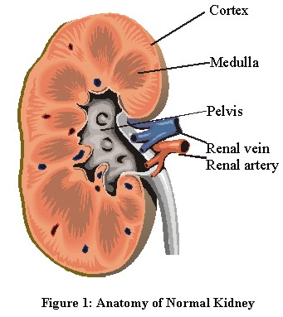
Parts of nephron
A nephron is the fundamental structural and functional part of the kidney. It filters the blood, reabsorbing what is required and excreting the rest as urine.
A nephron gets rid of wastes from the body, controls blood volume and pressure, regulates levels of electrolytes and metabolites, and regulates blood pH. Its functions are vital and are controlled by the endocrine system by hormones like antidiuretic hormone, aldosterone, and parathyroid hormone.
There are three major anatomical parts of the kidney: the cortex, the medulla, and the renal pelvis. The cortex receives most of the blood flow, and is mostly concerned with reabsorbing filtered material. The medulla contains ion channels and pumps and serves to concentrate the urine. The pelvis collects urine for excretion.

Slide 6
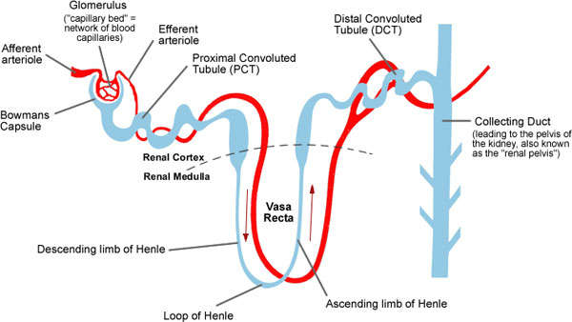
The functional unit of the kidney is the nephron, with five parts.
1. The glomerulus, which is the blood kidney exchange, plasma is filtered from capillaries into the Bowman’s capsule.
2. The proximal convoluted tubule, which reabsorbs most of the filtered load, including nutrients and electrolytes.
3. The loop of Henle, which concentrates urine
4. The distal convoluted tubule, which reabsorbs water and sodium depending on current metabolic needs
5. The collecting system, which collects urine for excretion, and feeds into the renal pelvis

Slide 7
Disorders of the excretory disorders
Gout is a disorder in which excess uric acid, which is insoluble, starts to accumulate in the joints, causing pain and deformation as well as kidney stones About 4% of Americans suffer from gout. Nonsteroidal anti-inflammatory drugs (NSAIDs) may control inflammation and pain in people with gout.
Bladder infections are known as cystitis or inflammation of the bladder. They are common in women but very rare in men. More than half of all women get at least one bladder infection at some time in their lives. Symptoms include painful urination, bloody urine. UTI’s are usually easy to treat with antibiotics unless they spread to the kidneys.

Slide 8
http://faculty.clintoncc.suny.edu/faculty/michael.gregory/files/bio%20102/bio%20102%20lectures/excretory%20system/excretor.htm
http://www.ccmtutorials.com/renal/pathphys/page_02.htm
http://ezinearticles.com/?The-Functions-of-the-Nephron-of-Kidney&id=1342876
http://genericlook.com/anatomy/Nephron/
http://biology.clc.uc.edu/courses/bio105/kidney.htm
http://www.sciencedaily.com/articles/n/nephritis.htm
http://www.webmd.com/a-to-z-guides/understanding-bladder-infections-basic-information

