Slide 1
Respiratory system

Slide 2
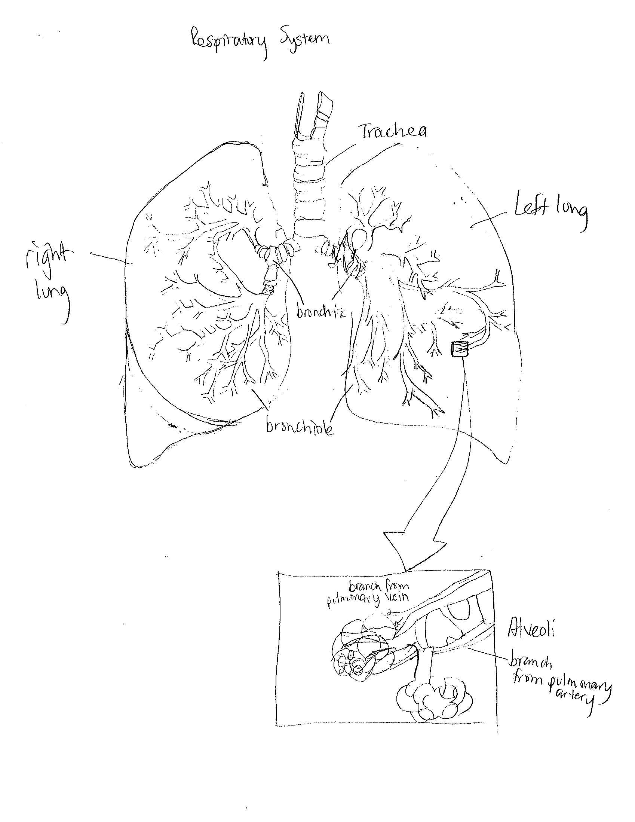
The primary function of the respiratory system is the supply of oxygen to the blood and the removal of carbon dioxide

Slide 3
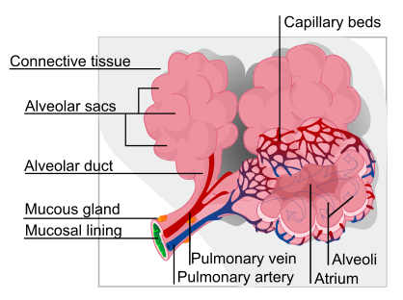
The alveoli are the final branchings of the respiratory system and act as the primary gas exchange units of the lung. They are only one cell thick, facilitating efficient gas exchange. Tthe ratio of SA to volume in the alveoli is large.

Slide 4
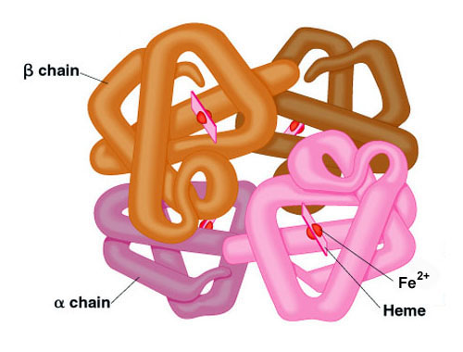
The majority of carbon dioxide is transported in bicarbonate ions Carbon dioxide enters red blood cells in the tissue capillaries where it combines with water to form carbonic acid (H₂CO₃). Carbonic acid then dissociates to form bicarbonate ions (HCO₃⁻ ) and hydrogen ions (H⁺).
Only a small amount of O2 is carried as dissolved solution. Most of the oxygen is carried in chemical combination with the hemoglobin in red blood cells

Slide 5
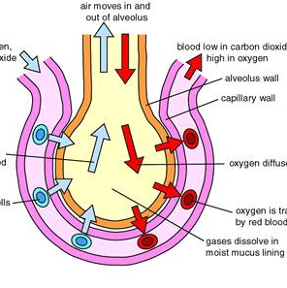
When the lungs expand, creating a region of lower air pressure than outside of the body, air floods through the trachae, through the bronchii and then the bronchioles, and travels to the tiny sacs called alveoli, where oxygen diffuses through the one-celled membrane and into the adjoining capillary, where it bonds temporarily to hemoglobin molecules for transport

Slide 6
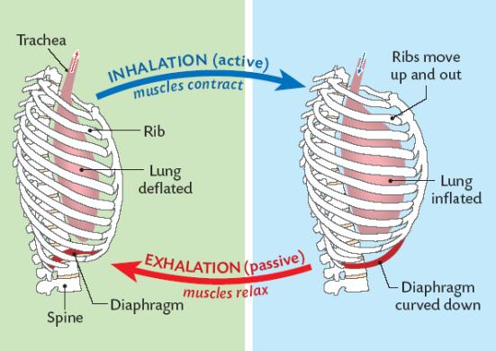
Inhalation and exhalation are the processes by which the body brings in oxygen and expels carbon dioxide. The breathing process is facilitated by a large dome-shaped muscle called the diaphragm.
When you breathe in, the diaphragm contracts and lowers the floor of the respiratory cavity, creating a vacuum. Air rushes in to fill the vacuum. With exhalation, the diaphragm relaxes and the lungs deflate.

Slide 7
Cystic fibrosis (CF) is an genetically recessive disease characterized by an abnormality in the cell’s ion channels. CFTR controls the flow of water and certain salts in and out of the body's cells. As the movement of salt and water in and out of cells is altered, mucus becomes thickened. The thickened mucus can affect many organs and body systems including:
respiratory – susceptibility to bacterial infections of the lungs
digestive – inhibited absorption of nutrients
sweat glands – extra-salty skin
In the United States, the prevalence is as follows:
Whites of northern European origin - 1 case per 3,200-3,500 population
Hispanics - 1 case per 9,200-9,500 population
African Americans - 1 case per 15,000-17,000 population
Asian Americans - 1 case per 31,000 population

Slide 8
Treatment for Cystic Fibrosis
Medications
Antibiotics. These drugs are used to treat and prevent bacterial lung infections
Therapy
Surgery
Feeding Tube- thick mucus in the digestive tract inhibits proper uptake of nutrients, so the doctor may prescribe a feeding tube
Lung transplant- in severe cases, arising from the increasing resistance of bacterial to drugs, life-threatening pulmonary complications, a lung transplant may be necessary
Bronchodilators. Medications that help breathing by relaxing muscles around the bronchiole tubes
Mucus-thinning drugs. Drugs that improve lung function by reducing viscosity of mucus
Inflatable vest. This device vibrates at high frequency to loosen chest mucus.
Breathing devices. Performing specific breathing exercises while exhaling through the device's tube or a mask may also be helpful.

Slide 9
Bronchiolitis is an infection of the lower respiratory tract that usually affects infants. There is swelling in the smaller airways or bronchioles of the lung, which causes obstruction of air in the smaller airways. The pathogen may be a virus or a bacteria. It is highly contagious, especially for children in daycare centers. Seventy-five percent of bronchiolitis occurs in the first year of life.
common cold symptoms, including:
runny nose
congestion
fever
Cough
Treatment is generally focused on easing of symptoms
intravenous fluids
breathing treatments
increased fluid intake
frequent suctioning of nasal passages
medications

Slide 10
http://www.ambulancetechnicianstudy.co.uk/respsystem.html
http://www.elp.manchester.ac.uk/pub_projects/2001/MNQC7NDS/carbon_dioxide.htm
http://sbi3u1rmcdonald.edublogs.org/2010/06/05/take-a-deep-breath-are-you-ready/
http://leavingbio.net/Respiratory%20System/THE%20RESPIRATORY%20SYSTEM.htm
http://www.chkd.org/healthlibrary/content.aspx?pageid=P02943
http://emedicine.medscape.com/article/1001602-overview#a0156
http://www.mayoclinic.com/health/cystic-fibrosis/ds00287/dsection=treatments-and-drugs
http://www.chkd.org/healthlibrary/content.aspx?pageid=P02929

