Slide 1
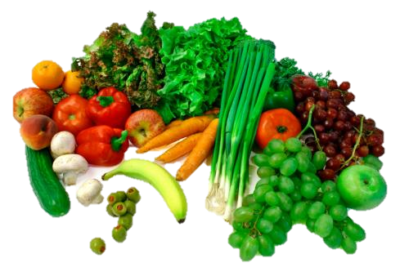
Digestive System
Kara Robbins

Slide 2
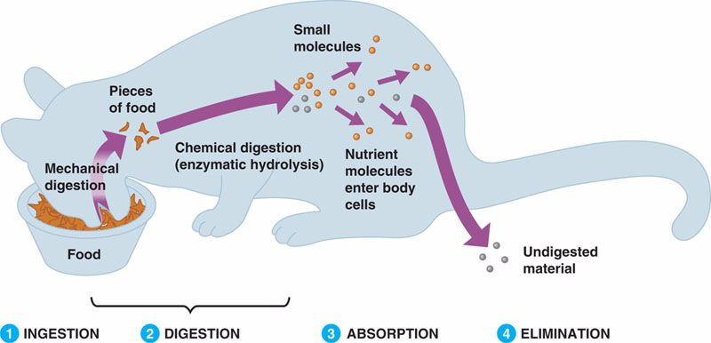
Function:
Food processing (ingestion, digestion, absorption, and elimination)

Slide 3
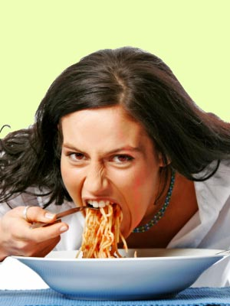
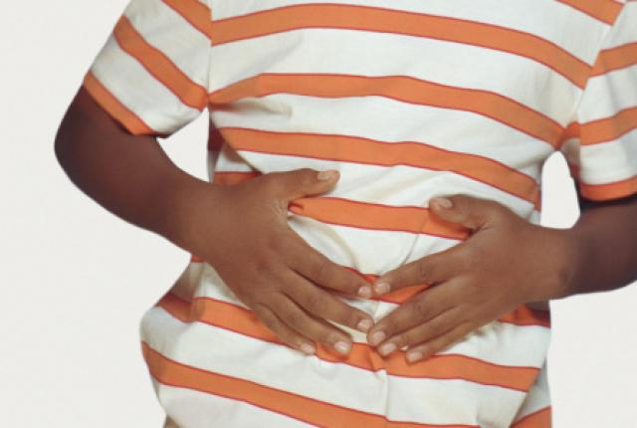
Function
Ingestion
Act of eating
Digestion
Process of breaking down food into molecules small enough for the body to absorb

Slide 4
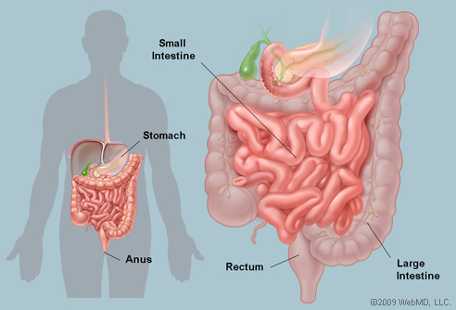
Function
Absorption
Animal’s cells take up small molecules such as amino acids and simple sugar from digestive compartment
Elimination
Undigested material passes out of the digestive compartment

Slide 5
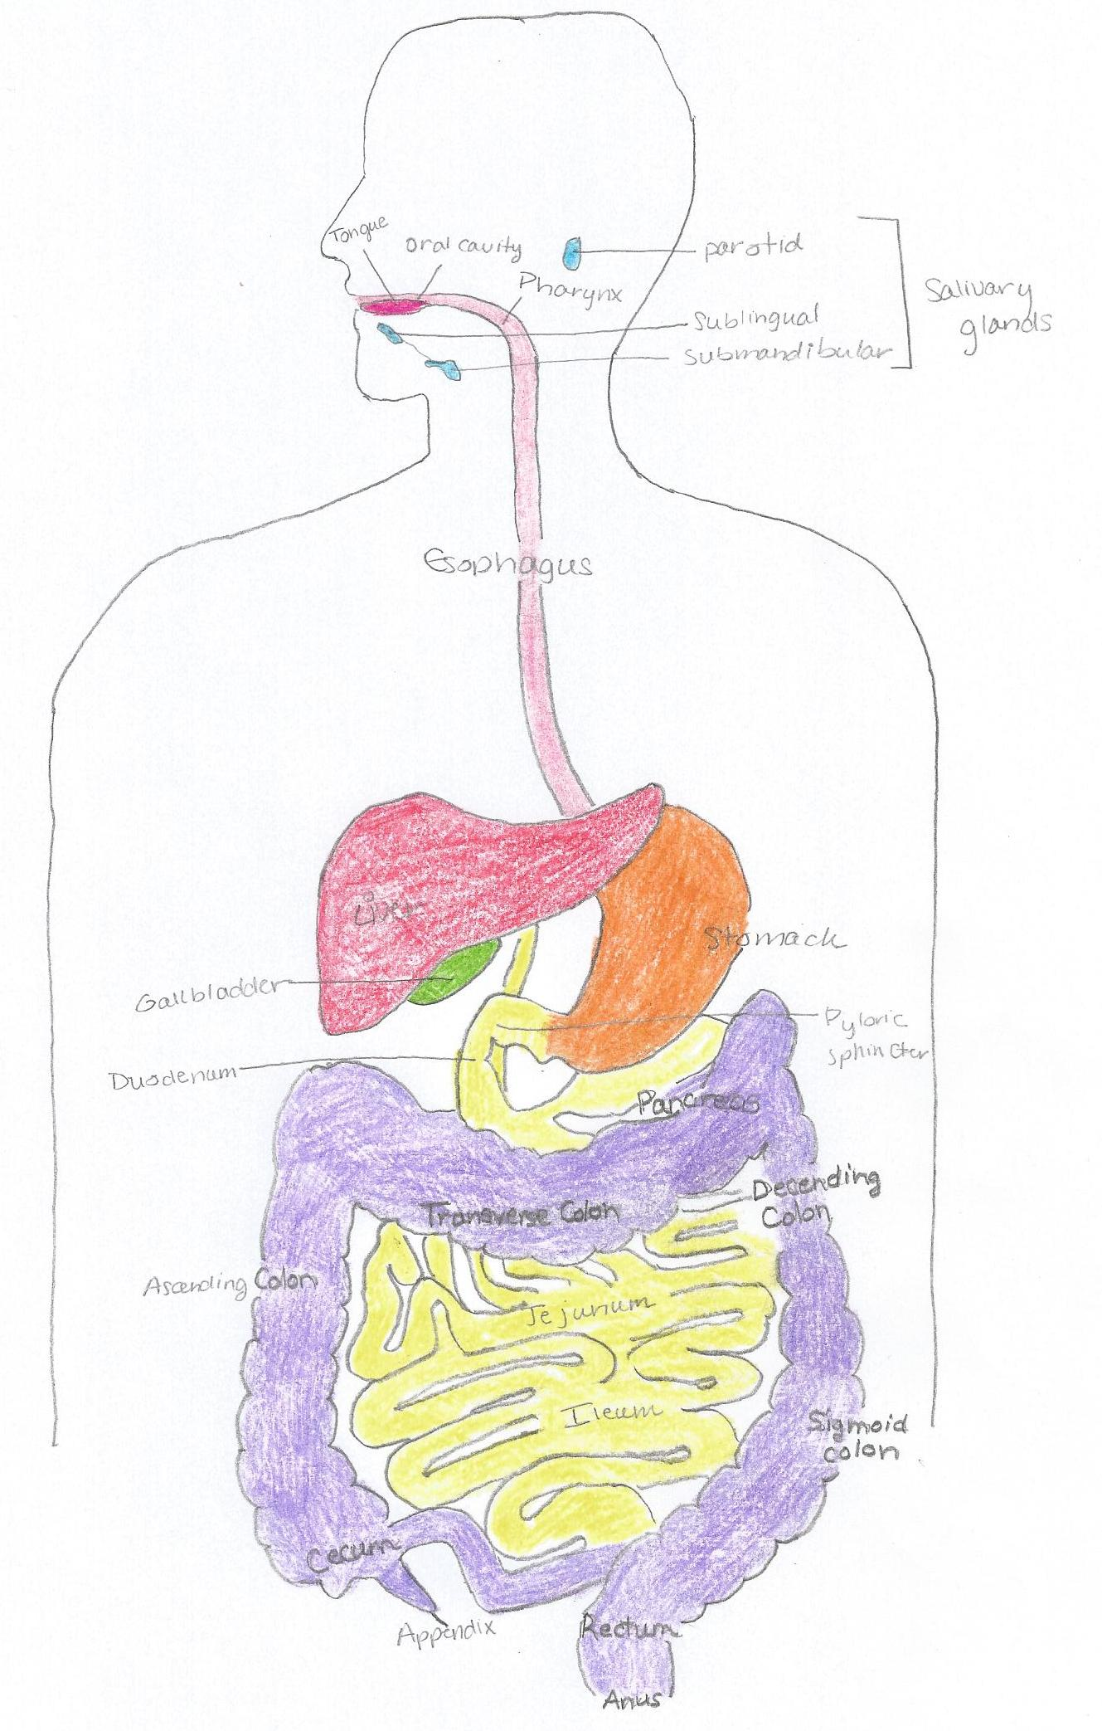
Digestive System

Slide 6
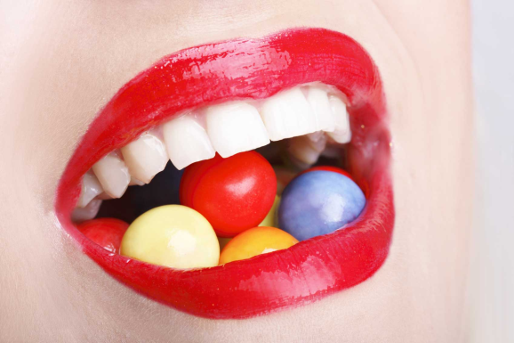
Mouth
Contains oral cavity: salivary glands
Food in oral cavity causes salivary glands to deliver saliva through ducts
Chemical digestion of Carbohydrates begins here
Tongues tastes food, manipulates it during chewing and help shape into ball called bolus
Tongues pushes bolus back to oral cavity
Tongue and teeth help grind and move food

Slide 7
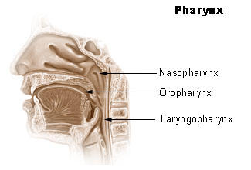
Pharynx
Region in throat that is a junction that opens to both the esophagus and windpipe
When we swallow, top of windpipe moves up so opening, the glottis, is blocked by a cartilaginous flap called the epiglottis

Slide 8
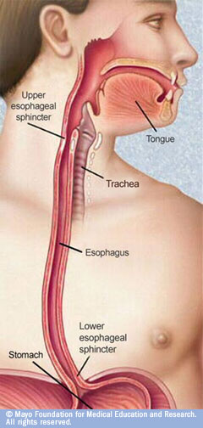
Esophagus
Conducts food from pharynx down to stomach by peristalsis
Act of swallowing begins voluntarily, but then involuntarily waves of contraction by smooth muscles in the rest of the esophagus take over

Slide 9
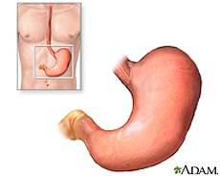
Stomach
Stores food and performs preliminary steps of digestion
Has accordianlike folds and very elastic wall
Secretes digestive fluid called gastric juice and mixes secretion with food by churning action of smooth muscles in stomach wall
pepsin – present in gastric juice an enzyme that begins the hydrolysis of proteins, breaks peptide bonds adjacent to specific amino acids
First secreted in inactive form pepsinogen
Made active by removing portions of molecules and exposing its active site

Slide 10
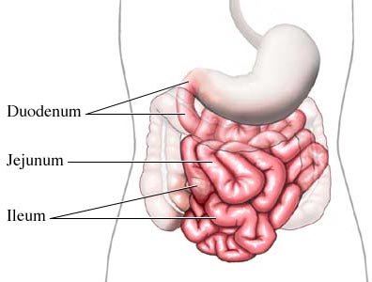
Small Intestine
Most of enzymatic hydrolysis of food macromolecules and absorption of nutrients into the blood occur here
Split into three parts: Duodenum, Jejunum, and Ileum

Slide 11
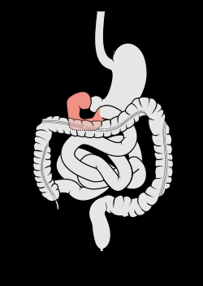
Duodenum
First part of small intestine
Marks starting point when it exits the stomach
Helps breakdown food with enzymes
Contains tubular submucosal glands called Brunner’s glands (lubricates lining of intestine)
Cholecystokinin is secreted and hydrolyzes and digests fats

Slide 12
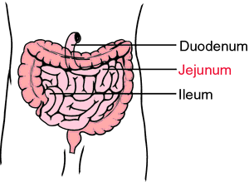
Jejunum
Second part of intestine
Helps with pH levels
Function mainly in absorption of nutrients and water

Slide 13
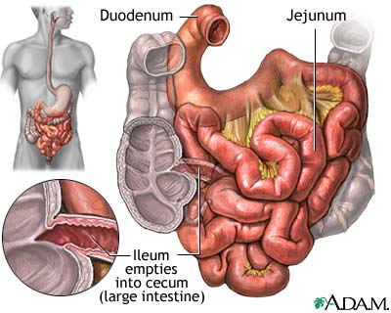
Ileum
Third part of intestine
Helps along with Jejunum in absorption of nutrients and water
Longest part of small intestine
Absorption of vitamin B12
Mostly absorbs fatty acid and glycerol, besides glucose and amino acids

Slide 14
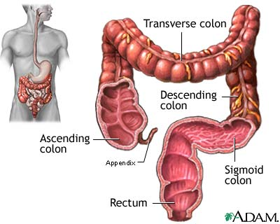
Large Intestine
Connected to small intestine in T-shaped junction where sphincter controls movement of material
Split into 5 parts: Cecum, Ascending Colon, Transverse Colon, Descending Colon, and Sigmoid Colon

Slide 15
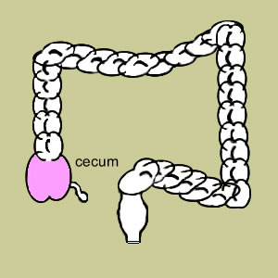
Cecum
Arm of the T, pouch, relatively small in humans
Receives fecal material from the Ileum
Separated from colon by cecocolic junction
Has fingerlike extension called appendix which is dispensable

Slide 16
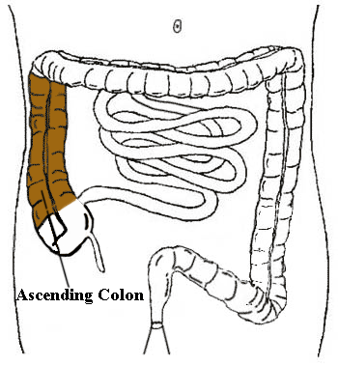
Ascending Colon
Removes water and other key nutrients from waste material and recycle it back into the body
Located between cecum and transverse colon

Slide 17
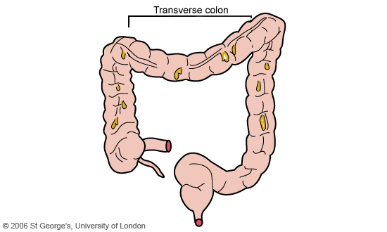
Transverse Colon
Food and waste spend most of their time in the transverse colon
Most movable area of colon
Digestive materials are forcefully pushed into next part of the colon, preparing for exit from the body

Slide 18
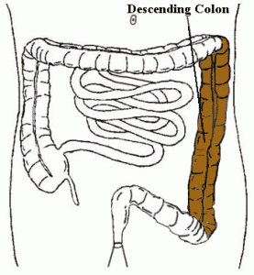
Descending Colon
Absorbs water from fecal matter
Pushed digestive waste products toward exit

Slide 19
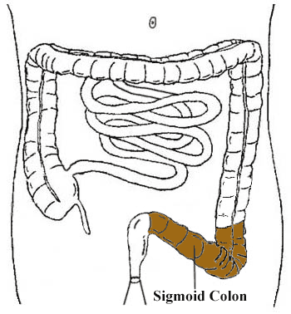
Sigmoid Colon
Closest to rectum and anus
Stores feces until they are ready to enter the rectum

Slide 20
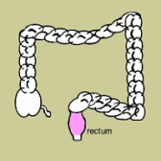
Rectum
Terminal portion of colon where feces are stored until they can be eliminated through anus

Slide 21
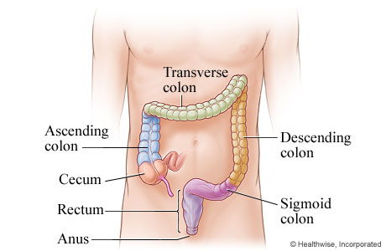
Anus
Opening in the alimentary canal where feces leave the body

Slide 22
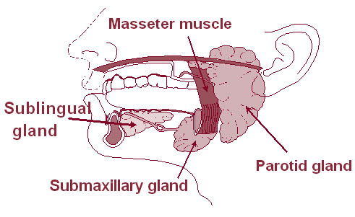
Salivary Glands
Exocrine glands associated with the oral cavity
Secretion of saliva contain substance to lubricate food
Adhere together chewed pieces into a bolus and begin process of chemical digestion
Three glands: Sublingual, Parotid, and Submaxillary

Slide 23
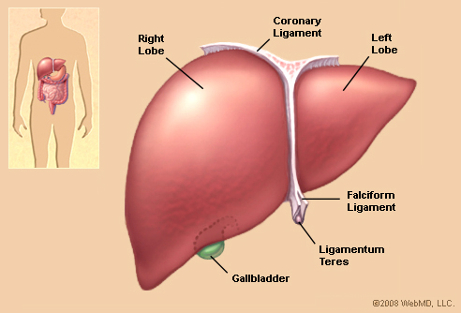
Liver
Largest organ in vertebrate body
Performs diverse function such as producing bile, preparing nitrogenous waste for disposal, and detoxifying poisonous chemicals in the blood

Slide 24
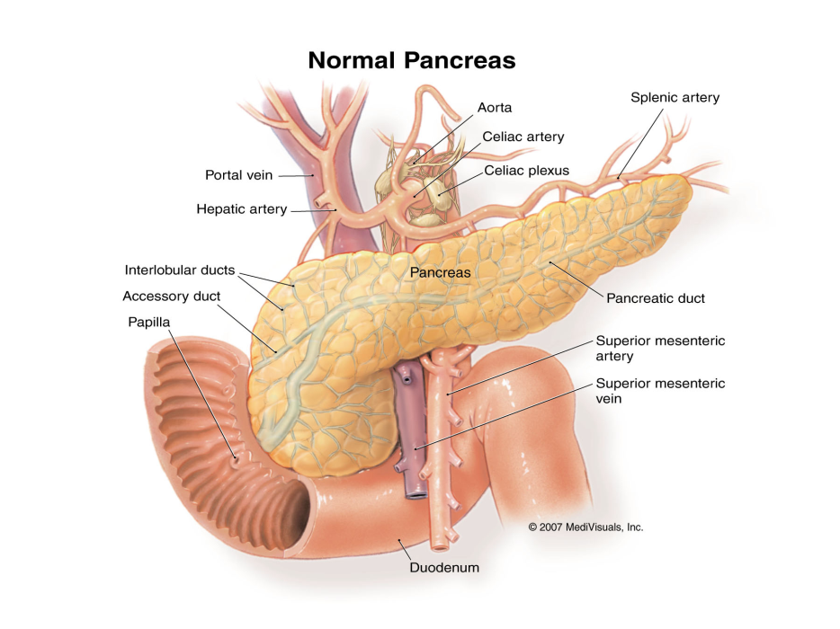
Pancreas
Gland with dual functions:
Non endocrine portion secretes digestive enzymes and an alkaline solution into the small intestine via a duct
Endocrine portion secrets the hormones insulin and glycogen into the blood

Slide 25
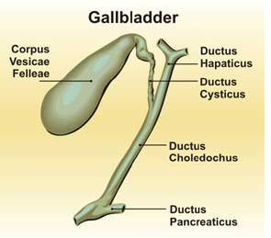
Gallbladder
Organ that stores bile and release it as needed into the small intestine

Slide 26
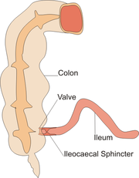
Sphincters
Ringlike valve consisting of modified muscles in a muscular tube, such as a digestive tract
Closes off the tube like a drawstring

Slide 27
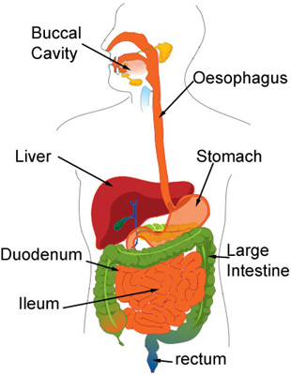
Alimentary Organs
Mouth-Pharynx-Esophagus-Stomach-Small Intestine-Large Intestine- Anus
Continuous, coiled, hollow, muscular tube that winds through the central body and is open at both ends
Digests food and absorbs fragments through its lining into the blood

Slide 28
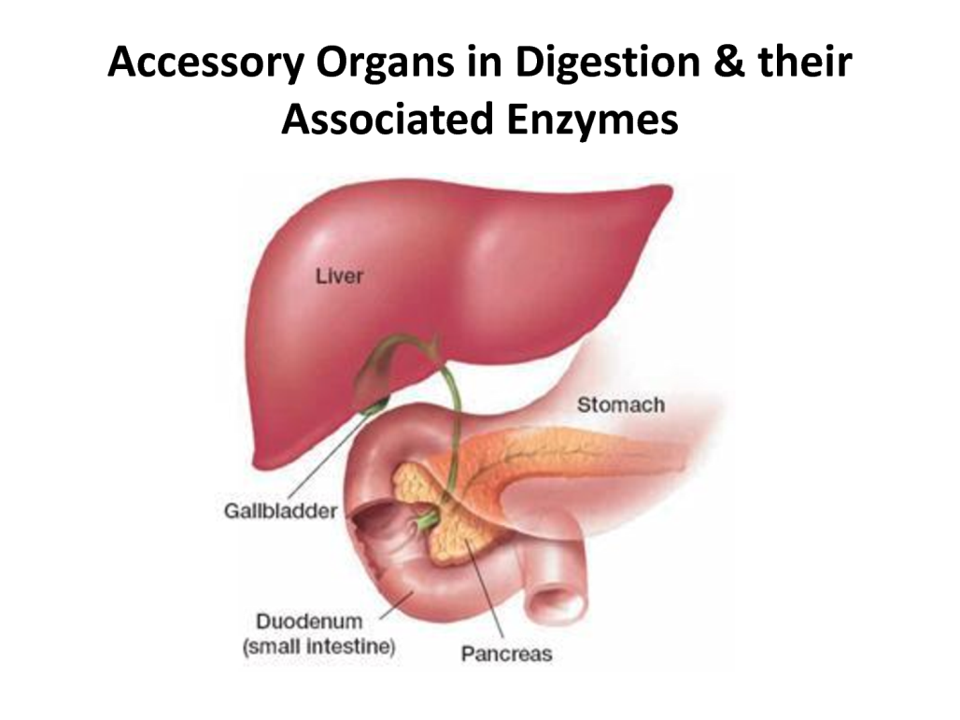
Accessory Organs
Teeth-Tongue-Gallbladder-Salivary Glands-Liver-Pancreas-Saliva-Bile-Enzymes
Help aid in the digestive process but not the major organs, such as the alimentary organs
Usually contain enzymes that help in chemical digestion

Slide 29
Types of Digestion
Physical
Chemical
Breakdown of food by physical means
Starts when using a knife or fork to break down large substances
Also includes peristalsis which helps move food down digestive tract
muscular churning of food within stomach helps mix foods substances with digestive juices
Chewing, churning, and mixing of food with digestive juices
Action splits up molecules
Proteins, fats, and carbohydrates are too large and must use chemical means to break down food
Use enzymes and other things such as saliva

Slide 30
Carbohydrate Digestion
Polysaccharides (starch, glycogen)
Disaccharides (sucrose, lactose)
Occurs in oral cavity, pharynx, and esophagus using salivary amylase leading to smaller polysaccharides (maltose)
Also occurs in lumen of small intestine using pancreatic amylases leading to maltose and other disaccharides
Is further digest in the epithelium of the small intestine leading to monosaccharides
Starts in oral cavity, pharynx, and esophagus using salivary amylase
Going through stomach, leading to lumen of small intestine using pancreatic amylases
Lastly, epithelium of small intestine leading to monosaccharides

Slide 31
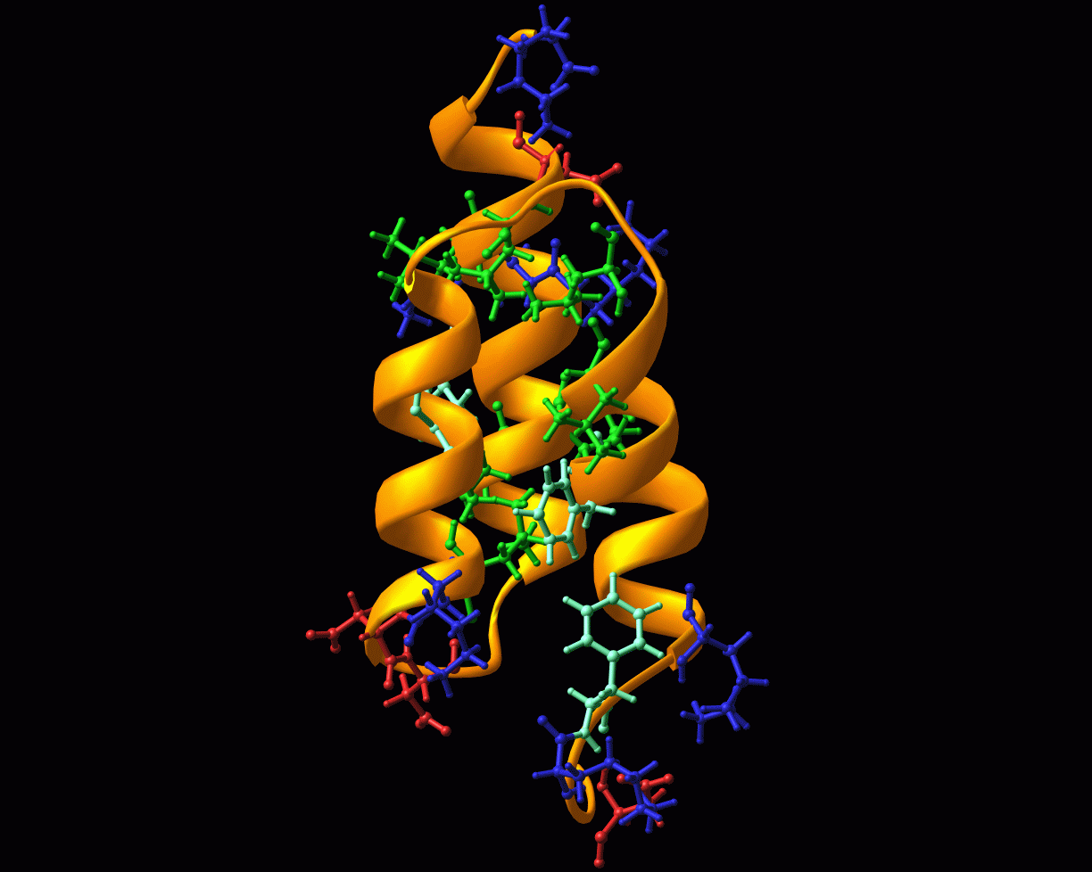
Protein Digestion
Begins in stomach using pepsin to break proteins down to small polypeptides
Continues in lumen breaking the polypeptides down using pancreatic trypsin and chymotrypsin into small polypeptides
Still in lumen, using pancreatic carboxypeptidase to break the smaller polypeptides into amino acids
In Epithelium, amino acids and small peptides are broken down using dipeptidases, carboxypeptidase, and aminopeptidase to amino acids

Slide 32
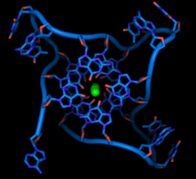
Nucleic Acid
Begins in lumen, DNA and RNA are broken down using pancreatic nucleases to nucleotides
In epithelium, nucleotidases breaks down nucleotides into nucleosides
Nucleosides are then broken down using nucleosidases and phosphates into nitrogenous bases, sugars, and phosphates

Slide 33
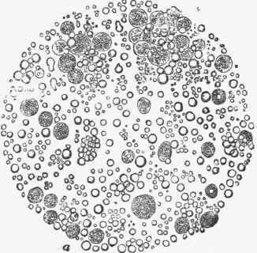
Fats
Starts in lumen, fat globules (insoluble in water) are broken down using bile salts to fat droplets
Fat droplets are broken down using pancreatic lipase to glycerol, fatty acids, and glycerides

Slide 34
Disorders: Constipation
Occurs in 2% of the population (women and elderly most commonly affected)
Occurs when bowel movement becomes difficult or less frequent
Symptoms:
Stool and feces become harder and more difficult to pass
Infrequent bowel movement
Swollen Abdomen or abdominal pain
Vomiting
Caused by disorder of bowel function rather than structural problem
Causes:
Inadequate water intake, fiber in diet
Disruption of regular diet or routine
Traveling
Stress
Resisting urge
Eating Disorders
Pregnancy
Treatment:
Eat well
Drink Water
Exercise regularly
Move bowel when you feel the urge
Eat prunes or bran cereal
Use a laxative

Slide 35
Disorders: Gastritis
Inflation, irritation, or erosion of the lining of the stomach
Caused by irritation due to excess alcohol use, chronic vomiting, stress, or use of certain medication such as antiflammatory drugs
Symptoms:
Nausea
Abdominal bloating
Vomiting
Indigestion
Hiccups
Loss of appetite
Treatment:
Take antacids
Avoid hot spicy food
About 50% of population suffers from this

