Slide 1
The Excretory System
T. Zack Crawford

Slide 2
Function
The function of the excretory system is to remove unnecessary waste materials from the body to maintain homeostasis and prevent damage from the body.

Slide 3
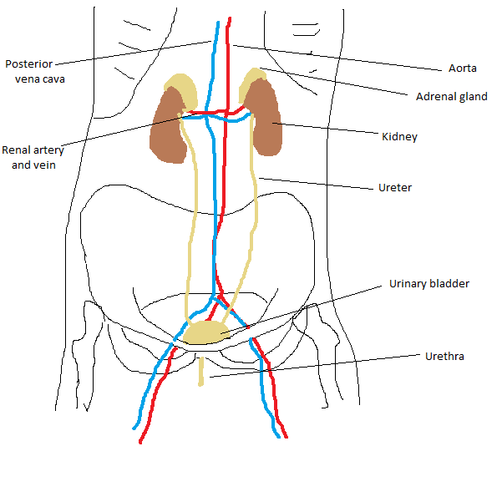

Slide 4
Nitrogenous Wastes
Nitrogenous wastes are produced by protein metabolism. Amino groups removed from amino acids combine with hydrogen to form ammonia which is toxic to the body.
Marine animals directly excrete this toxin.
Land organisms, on the other hand, must dispose of ammonia waste while at the same time conserving water.
Amphibians and mammals convert this ammonia to a safer compound, urea, which is dumped into the blood, concentrated at the kidneys, and then excreted.
Birds and insects, instead, secrete uric acid which is made through energy expenditure. The benefit to this method is that it requires very little water loss.

Slide 5
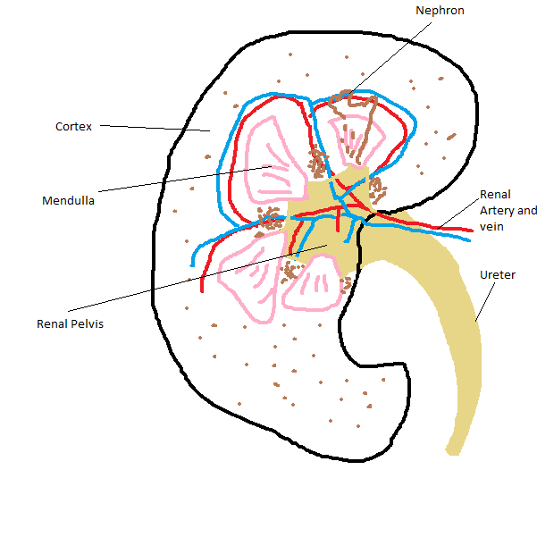
The Kidney

Slide 6
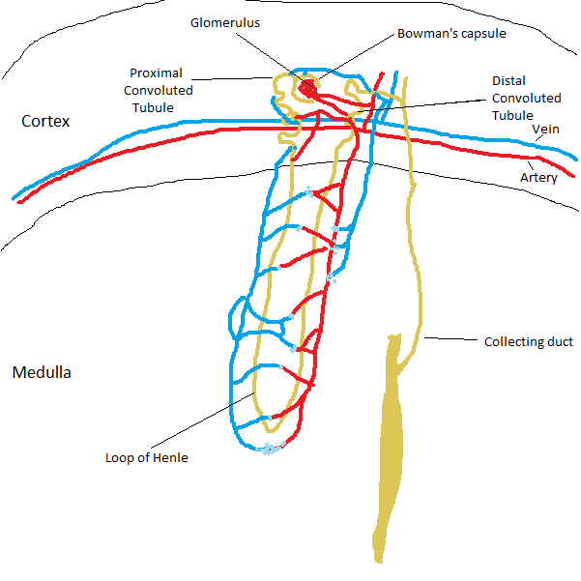
The Nephron
Major functional unit of the kidney
Up to 1.5 million in one kidney
Filters urea from the blood
There are 5 major components of the nephron
Glomerulus and Bowman’s capsule - Mechanically filters the blood
Proximal Convoluted Tubule – Reabsorbs water, salts, glucose, and amino acids
Loop of Henle – creates concentration gradient in the medulla
Distal Convoluted Tubule – secretes H+, potassium, and certain drugs

Slide 7
Processes within the Nephron
Filtration – Each nephron begins in a renal corpuscle consisting of a glomerulus and Bowman’s capsule. Cells, proteins, and other large molecules are filtered our by a process of ultrafiltration. The product is an ultrafiltrate to pass through the proximal convoluted tubule, loop of Henle, distal convoluted tubule, and collecting ducts before being expelled from the body as urine.

Slide 8
Processes within the Nephron
Reabsorption – process where solutes and water are removed from the tubular fluid so that they may be transported into the blood.
Secretion – the active transfer of materials from the capillaries around the nephron to the tubular lumen in the loop of Henle so that they may be expelled. These materials may include natural poisons or drugs.
Excretion – refers to the process where urine is sent through the collecting duct and ureter to the bladder where it may be expelled from the body.

Slide 9
Kidney stones
Kidney stones are small crystals that form in the kidney. They are caused by super saturation of urine with crystal forming substances such as calcium.
Kidney stones are generally diagnosed with excruciating, intermittent pain in the groin, flank, or inner thigh.
About 80% of cases are in men rather than women. The North American and European annual incidence of kidney stones is roughly .5%. Recurrence rates are estimated at 50% over a 10 year period and 75% over 20 years.
Up to 98% of stones may pass through urination within 4 weeks of onset symptoms, but larger stones must be removed surgically.
Less invasive treatments have emerged since the 1980’s such as extracorporeal shock wave lithotripsy. This treatment includes focused, high energy pulses of ultrasonic energy to fragment the stone.

Slide 10
Chronic kidney disease
CKD is the progressive loss of renal function over time.
CKD is most commonly caused by diabetes, hypertension, and glomerulonephritis
CKD may cause increased blood pressure, urea buildup in the blood which may be excreted by sweating causing uremic frost, and potassium buildup in the blood causing malaise.
CKD may be identified by a blood test for creatinine.
As many as 17% of adults age 20+ in the US may be affected by CKD.
For progressed CKD, renal replacement therapy in the form of dialysis or a transplant will become necessary.
There are, however; several compounds in development for treating CKD such as bardoxolone methyl, olmesartan medoxomil, sulodexide, and avosentan.

Slide 11
Sources
http://en.wikipedia.org/wiki/Excretory_system
http://www.emc.maricopa.edu/faculty/farabee/biobk/biobookexcret.html
http://en.wikipedia.org/wiki/Kidneys
http://en.wikipedia.org/wiki/Nephron
http://en.wikipedia.org/wiki/Renal_physiology
http://en.wikipedia.org/wiki/Kidney_stones
http://en.wikipedia.org/wiki/Chronic_kidney_disease#Signs_and_symptoms

