Slide 1
http://www.hagencartoons.com/cartoon653.gif

Slide 2
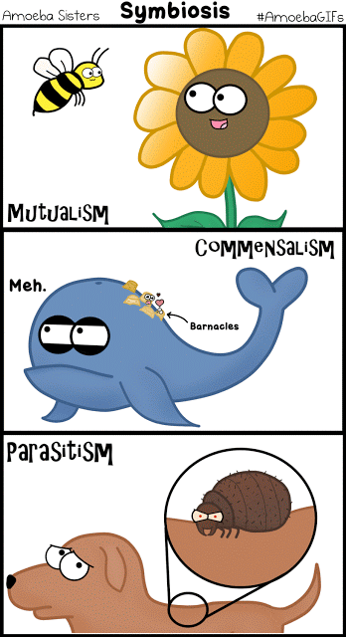
https://amoebasistersgifs.blogspot.com/2015/06/symbiosis.html

Slide 3
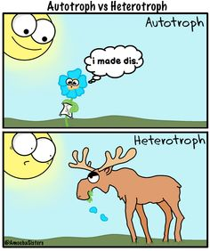
https://s-media-cache-ak0.pinimg.com/236x/3d/d7/e7/3dd7e738a1a8c56fde1b4fc39be24b94.jpg

Slide 4
https://amoebasistersgifs.blogspot.com/

Slide 5
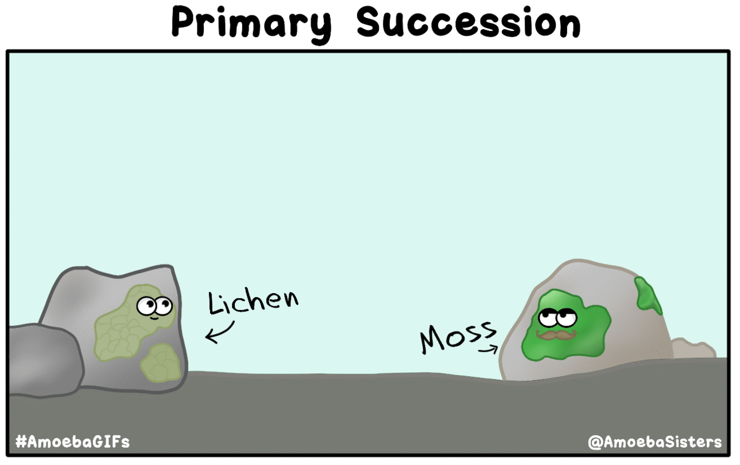
https://amoebasistersgifs.blogspot.com/2016/01/primary-succession.html

Slide 6
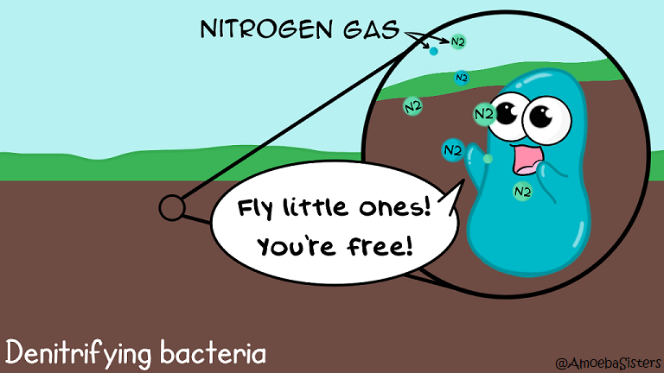
http://www.amoebasisters.com/parameciumparlorcomics

Slide 7
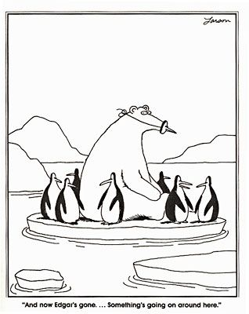
https://www.pinterest.com/pin/ATMmPYb0cVPIMl97NFBys2Uj5GCI4Jh0ItrsRLu5bFbwE2IP-QETEAo/

Slide 8
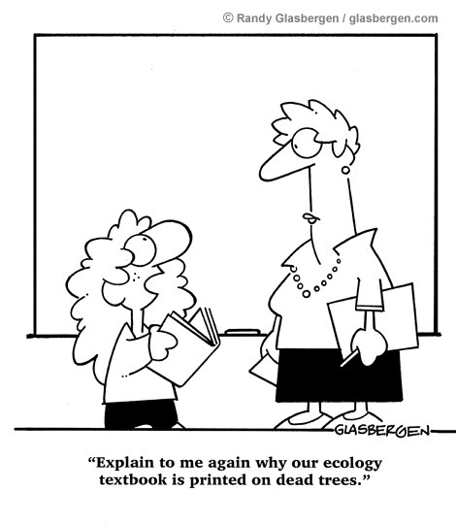
http://www.glasbergen.com/wp-content/gallery/going-green-global-warming-the-environment/toon395.gif

Slide 9
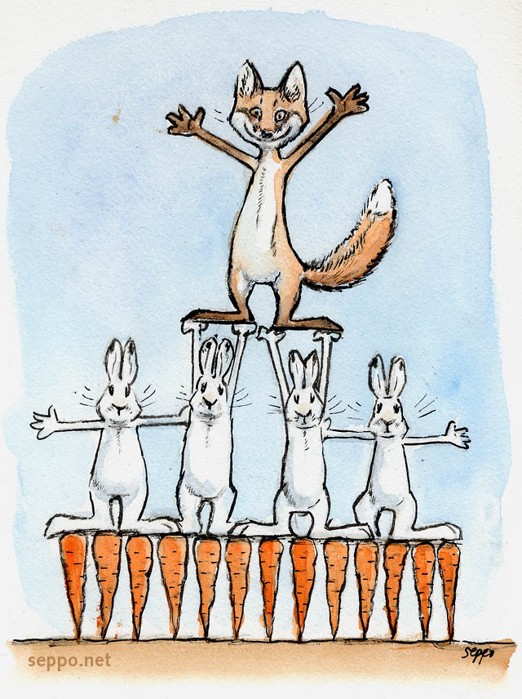
https://s-media-cache-ak0.pinimg.com/originals/47/ce/24/47ce2431c2ca5b6b8e0a936dda12a155.jpg

Slide 10
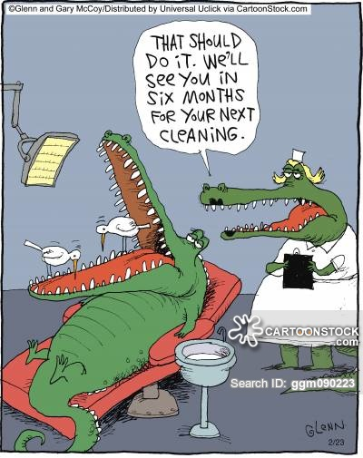
https://s3.amazonaws.com/lowres.cartoonstock.com/animals-crocodile-alligator-teeth-bird-clean-ggm090223_low.jpg

Slide 11
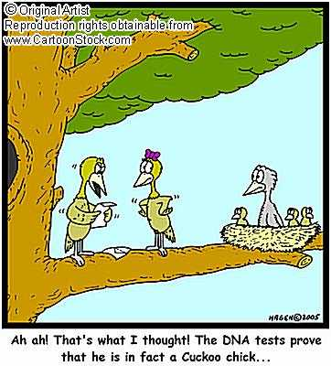
https://local-brookings.k12.sd.us/biology/ch3biosphere/cookoo.jpg

Slide 12
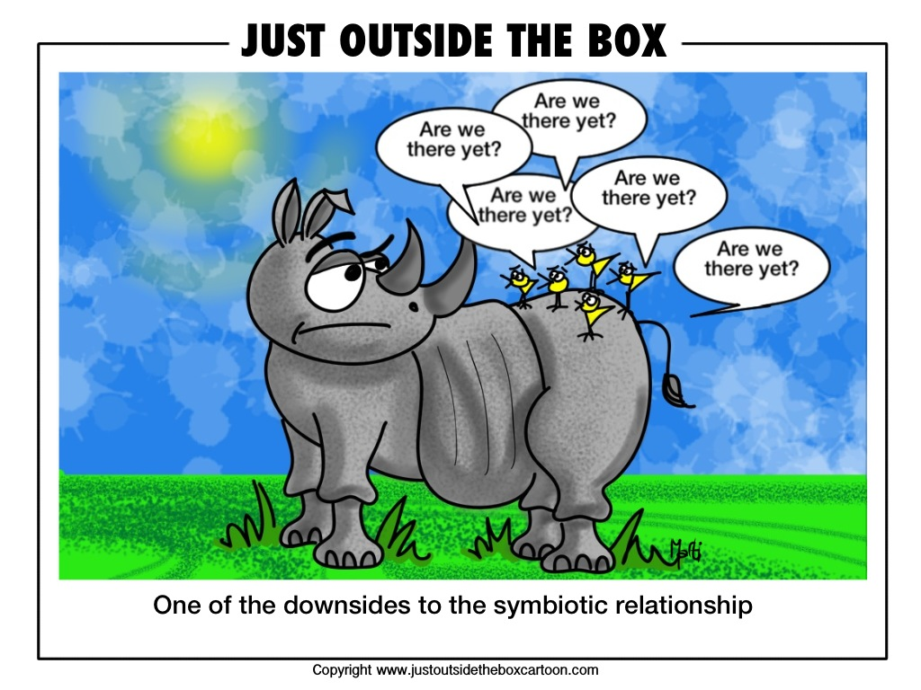
http://justoutsidetheboxcartoon.com/wp-content/uploads/2012/10/308-are-we-there-yet.jpg?x66092

Slide 13
http://www.cobblearning.net/lpangburn/files/2013/09/sym-2ikjv1v.jpg

Slide 14
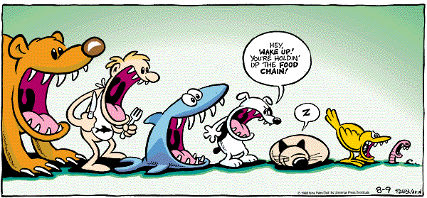
http://www.ninapaley.com/FluffArchives/fluff_images/fl980809.gif

Slide 15
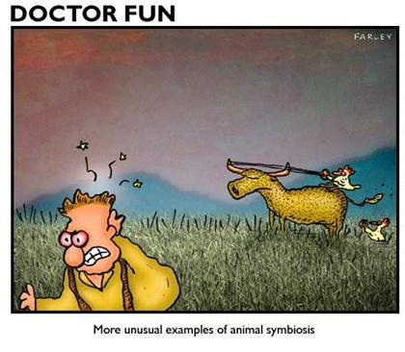
http://maggiesscienceconnection.weebly.com/uploads/5/1/0/5/5105330/362157465.jpg

Slide 16
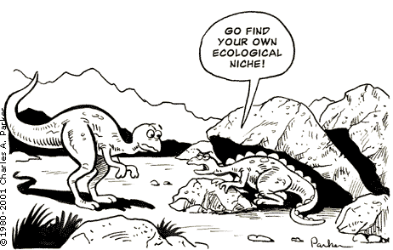
http://redspottednewt.weebly.com/uploads/2/6/7/2/26722897/5531640_orig.png

Slide 17
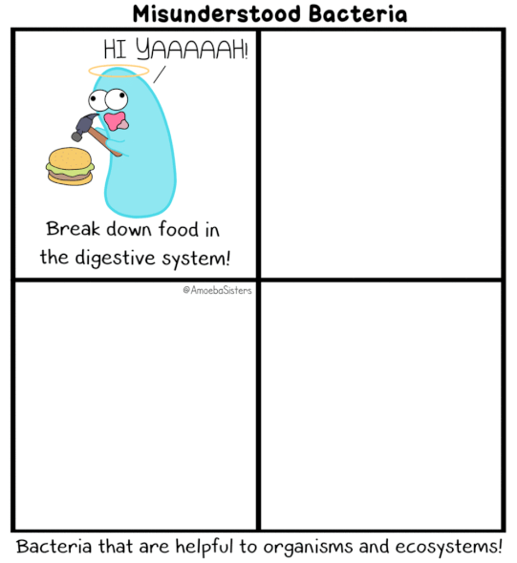
https://www.amoebasisters.com/uploads/2/1/9/0/21902384/published/misunderstood-bacteria-gif.gif?1530912240

Slide 18
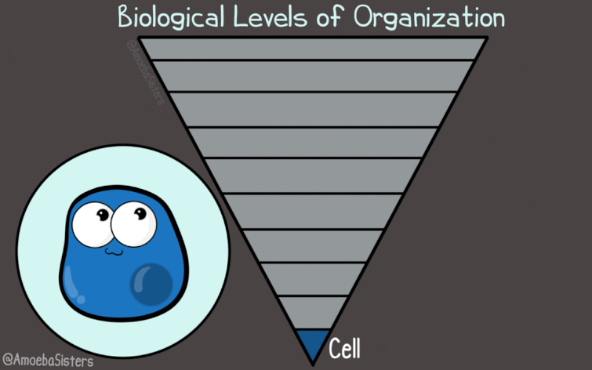
https://www.amoebasisters.com/uploads/2/1/9/0/21902384/published/biological-levels-of-organization_1.gif?1547233375

