Slide 1
BIOMOLECULE MODELING Kelly Riedell Brookings Biology
Cut and paste molecules are from Kim Foglia’s Explore Biology website
Toobers Activity is from 3D Molecular Designs AASK Kit

Slide 2
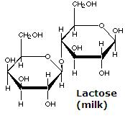
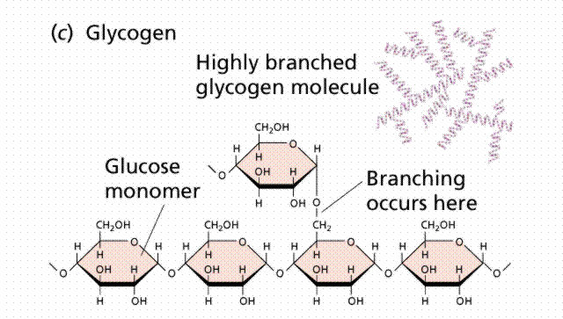
CARB CUTOUTS
Thanks to Kim Foglia @ http://www.explorebiology.com
for the molecule cutout shapes

Slide 3
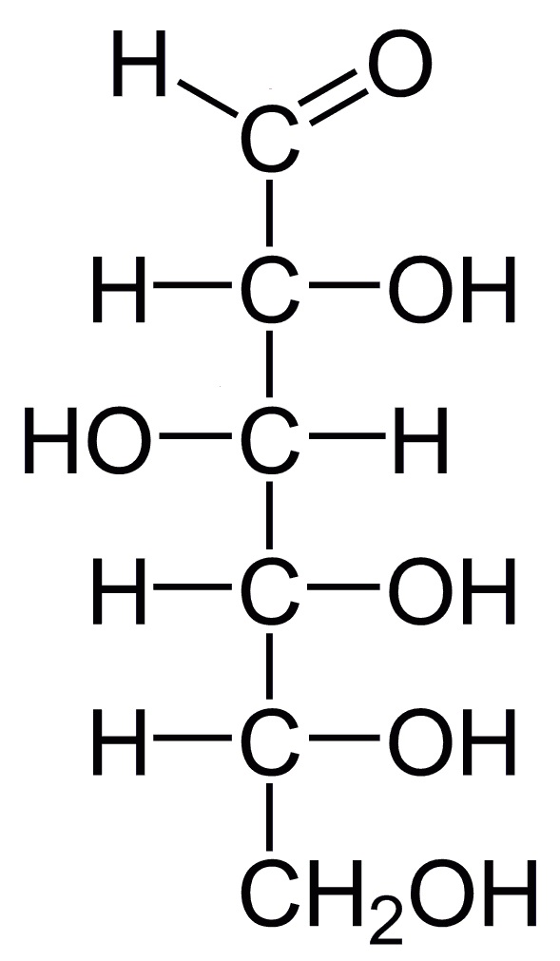
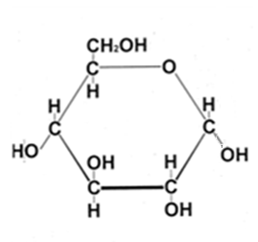
GLUCOSE C₆H₁₂O₆

Slide 4
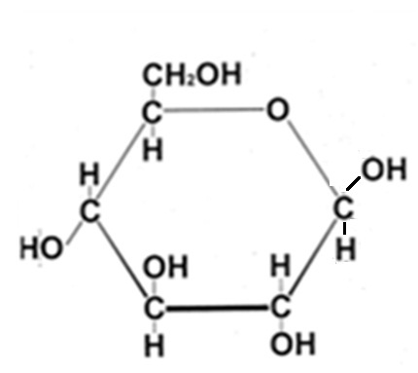
Glucose in water
“b”
C₁- OH hangs DOWN
C₁- OH sticks UP
ALPHA ( α ) glucose
BETA ( β ) glucose

Slide 5
6
6
5
5
4
1
4
1
3
2
2
3
~ Choose 2 glucose cutouts to join ~ Number the carbons ~ α or β glucose?
MONOSACCHARIDES = 1 sugar
DEHYDRATION SYNTHESIS
This Youtube video was made from:
http://academic.cengage.com/biology/discipline_content/animations/reaction_types.html

Slide 6
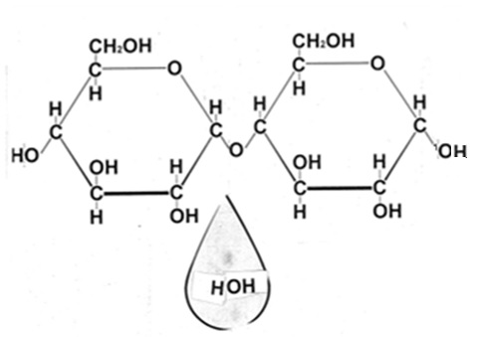
Type of saccharide with 2 sugars? This could be the start of which polysaccharides?
α 1,4 glycosidic linkage
6
6
5
5
4
1
4
1
2
2
3
3
BE SURE TO LABEL YOUR MODEL
DEHYDRATION SYNTHESIS

Slide 7
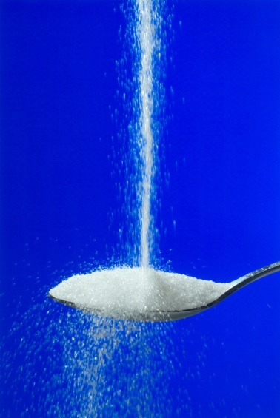
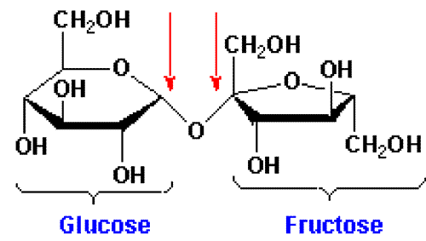
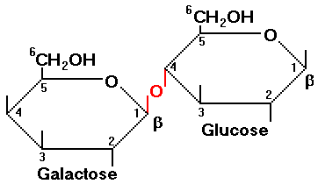
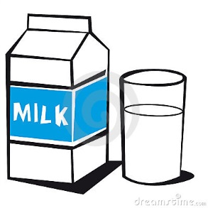
DISACCHARIDES
SUCROSE = TABLE SUGAR
LACTOSE = MILK SUGAR
http://suckitupfitnessbydebeers.com/wp-content/uploads/2013/11/sucrose.gif
http://blog.simpleposture.com/wp-content/uploads/2014/08/pouring-sugar.jpg
http://www.rpi.edu/dept/chem-eng/Biotech-Environ/FUNDAMNT/lactose.gif
http://thumbs.dreamstime.com/x/milk-1100894.jpg

Slide 8
Add 2 more glucose molecules to your chain. Add water molecules where appropriate.
Attach this to your BILL and answer the carbohydrate questions provided
α
α
α
α

Slide 9
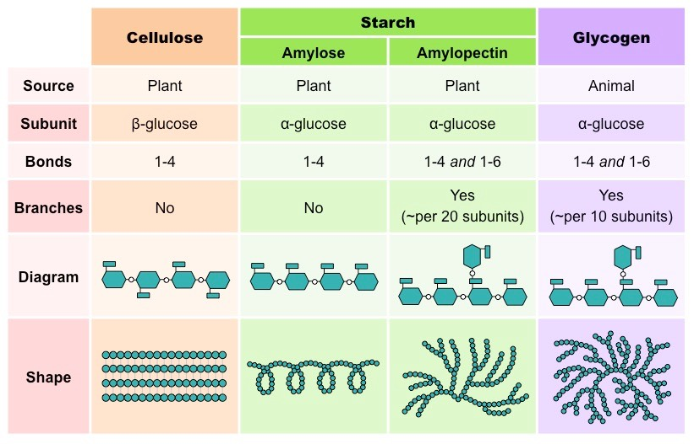
POLYSACCHARIDES 100’s – 1000’s of sugars
http://ib.bioninja.com.au/_Media/glucose-polysaccharides_med.jpeg

Slide 10
OLIGOSACCHARIDES
GLYCOPROTEINS
http://209.68.138.57/lc/archive/biology/PublishingImages/c04_03.jpg

Slide 11
6
6
5
5
4
1
4
1
3
2
2
3
Are these α or β ?
What polysaccharide(s) could be made from this subunit?

Slide 12
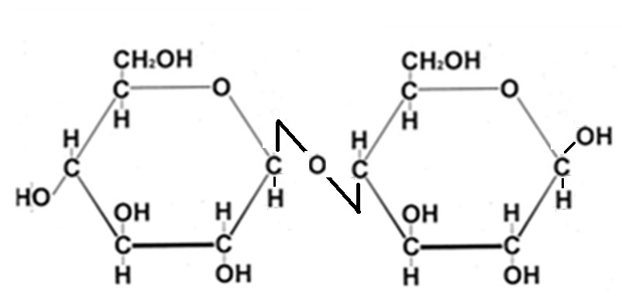
What if we used β-glucose?
NAME THE BOND
ß 1-6 glycosidic linkage

Slide 13
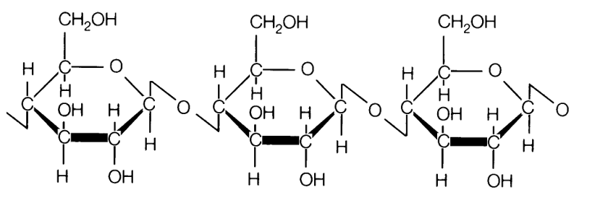
This could be the beginning of which polysaccharide?
https://thebiochemsynapse.files.wordpress.com/2013/02/cellulose.gif

Slide 14
How can I make a polysaccharide that branches?
Name the bond.
6
5
1
4
3
2
6
5
1
4
2
3

Slide 15
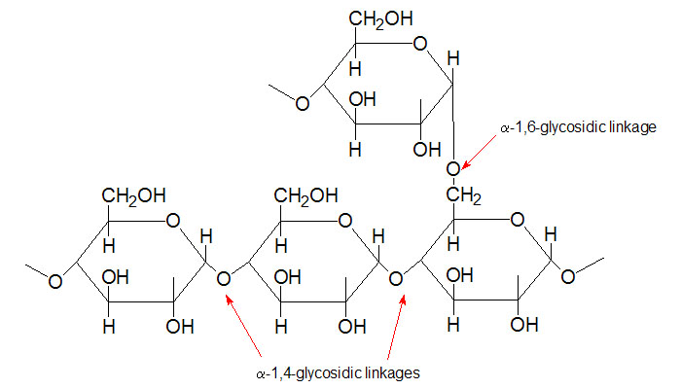
http://static1.squarespace.com/static/52668d02e4b0f593739ec2b6/t/53570be4e4b0fde8a1d5d536/1398213605501/

Slide 16
What if subunit is modified?
http://www.ceoe.udel.edu/horseshoecrab/research/chitin.html
α or β glucose ?
Polysaccharide? Uses?
N-acetyl-D-glucosamine
http://oriabure-biology.wikispaces.com/file/view/chitin2.jpg/87408319/684x318/chitin2.jpg

Slide 17
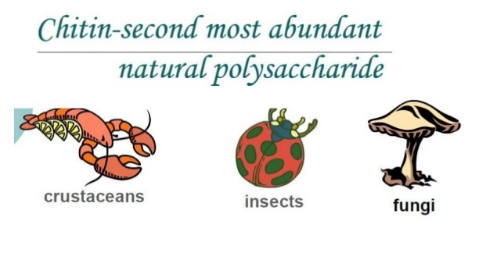
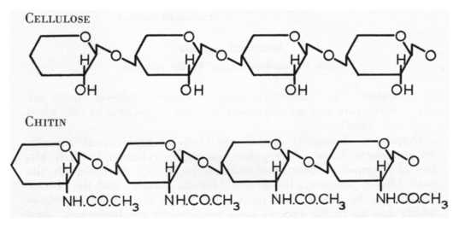
http://image.slidesharecdn.com/chitosannanoparticlesynthesis-160127064751/95/chitosan-nanoparticle-synthesis-3-638.jpg?cb=1453877318 http://oriabure-biology.wikispaces.com/file/view/chitin2.jpg/87408319/684x318/chitin2.jpg

Slide 18
SWYK
9. SHOW WHAT YOU KNOW (SWYK) Add pictures, diagrams, Compare/contrast charts, Venns, concept maps, etc.

Slide 19
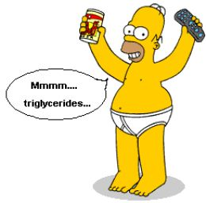
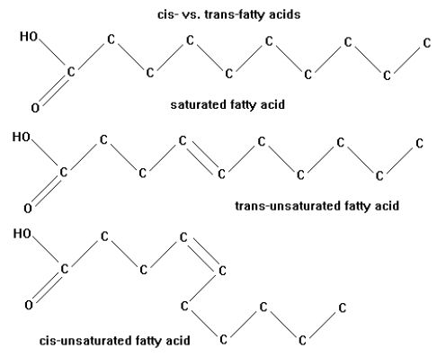
FATS
http://en.wikipedia.org/wiki/Fat
http://zrichards.hubpages.com/hub/Its-Simple-Science-Really-Fats

Slide 20
MAKE A FAT
Made of 2 kinds of subunits
ONLY macromolecule that is NOT A POLYMER!
FATTY ACID
FUNCTIONAL GROUPS? Why is it called an acid?
GLYCEROL

Slide 21
Fatty Acids
FATTY ACID TAILS CAN BE:
Different lengths (most 13-17 Carbons)
SATURATED OR UNSATURATED
cis-isomer has kinks (liquid at room temp)
trans-isomer commercially made (rare in nature) ~ linked to cardiovascular disease
Different fats/fatty acids have different functions
Different organisms have different kinds of fatty acids

Slide 22
MAKE A FAT
VIDEO
GLYCEROL
3 FATTY ACIDS
What reaction can you use to join the pieces?

Slide 23
FAT= TRIGLYCERIDE/TRIACYLGLYCEROL
LIPIDS/FATS Only macromolecule that is: ~ hydrophobic
~NOT a polymer made from many similar subunits joined in long chains
DOUBLE BOND = unsaturated
GLYCEROL
3 FATTY ACIDS

Slide 24
STRUCTURE/FUNCTION!
UNSATURATED
FA’s affect
structure.
Can’t pack as tightly.
How might this change molecule function?
GLYCEROL

Slide 25
http://www.livescience.com/images/i/000/052/230/i02/trans-fats-111111c-02.jpg?1322004031?interpolation=lanczos-none&downsize=640:*

Slide 26
Attach your fat molecule into your BILL
Label the FAT molecule Fat = triglyceride = triacylglycerol
Label GLYCEROL and FATTY ACID parts
Circle and label the bond that makes one fatty acid unsaturated
What are some functions of fats?

Slide 27
PHOSPHOLIPID
PHOSPHATE
GYCEROL
FATTY ACID

Slide 28
PHOSPHOLIPID
R-can be different in different phospholipids
Glycerol
Phosphate

Slide 29
Label the PHOSPHOLIPID molecule
Label the part that is POLAR/HYDROPHILIC
What makes it polar?
Label the part that is NONPOLAR/HYDROPHOBIC
What makes it non-polar?

Slide 30
Phospholipids are often shown like this Find this shape in your model Outline it with pencil
Remember which parts are POLAR and which are NON-POLAR
WHAT IS THE FUNCTION OF PHOSPHOLIPIDS IN CELLS?

Slide 31
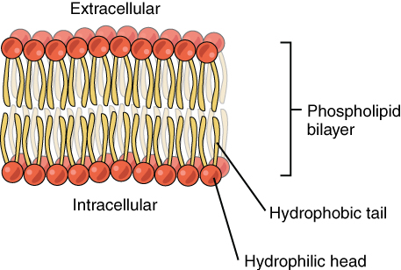
https://figures.boundless.com/19976/large/0302-phospholipid-bilayer.jpg
http://what-when-how.com/wp-content/uploads/2011/09/tmp1732_thumb2_thumb_thumb.jpg
GROUP ACTIVITY
Work with others to build a cell membrane with the phospholipids you built.
Where are the “heads” & “tails” located?
WHY?

Slide 32
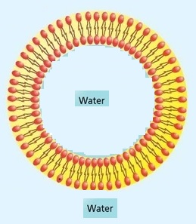
http://what-when-how.com/wp-content/uploads/2011/09/tmp1732_thumb2_thumb_thumb.jpg
STRUCTURE/FUNCTION RELATIONSHIP !
WHY is it important for cells that phospholipids behave as they do?

Slide 33
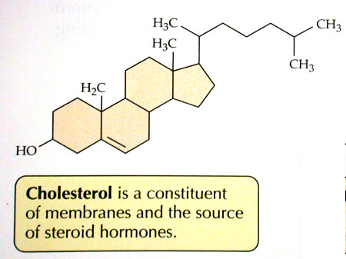
http://academic.brooklyn.cuny.edu/biology/bio4fv/page/cholesterol.JPG
Found in ANIMALS
- NOT PLANTS
three hexagons and a doghouse.

Slide 34
http://fog.ccsf.cc.ca.us/~mmalacho/physio/oll/Lesson2/images/10EndoSlide15.GIF
What makes them different?
ANOTHER
STRUCTURE/FUNCTION RELATIONSHP !!!!!
FUNCTIONAL GROUPS!

Slide 35
PROTEINS
http://barleyworld.org/book/export/html/20

Slide 36
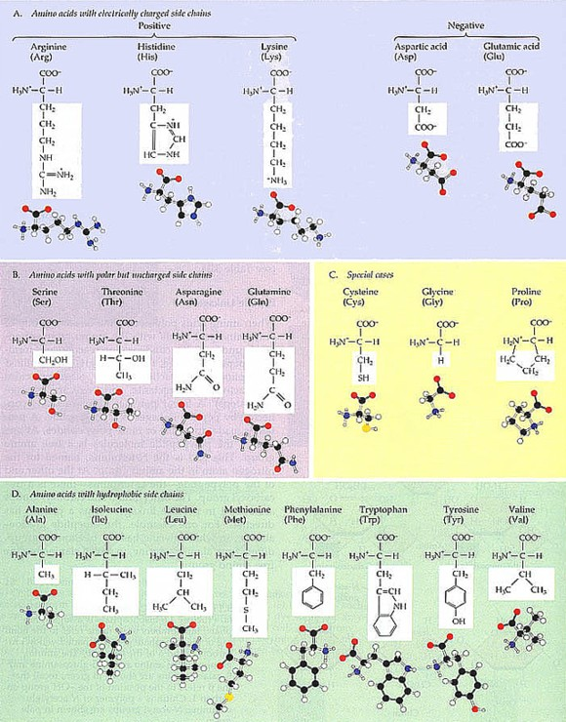
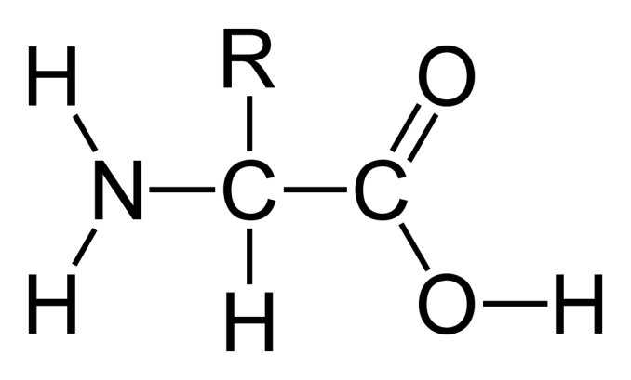
PROTEINS
What SUBUNIT is used to make PROTEINS?
What TWO functional groups do all amino acids share?
http://www.detectingdesign.com/images/Abiogenesis/Amino%20Acid%20Chart.jpg

Slide 37
MODELING
LABEL: αlpha carbon
Circle the carboxyl group
Draw a triangle around the amino group
http://www.detectingdesign.com/images/Abiogenesis/Amino%20Acid%20Chart.jpg

Slide 38
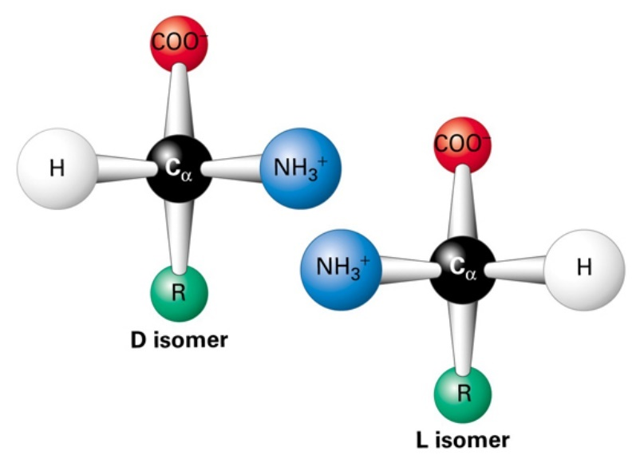
All amino acids can form mirror image (enantiomer) isomers except ?
MAKE A CONNECTION: Evidence of shared evolutionary history
Same 20 amino acids used to make proteins in all living things
Most aa’s = L-form stereoisomer

Slide 39
AMPHIPATHIC Molecules that have both hydrophilic and hydrophobic groups
AMPHOTERIC
Having the characteristics of both an acid and a base, and capable of reacting as either
ZWITTER ION molecule that has BOTH a positive and a negative charge

Slide 40
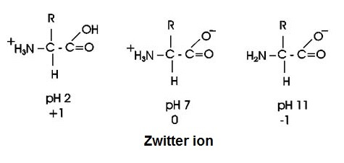
AMINO ACIDS CHANGE DEPENDING ON pH
Molecules that can act as acids (H+ donors) OR bases (H+ receivers) = AMPHOTERIC
Molecules that have separate positive (+) and negative (-) parts = ZWITTER IONS
http://www2.chemistry.msu.edu/faculty/reusch/VirtTxtJml/Images3/alatitr.gif

Slide 41
PROTEINS
MAKE A POLYPEPTIDE CHAIN
WHAT CHEMICAL REACTION CAN WE USE TO JOIN SUBUNITS?
Join your amino acid cutouts

Slide 42
ADD LABELS to your MODEL
DEHYDRATION SYNTHESIS Bond that joins subunits called a PEPTIDE bond (COVALENT bond)
Which groups are involved in this bond?
Draw arrows to identify the peptide bonds in your model

Slide 43
ADD LABELS to your MODEL
POLYPEPTIDE has direction
N-terminus (amino end)
C-terminus (carboxyl end)

Slide 44
LABEL THE FOLLOWING ON YOUR CUTOUT POLYPEPTIDE CHAIN
Label N-terminus and C-terminus
Draw arrows to show locations of all PEPTIDE BONDS
Identify what type of chemical bond this is
Put SQUARES around the R groups and use your amino acid chart to identify & label the type of R group (non-polar, polar, charge basic, charged acidic, etc)
Label each amino acid as hydrophobic or hydrophilic
Label what level of protein structure your model represents
( 1° 2° . 3° , or 4° ?)

Slide 45
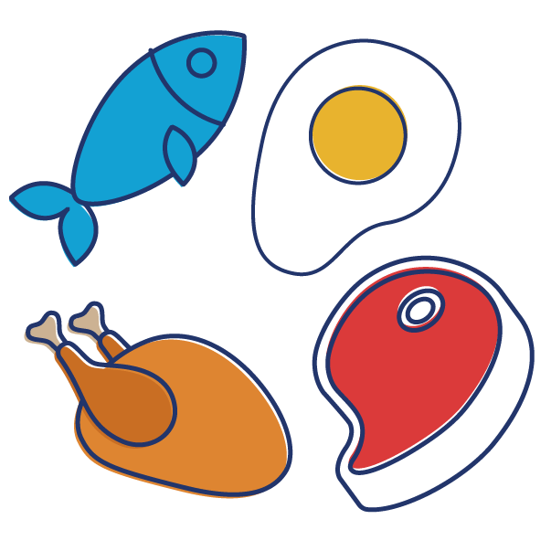
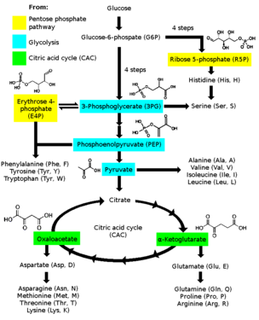
Where do amino acids come from?
“VEGGIE” ALERT ! 9 “essential” amino acids can’t be synthesized by humans; must come from diet especially Lysine and tryptophan (in low amounts in most plant proteins) Strict vegetarians need to make sure that their diet contains sufficient amounts of these
Many amino acids can be made from intermediates from glycolysis and Krebs cycle pathways
https://www.medicinehow.com/wp-content/uploads/2016/12/Protain-after-Workout-02.png

Slide 46
BIOMOLECULE MODELING
Toobers Activity from 3D Molecular Designs AASK Kit
ACTIVITY 2

Slide 47
http://www.3dmoleculardesigns.com/AASK/AASK%20Teacher%20Notes.pdf
http://www.3dmoleculardesigns.com/bglobin/Blue%20Segement%20-%20Intro%20and%20Directions%20Teacher%20Key.pdf

Slide 48
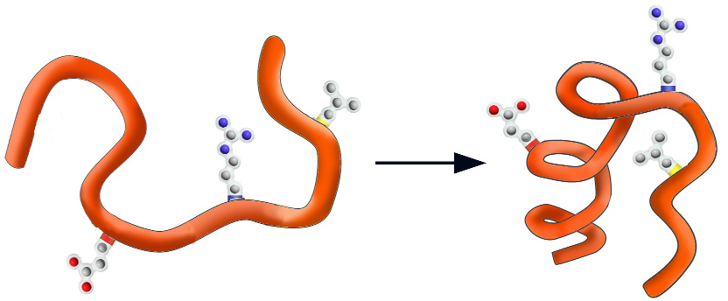
WHY FOLD?
Physics suggests the final shape should represent a low energy state for all of the atoms in the structure.
EX: water runs downhill to reach a lower energy state.
http://www.3dmoleculardesigns.com/AASK/AASK%20Teacher%20Notes.pdf
HIGH ENERGY
LOW ENERGY

Slide 49
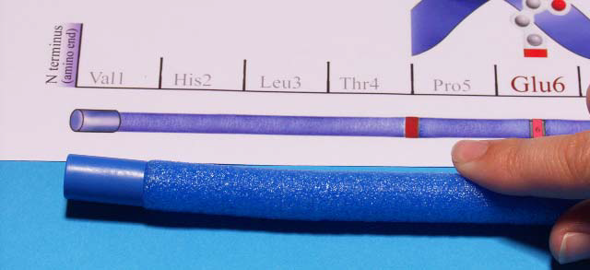
Blue cap represents the N-terminus on the polypeptide chain
Red cap represents the C-terminus on the polypeptide chain
http://www.3dmoleculardesigns.com/AASK/AASK%20Teacher%20Notes.pdf

Slide 50
POLYPEPTIDE SEQUENCE
WHAT DETERMINES THE PRIMARY STRUCTURE
OF A POLYPEPTIDE CHAIN? How is a POLYPEPTIDE different from a PROTEIN?
DNA sequence codes for AMINO ACID sequence
PROTEIN = POLYPEPTIDE FOLDED INTO 3D SHAPE
http://www.3dmoleculardesigns.com/AASK/AASK%20Teacher%20Notes.pdf

Slide 51
AMINO ACID –R groups

Slide 52
AMINO ACID COLOR CODE
HYDROPHILIC POLAR HISTIDINE (His) = WHITE
CYSTEINE (Cys) = GREEN
HYDROPHILIC POLAR CHARGED BASIC ARGININE(Arg) = BLUE
HYDROPHOBIC NON-POLAR = YELLOW Phe + Leu

Slide 53
Secondary structure (2°)
http://www.3dmoleculardesigns.com/AASK/AASK%20Teacher%20Notes.pdf
α-HELIX β-PLEATED SHEET

Slide 54
FOLD FIRST 13 AMINO ACIDS (22 “ from N-terminus)
INTO A 2-STRANDED β-PLEATED SHEET
http://www.3dmoleculardesigns.com/AASK/AASK%20Teacher%20Notes.pdf

Slide 55
FOLD LAST 14 AMINO ACIDS (C-terminus end) INTO AN α-HELIX
http://www.3dmoleculardesigns.com/AASK/AASK%20Teacher%20Notes.pdf

Slide 56
http://www.3dmoleculardesigns.com/AASK/AASK%20Teacher%20Notes.pdf

Slide 57
Secondary structure (2°)
Image from POGIL
WHAT TYPE OF BONDS HOLD 2° STRUCTURE TOGETHER?
WHICH PARTS OF THE
POLYPEPTIDE CHAIN
ARE INVOLVED?
Side chain R groups NOT involved
Held together by HYDROGEN BONDS between the C=O of one amino acid and the N-H of another in the BACKBONE OF THE CHAIN

Slide 58
http://www.3dmoleculardesigns.com/AASK/AASK%20Teacher%20Notes.pdf
This is SECONDARY STRUCTURE (2° )
NEXT the α-helices and β-pleated sheets start to fold up due to interactions between R GROUPS = TERTIARY (3°)STRUCTURE
http://barleyworld.org/book/export/html/20

Slide 59
TERTIARY STRUCTURE (3°)
http://www.3dmoleculardesigns.com/AASK/AASK%20Teacher%20Notes.pdf

Slide 60
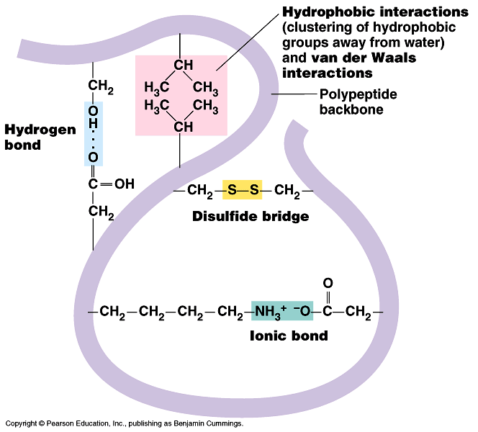
What holds the
TERTIARY
structure
together?
Stabilized by a combination of many NON-COVALENT interactions BETWEEN R GROUPS:
Hydrophobic/hydrophilic forces
hydrogen bonds between polar atoms
ionic interactions between charged side chains
Van der Waals forces
Disulfide bridges

Slide 61
QUATERNARY STRUCTURE (4°) (NOT ALL PROTEINS HAVE THIS)
http://www.sciencecases.org/tazswana/tazswana4.asp

Slide 62
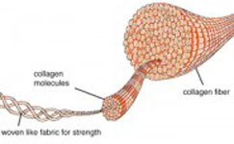
QUATERNARY STRUCTURE (4°) (NOT ALL PROTEINS HAVE THIS)
Held together by interactions between R groups in different polypeptide chains
Image from POGIL
http://cdn2.bigcommerce.com/server1100/b20f3/product_images/uploaded_images/collagen-fibers-tn.jpg

Slide 63
WHAT DO WE CALL IT WHEN A PROTEIN “UNWINDS” and LOSES ITS 3D SHAPE? WHICH BONDS ARE DISRUPTED? WHICH BONDS REMAIN INTACT? WHAT ENVIRONMENTAL FACTORS CAN DISRUPT 3D SHAPES?
REMEMBER: STRUCTURE ~ FUNCTION
See a movie
Image from POGIL
http://cdn2.bigcommerce.com/server1100/b20f3/product_images/uploaded_images/collagen-fibers-tn.jpg

Slide 64
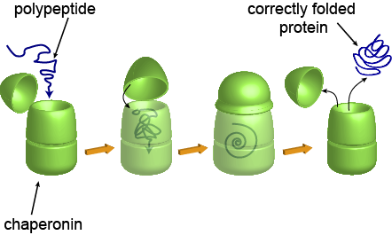
Proteins that help other proteins fold into their correct 3-D shape
CHAPARONINS
Image from POGIL
http://cdn2.bigcommerce.com/server1100/b20f3/product_images/uploaded_images/collagen-fibers-tn.jpg

Slide 65
FROM 2020 AP BIOLOGY CED
SCIENCE PRACTICE 2:Visual Representations
Analyze visual representations of biological concepts and processes.
2.A Describe characteristics of a biological concept, process, or model represented visually.
2.B Explain relationships between different characteristics of biological concepts, processes, or models represented visually a. In theoretical contexts. b. In applied contexts.
2.C Explain how biological concepts or processes represented visually relate to larger biological principles, concepts, processes, or theories.
2.D Represent relationships within biological models, including
b. Diagrams.

Slide 66
UNIT 1: Chemistry of Life
ENDURING UNDERSTANDING ENE-1 The highly complex organization of living systems requires constant input of energy and the exchange of macromolecules.
LEARNING OBJECTIVE ENE-1.A Describe the composition of macromolecules required by living organisms.
ESSENTIAL KNOWLEDGE
ENE-1.A.1 Organisms must exchange matter with the environment to grow, reproduce, and maintain organization.
ENE-1.A.2 Atoms and molecules from the environment are necessary to build new molecules—
a. Carbon is used to build biological molecules such as carbohydrates, proteins, lipids, and nucleic acids. Carbon is used in storage compounds and cell formation in all organisms.
b. Nitrogen is used to build proteins and nucleic acids. Phosphorus is used to build nucleic acids and certain lipids.

Slide 67
ENDURING UNDERSTANDING
SYI-1 Living systems are organized in a hierarchy of structural levels that interact
LEARNING OBJECTIVE SYI-1.B Describe the properties of the monomers and the type of bonds that connect the monomers in biological macromolecules.
ESSENTIAL KNOWLEDGE SYI-1.B.1 Hydrolysis and dehydration synthesis are used to cleave and form covalent bonds between monomers.
X EXCLUSION STATEMENT—The molecular structure of specific nucleotides and amino acids is beyond the scope of the AP Exam.

Slide 68
ENDURING UNDERSTANDING
SYI-1 Living systems are organized in a hierarchy of structural levels that interact.
LEARNING OBJECTIVE
SYI-1.B Describe the properties of the monomers and the type of bonds that connect the monomers in biological macromolecules.
ESSENTIAL KNOWLEDGE
SYI-1.B.2 Structure and function of polymers are derived from the way their monomers are assembled—
a. In nucleic acids, biological information is encoded in sequences of nucleotide monomers. Each nucleotide has structural components: a five-carbon sugar (deoxyribose or ribose), a phosphate, and a nitrogen base (adenine, thymine, guanine, cytosine, or uracil). DNA and RNA differ in structure and function.
b. In proteins, the specific order of amino acids in a polypeptide (primary structure) determines the overall shape of the protein. Amino acids have directionality, with an amino (NH2) terminus and a carboxyl (COOH) terminus. The R group of an amino acid can be categorized by chemical properties (hydrophobic, hydrophilic, or ionic), and the interactions of these R groups determine structure and function of that region of the protein.

Slide 69
ENDURING UNDERSTANDING
SYI-1 Living systems are organized in a hierarchy of structural levels that interact.
LEARNING OBJECTIVE
SYI-1.B Describe the properties of the monomers and the type of bonds that connect the monomers in biological macromolecules.
ESSENTIAL KNOWLEDGE
SYI-1.B.2 Structure and function of polymers are derived from the way their monomers are assembled—
c. Complex carbohydrates comprise sugar monomers whose structures determine the properties and functions of the molecules.
d. Lipids are nonpolar macromolecules—
i. Differences in saturation determine the structure and function of lipids.
ii. Phospholipids contain polar regions that interact with other polar molecules, such as water, and with nonpolar regions that are often hydrophobic.

Slide 70
ENDURING UNDERSTANDING
SYI-1 Living systems are organized in a hierarchy of structural levels that interact.
LEARNING OBJECTIVE
SYI-1.C Explain how a change in the subunits of a polymer may lead to changes in structure or function of the macromolecule.
ESSENTIAL KNOWLEDGE
SYI-1.C.1 Directionality of the subcomponents influences structure and function of the polymer—
a. Nucleic acids have a linear sequence of nucleotides that have ends, defined by the 3’ hydroxyl and 5’ phosphates of the sugar in the nucleotide. During DNA and RNA synthesis, nucleotides are added to the 3’ end of the growing strand, resulting in the formation of a covalent bond between nucleotides.
b. DNA is structured as an antiparallel double helix, with each strand running in opposite 5’ to 3’ orientation. Adenine nucleotides pair with thymine nucleotides via two hydrogen bonds. Cytosine nucleotides pair with guanine nucleotides by three hydrogen bonds.
c. Proteins comprise linear chains of amino acids, connected by the formation of covalent bonds at the carboxyl terminus of the growing peptide chain
d. Proteins have primary structure determined by the sequence order of their constituent amino acids, secondary structure that arises through local folding of the amino acid chain into elements such as alpha-helices and beta-sheets, tertiary structure that is the overall three-dimensional shape of the protein and often minimizes free energy, and quaternary structure that arises from interactions between multiple polypeptide units. The four elements of protein structure determine the function of a protein.
e. Carbohydrates comprise linear chains of sugar monomers connected by covalent bonds. Carbohydrate polymers may be linear or branched.

Slide 71
ENDURING UNDERSTANDING
IST-1 Heritable information provides for continuity of life
LEARNING OBJECTIVE IST-1.A Describe the structural similarities and differences between DNA and RNA.
ESSENTIAL KNOWLEDGE
IST-1.A.1 DNA and RNA molecules have structural similarities and differences related to their function—
a. Both DNA and RNA have three components—sugar, a phosphate group, and a nitrogenous base—that form nucleotide units that are connected by covalent bonds to form a linear molecule with 5’ and 3’ ends, with the nitrogenous bases perpendicular to the sugar-phosphate backbone.
b. The basic structural differences between DNA and RNA include the following:
i. DNA contains deoxyribose and RNA contains ribose.
ii. RNA contains uracil and DNA contains thymine.
iii. DNA is usually double stranded; RNA is usually single stranded.
iv. The two DNA strands in double-stranded DNA are antiparallel in directionality.

Slide 72
UNIT 6: Gene Expression and Regulation
ENDURING UNDERSTANDING
IST-1 Heritable information provides for continuity of life.
LEARNING OBJECTIVES
IST-1.L Describe the characteristics of DNA that allow it to be used as the hereditary material.
IST-1.L.1 DNA, and sometimes RNA, exhibits specific nucleotide base pairing that is conserved through evolution: adenine pairs with thymine or uracil (A-T or A-U) and cytosine pairs with guanine (C-G)—
Purines (G and A) have a double ring structure.
Pyrimidines (C, T, and U) have a single ring structure.

