Slide 1
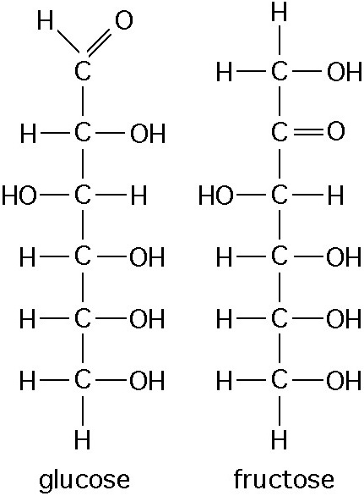
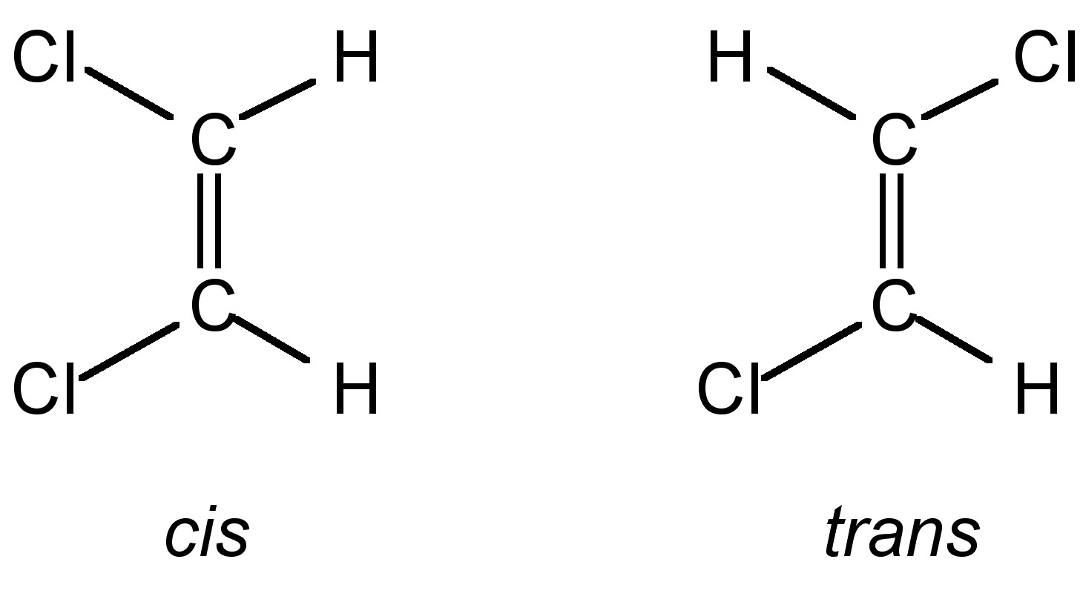
Modeling ISOMERS
Kelly Riedell Brookings Biology
EK 4.A.1 The subcomponents of biological molecules and their sequence determine the properties of that molecule. SP 1. The student can use representations and models to communicate scientific phenomena and solve scientific problems.

Slide 2
Make a molecule with 3 carbon atoms 7 hydrogen atoms 1 chlorine atom
Compare your model with someone else. Are these the same or different substances?

Slide 3
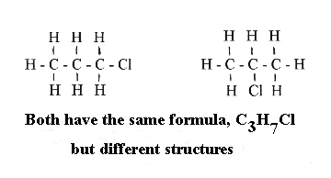
STRUCTURAL ISOMERS
http://homepages.ius.edu/DSPURLOC/C122/images/structure.gif

Slide 4
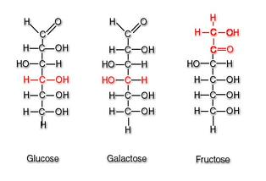
STRUCTURAL ISOMERS
http://kel-tay-lii.wikispaces.com/file/view/liner_glucose_galactose_and_fructose.jpg/296693972/314x214/liner_glucose_galactose_and_fructose.jpg

Slide 5
How are isomers different from isotopes?

Slide 6
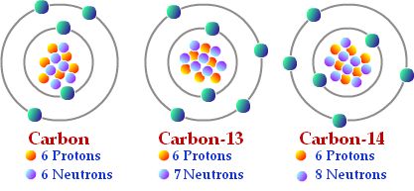
http://images.tutorcircle.com/cms/images/44/isotopes-of-carbon.png
How are ISOMERs different from ISOTOPES?
ISOMER
ISOTOPE
Atoms with same number of protons and electrons but different numbers of neutrons Same atomic number; different atomic mass
Molecules with same number and kinds of atoms but arranged in different ways Same chemical formula
Can show different properties
Some can be radioactive

Slide 7
GEOMETRIC ISOMERS
Structural isomers: differ from each other in the arrangement of groups with respect to a double bond, ring, or other rigid structure.
http://cnx.org/resources/f3e046c6759f35392adfb71267acaa03/Fig2.jpg

Slide 8
GEOMETRIC ISOMERS
Make a model of a MOLECULE WITH 1 double bond between 2 CARBONS
Make a model of a GEOMETRIC isomer for this molecule.
Show your neighbor. Are these geometric isomers?
DRAW a picture of your isomers in your BILL.
LABEL cis and trans forms How are cis and trans isomers different?

Slide 9
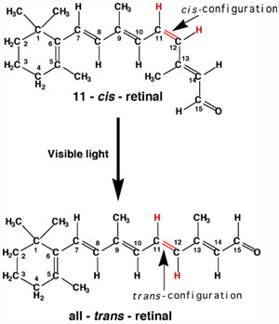
RHODOPSIN in rod cells contains RETINAL molecules
INACTIVE form
RETINAL changes from cis to trans forms when struck by light
Activated form sends electrical impulses to brain that are interpreted as light
VIDEO
How does the presence of a cis-double bond affect the SHAPE of the retinal molecule AND its FUNCTION?
ACTIVATED FORM
RETINAL = derived from vitamin A (why a lack of vitamin A causes vision problems).
http://www.chemistry.wustl.edu/~edudev/LabTutorials/Vision/images/Isomerization.jpg

Slide 10
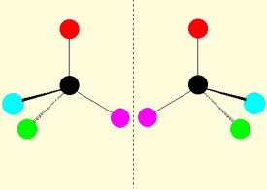
ENANTIOMERS
Molecules with an ASYMMETRIC CARBON can make mirror-image enantiomers
= CARBON attached to 4 DIFFERENT atoms/groups
http://www2.lbl.gov/Science-Articles/Archive/assets/images/2002/Apr-22-2002/Enantiomers.jpg

Slide 11
ENANTIOMERS
http://www.avogadro.co.uk/organic/enantio.gif

Slide 12
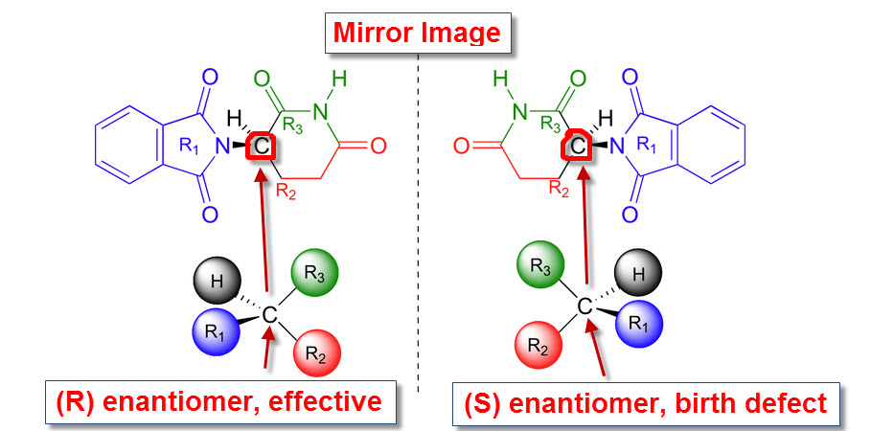
Thalidomide
http://2.bp.blogspot.com/-5hOytpGZBzg/Tfi6vUcyxgI/AAAAAAAAJnM/Lu0YT3yC8dA/s1600/optical+isomers+2.jpg

Slide 13
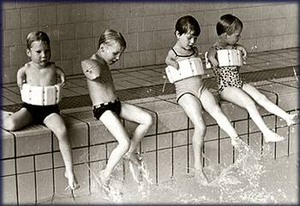
Thalidomide
http://www.chm.bris.ac.uk/motm/thalidomide/first_pic.jpg

Slide 14
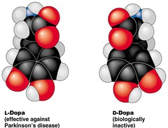
L-Dopa vs D-Dopa
http://o.quizlet.com/olaHF4dORR8vnqzIABRD1Q_m.jpg
http://cp91279.biography.com/1120330742/1120330742_1713651343_bio-michaeljfox-parkinsons-97481438001.jpg?pubId=1120330742

Slide 15
Make a model of a 1 carbon molecule that has an ASYMMETRIC CARBON.
Make a model of a ENANTIOMER isomer for this molecule.
Show your neighbor. Are these enantiomers?
DRAW a picture of your isomers in your BILL.
Give an example of enantiomer isomers with different biological properties

Slide 16
Does this molecule have an asymmetric carbon? If so, which one is asymmetric?
Would you expect this molecule to exist as enantiomer isomers?

