Slide 1
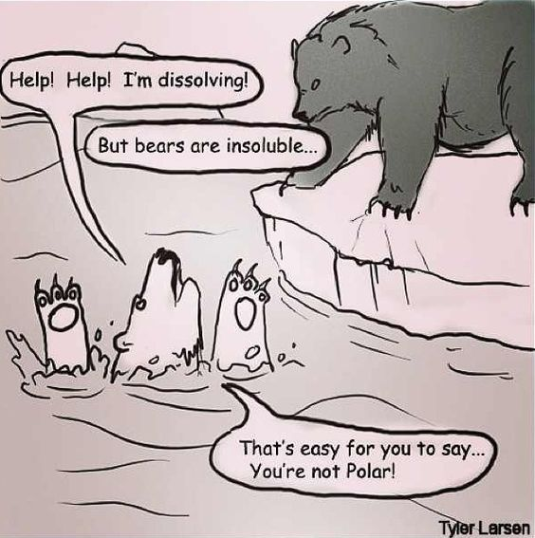
http://cdn.iwastesomuchtime.com/782012034822iwsmt.jpeg

Slide 2
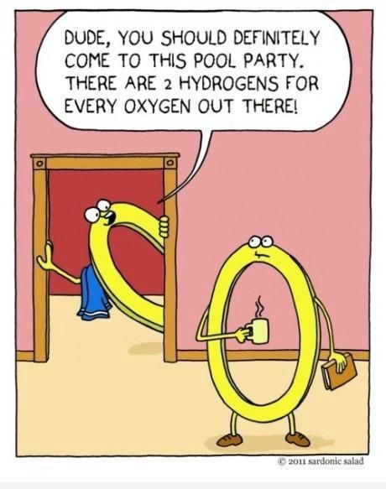
https://www.pinterest.com/pin/50313720816586136/

Slide 3
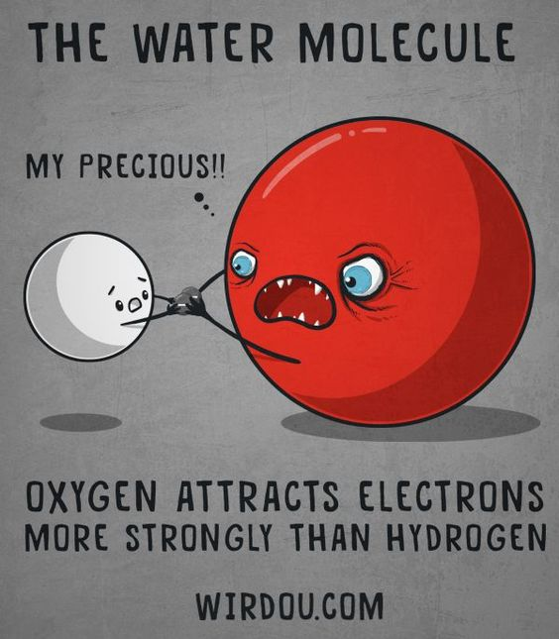
https://wirdou.com/page/4/

Slide 4
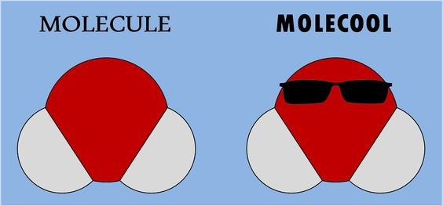
http://img1.rnkr-static.com/list_img_v2/7630/2427630/full/funny-science-puns.jpg

Slide 5
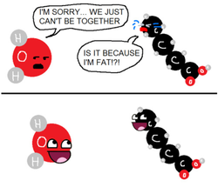
http://msfrancoisap.weebly.com/bio-jokes.html

Slide 6
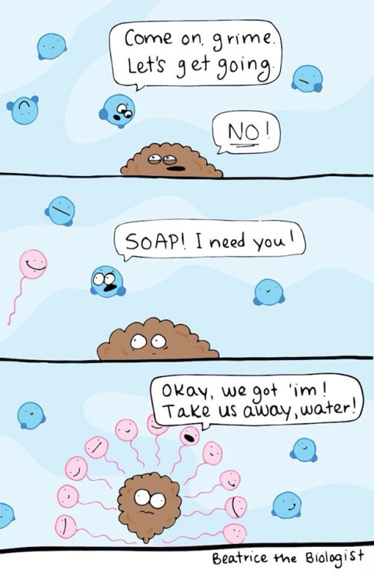
http://41.media.tumblr.com/7cb722d72f5bf68c3180b12c76b3c453/tumblr_mzt7bjWXcL1stoxi4o2_r2_500.jpg

Slide 7
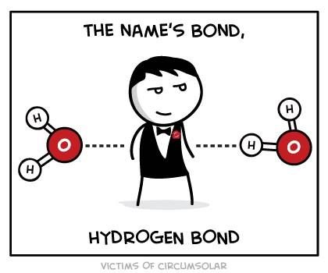
https://www.pinterest.com/pin/AY1yBSYigT3IoWFxRZCam3jqmB30fIz-OBOhiRM0PoZykOUd8OpEdhY/

Slide 8
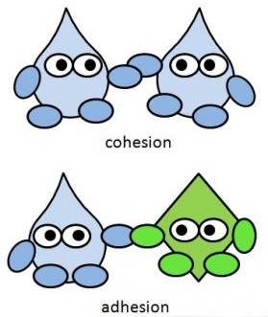
https://www.fastbleep.com/biology-notes/40/1166

Slide 9
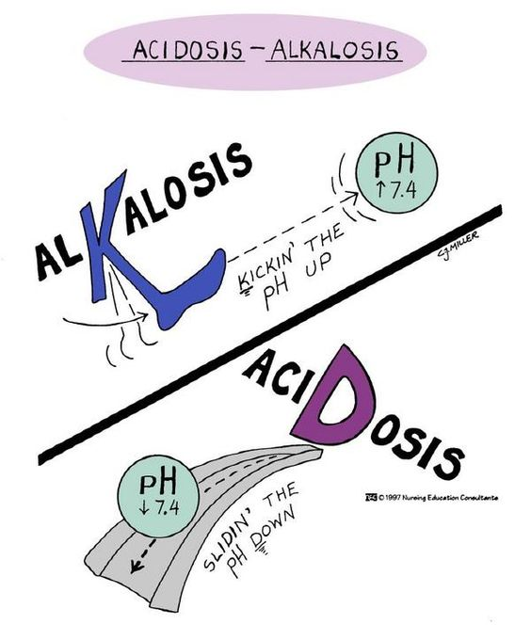
http://misslittlenurse.blogspot.com/2010/04/abg-analysis.html

Slide 10
http://amoebasisters.tumblr.com/image/152825632443

Slide 11
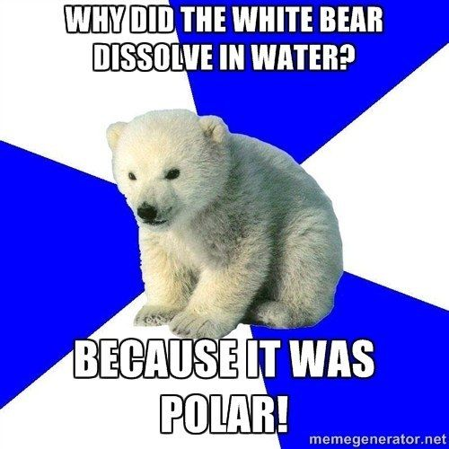
https://www.pinterest.com/pin/50313720817130126/

Slide 12
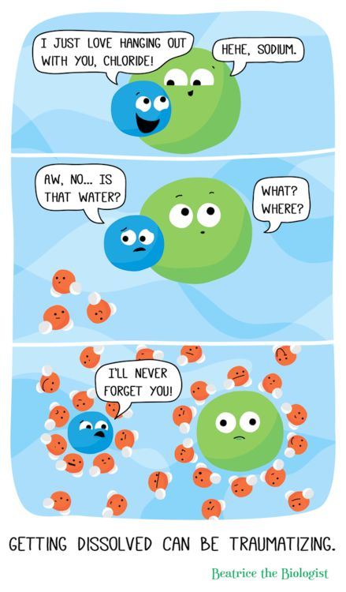
http://www.beatricebiologist.com/2014/07/getting-dissolved-can-be-traumatizing/

Slide 13
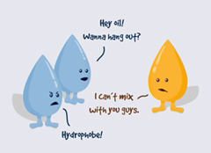
https://www.facebook.com/Carolina.Biological/photos/a.467232003653.259865.173476278653/10152807408233654/?type=1&theater

Slide 14
http://www.picofunny.com/?d=http%3A%2F%2F2.bp.blogspot.com%2F_ACaDF0kiT5I%2FTQfvi98HYuI%2FAAAAAAAAA2c%2F9ODaI4Uv2dU%2Fs1600%2Fwaterpolar.png

Slide 15
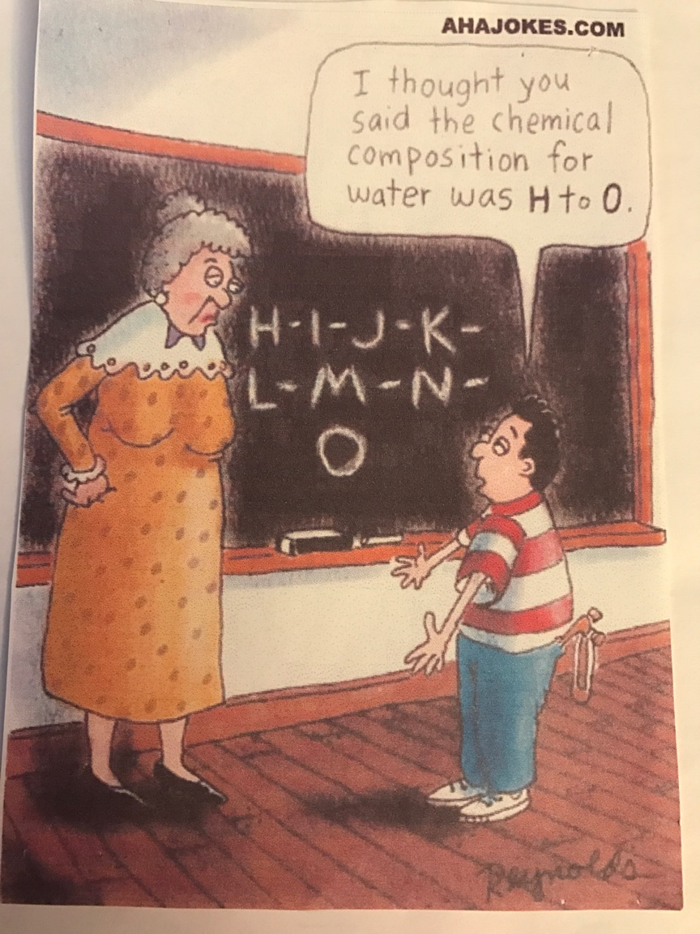

Slide 16
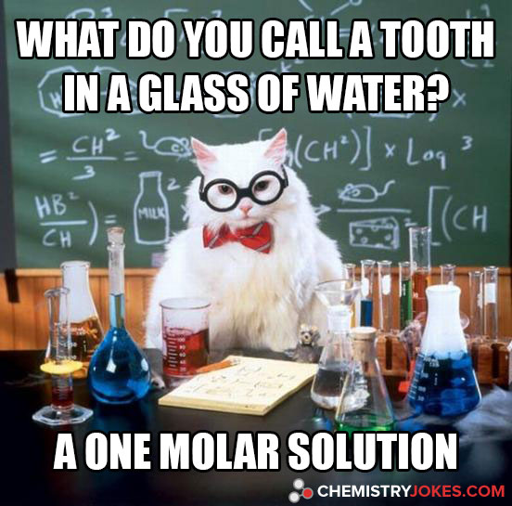
http://www.chemistryjokes.com/images/what-do-you-call-a-tooth-in-a-glass-of-water.jpg

Slide 17
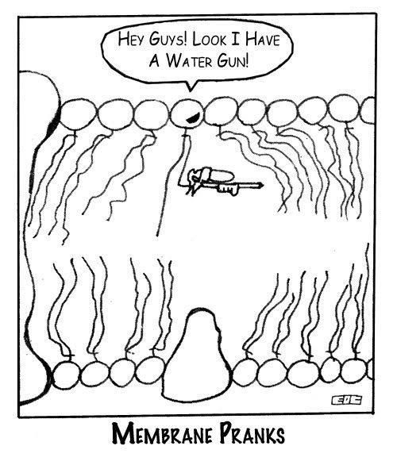
https://www.tumblr.com/tagged/cell-membrane

Slide 18
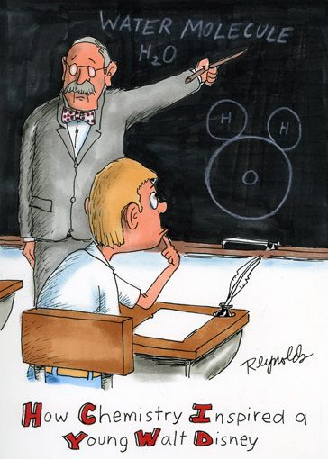
https://www.flickr.com/photos/pastilha/5655440124/in/photostream/

Slide 19
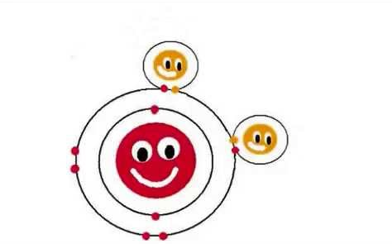
https://i.ytimg.com/vi/U7-MjuWn81U/hqdefault.jpg

Slide 20
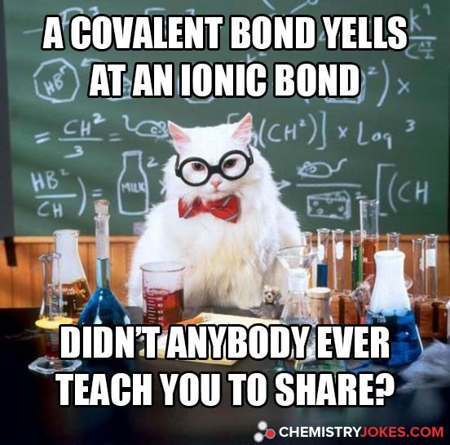
https://www.pinterest.com/pin/AQeO1Ywd_24Thg8mS5qOKOud2t-r9-s2LUKwKTzPkYvT7HBeKRN_aq4/

Slide 21
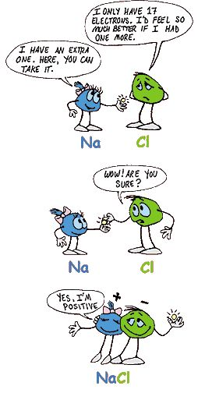
https://www.pinterest.com/pin/50313720817171935/

Slide 22
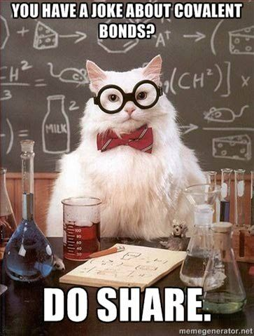
https://www.pinterest.com/pin/50313720817101288/

Slide 23
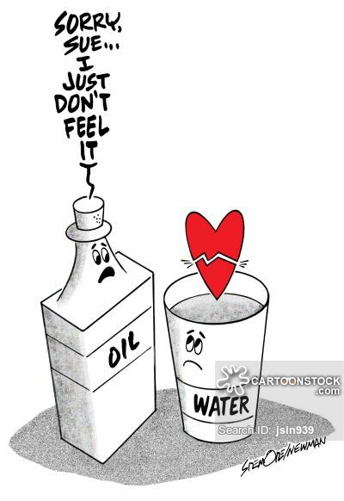
https://s3.amazonaws.com/lowres.cartoonstock.com/dating-chemistry-opposites_attract-love_life-love_life-water-jsin939_low.jpg

Slide 24
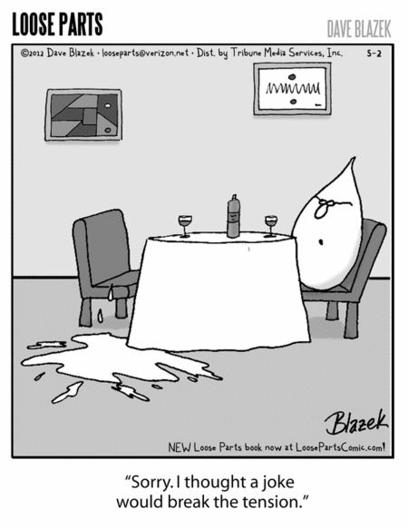
https://i.pinimg.com/736x/1e/ab/81/1eab81be23a61aa3c5cf316ba877ade3--chemistry-humor-science-humour.jpg

Slide 25
https://sciencefun.files.wordpress.com/2007/03/foxtrot-water.jpg

Slide 26
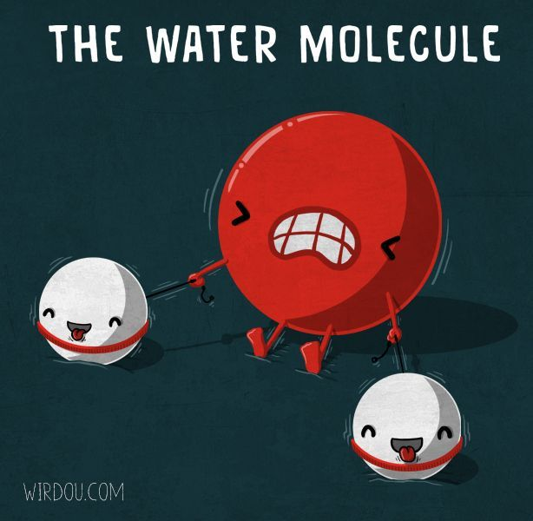
https://i.pinimg.com/736x/15/22/f0/1522f01f4f7f705ab3f61e96b43434ba--chemistry-humor-chemistry-help.jpg

Slide 27
http://www.frankandernest.com/images/archive/103/1030430.gif

Slide 28
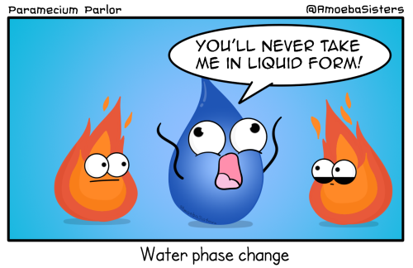
https://68.media.tumblr.com/62ad7cf7376fb840164537fb7ba26aff/tumblr_oavrxw8sTW1sk2szio1_500.png

Slide 29
https://s-media-cache-ak0.pinimg.com/736x/94/b3/24/94b32418d053918550cf1d0b7e6e481a--biology-jokes-chemistry-humor.jpg

Slide 30
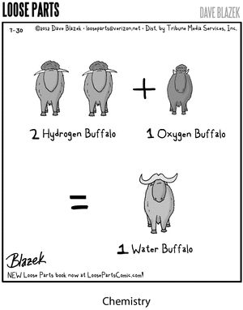
https://s-media-cache-ak0.pinimg.com/736x/96/08/9c/96089c71dae843c6a84ed0faa2157f37--funny-science-jokes-science-puns.jpg

Slide 31
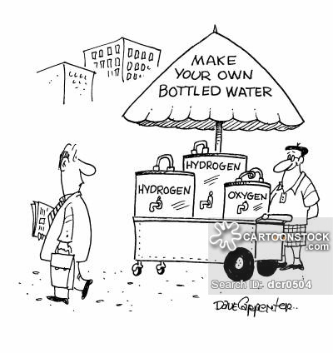
https://s3.amazonaws.com/lowres.cartoonstock.com/food-drink-water-bottled_water-fizzy_water-bottle_of_water-water_bottles-dcr0504_low.jpg

Slide 32
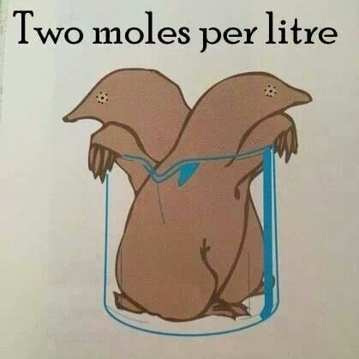
https://www.pinterest.com/pin/50313720819738276/

Slide 33
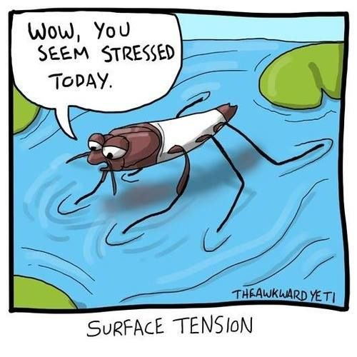
https://www.pinterest.com/pin/50313720819737966/

Slide 34
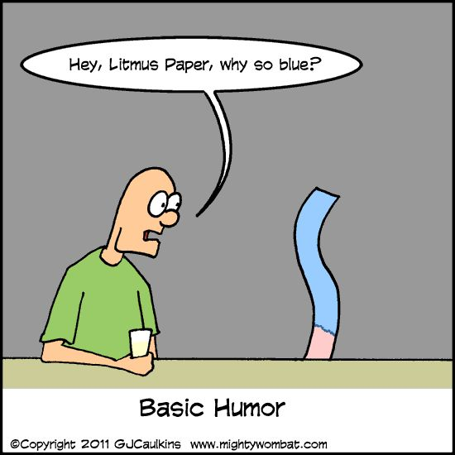
https://www.pinterest.com/pin/50313720820061069/

Slide 35
https://www.pinterest.com/pin/50313720817088863/

