Slide 1
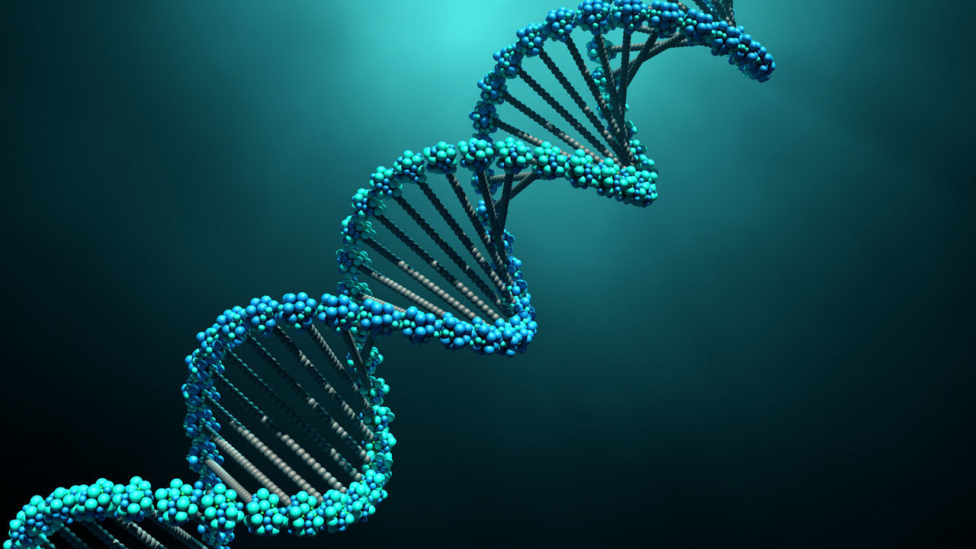
AP Biology Exam Unit 4 Review Byron Strohm

Slide 2
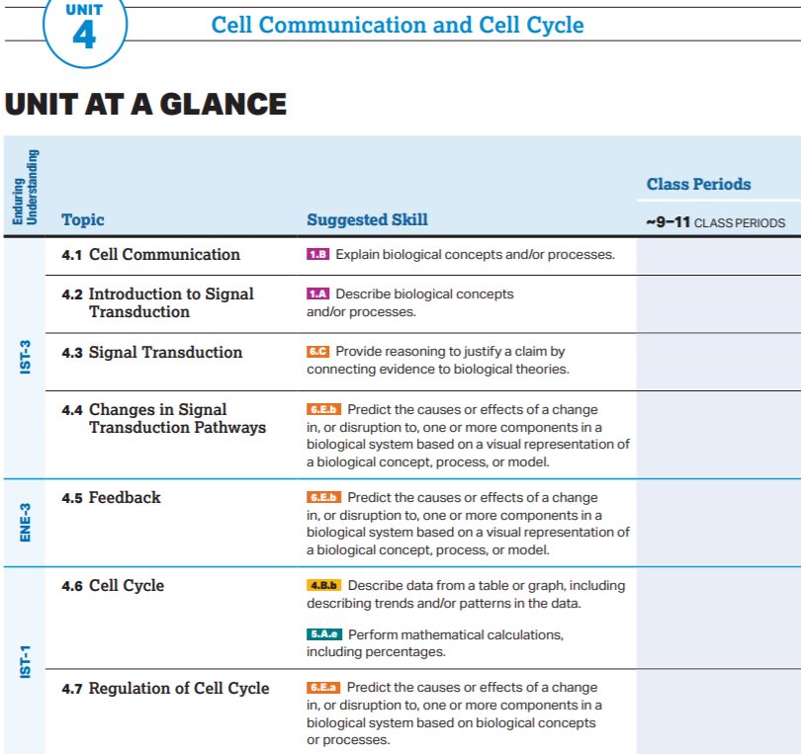

Slide 3
AP Biology Exam Review
4.1

Slide 4
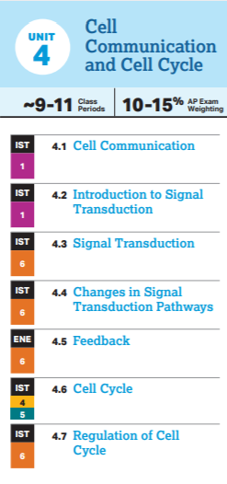
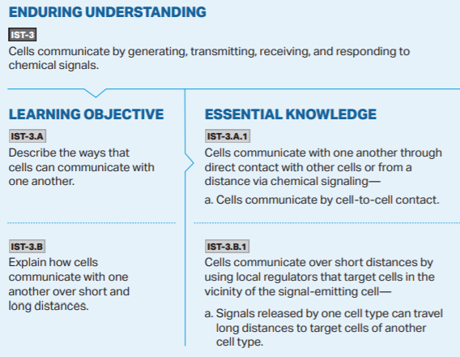

Slide 5
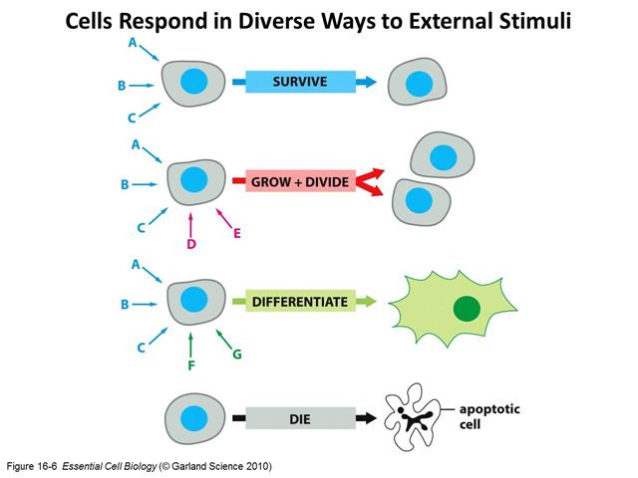

Slide 7
AP Biology Exam Review
4.2-4.3

Slide 8
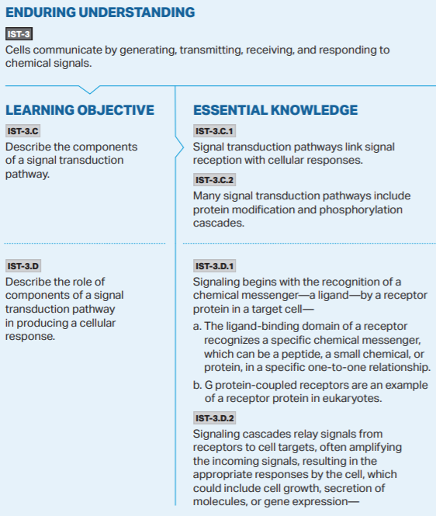
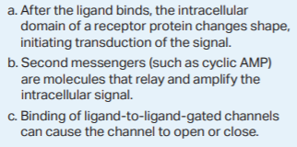

Slide 9
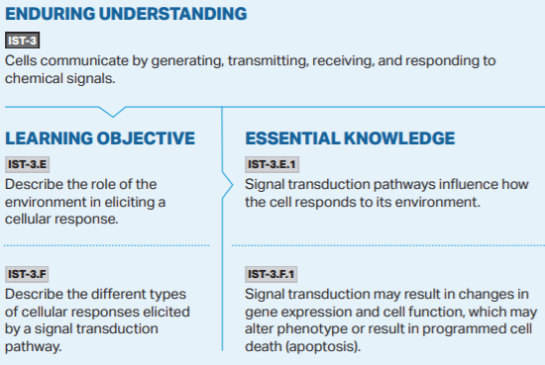

Slide 10
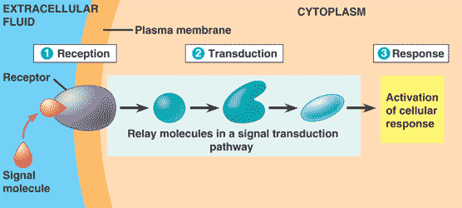

Slide 12
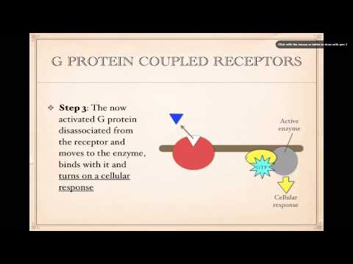

Slide 13
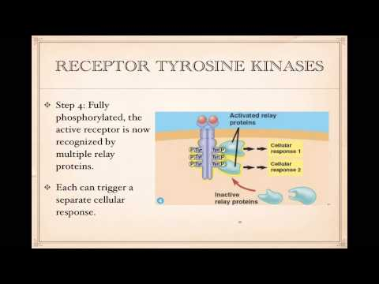

Slide 16
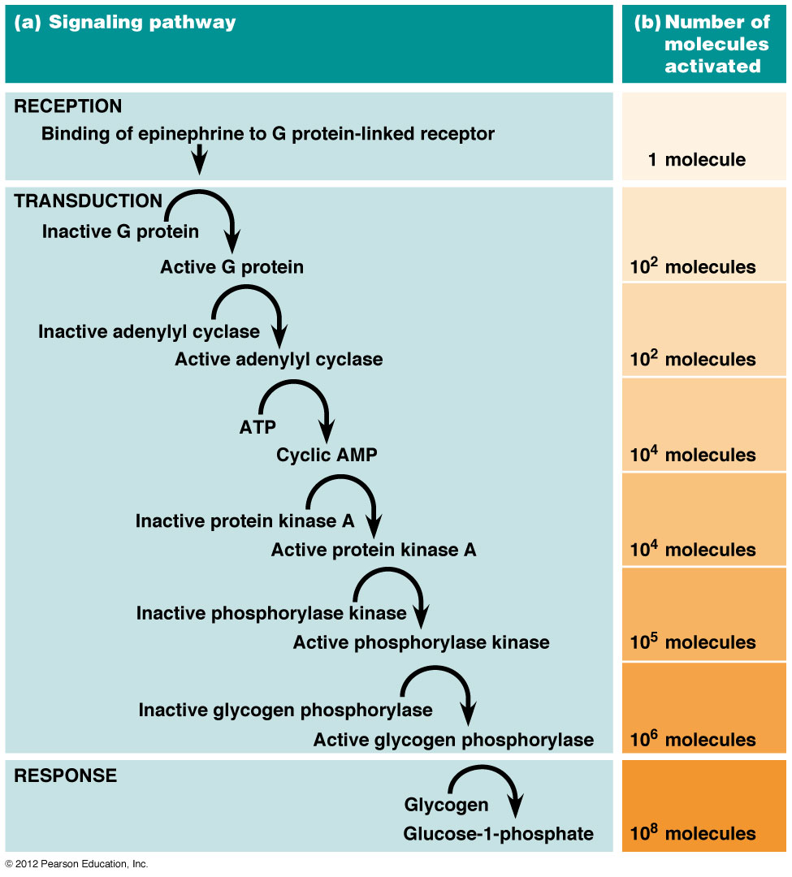
Signal Transduction Pathways obtain their “power” in being able to amplify the binding of a single ligand into a litany of coordinated Cellular Responses.
Amplification

Slide 17
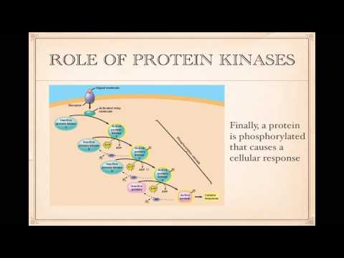

Slide 19
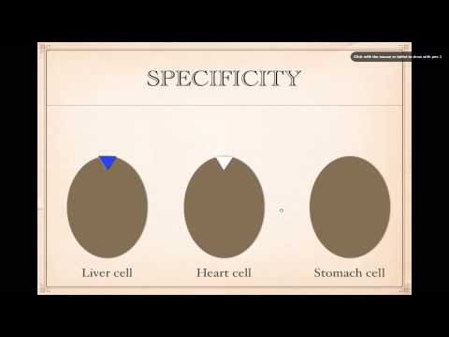

Slide 20
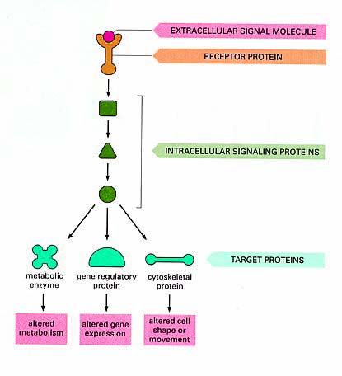
There is a massive range of Cellular Responses which can be induced through a Signal Transduction Pathway.
*Gene Regulation is a primary response in which specific genes will either be turned “on or off” (Expressed or Repressed) due to the upstream signaling of a specific pathway.

Slide 21
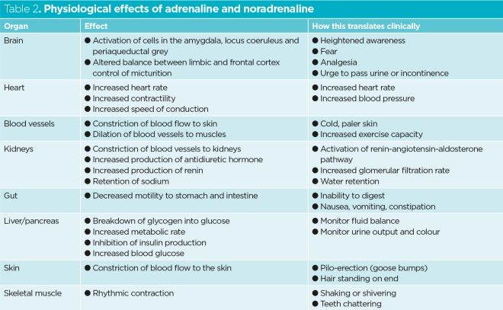
The same ligand can activate different pathways in different cell types due to the different intracellular proteins found within these different cells. This allows for the release of a single ligand type to trigger responses in tissues all over your body at the same time.
In order for this to work, each cell that is capable of responding to the ligand must produce the same receptor protein. The downstream impacts of the binding ligand is what causes the responses to be different within each cell type.
Adrenaline (Epinephrine) is a hormone which acts as a ligand in a large variety of Transduction Pathways. Each responding cell must present a receptor on its surface which is able to bind with the Adrenaline molecule.

Slide 22
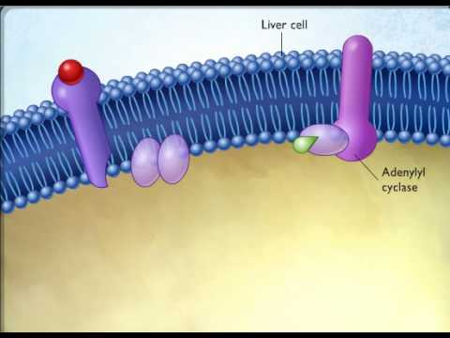
Can you identify the Reception, Transduction, and Response phases of this pathway?

Slide 23
AP Biology Exam Review
4.4

Slide 24
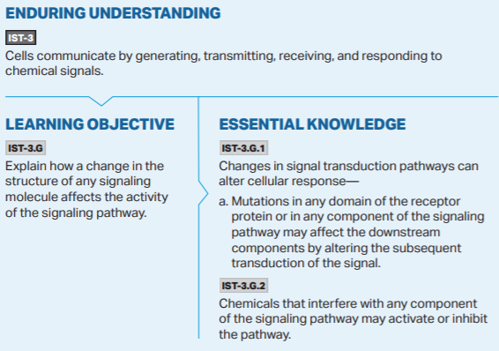

Slide 25
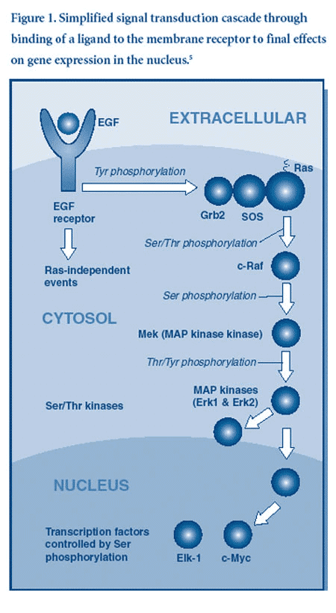
Signal Transduction Pathways can be shut down by disrupting the activity of any of the proteins involved in the transduction pathway upstream from the generated cellular response.
This can occur through a variety of means:
Competitive/Non-competitive inhibition of the proteins involved in the pathway
Mutations in the genes which code for the proteins involved in the pathway
Mutations in the genes which code for the proteins which produce/release the pathway’s ligand
*The bottom line: If you disrupt any part of the signal transduction pathway, you can change or prevent the cellular response from occurring. (This is how most medications work)

Slide 28
AP Biology Exam Review
4.5

Slide 29
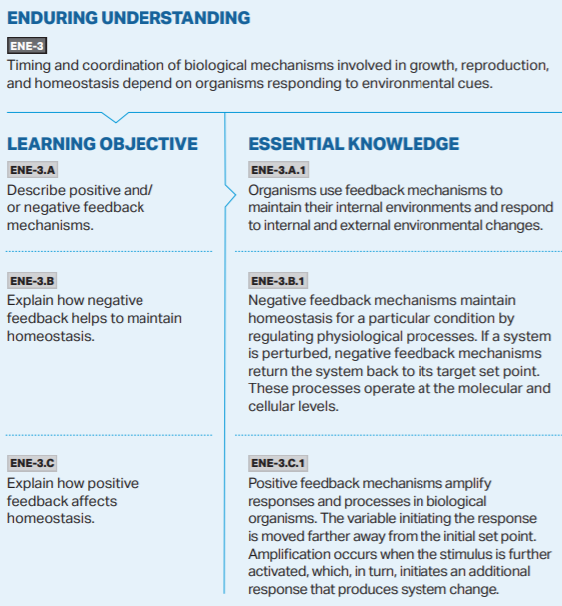

Slide 31
AP Biology Exam Review
4.6

Slide 32
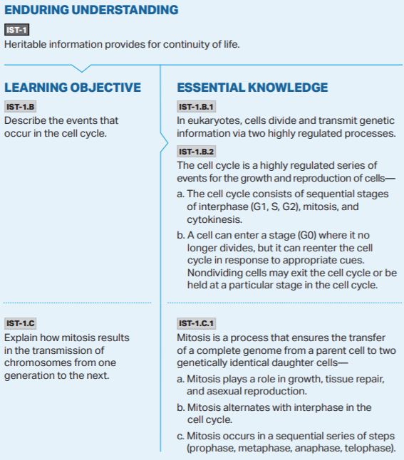

Slide 33
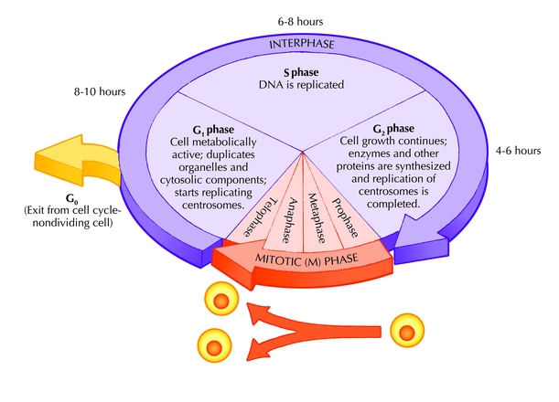
Mutations! Evolution!

Slide 34
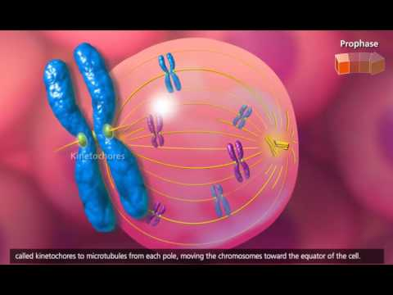

Slide 35
AP Biology Exam Review
4.7

Slide 36
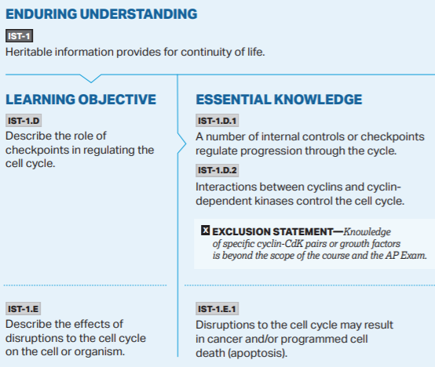

Slide 38
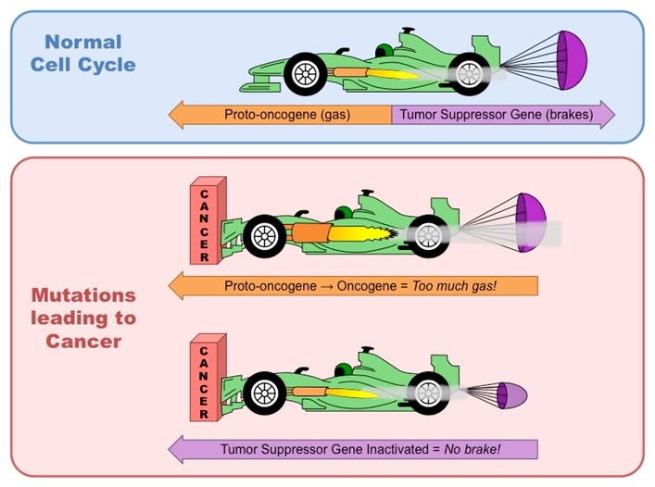
The cell cycle is regulated by two major classes of genes (and in turn by the proteins which they code for):
Tumor Suppressor Genes: Code for proteins which inhibit the cell cycle. When deactivated the cell cycle is able to progress
Proto-oncogenes: Code for proteins which stimulate the cell cycle.
*Mutations in these genes can lead to a cell progressing through the cell cycle in an abnormal and uncontrolled manner. This is what can cause a cell to become cancerous.

Slide 39
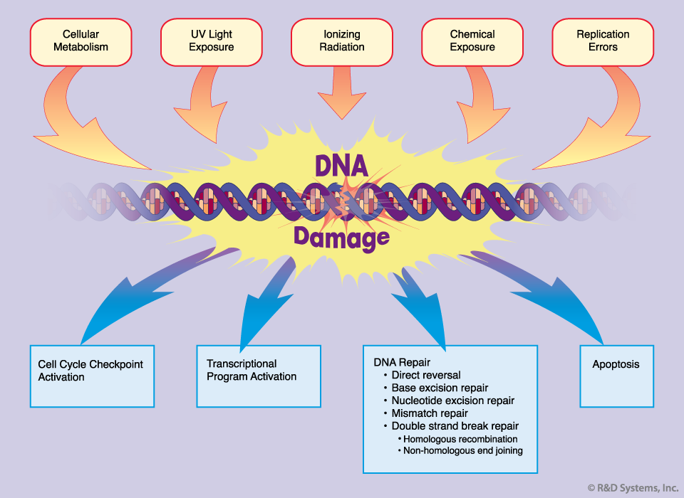
Mutations build up over time leading to age being a primary risk factor in developing cancer.

