Slide 1
Cells, Communication and Molecular Biology Review
1) Sign in
2) Make a Venn Diagram comparing prokaryote, plant and animal cells

Slide 2
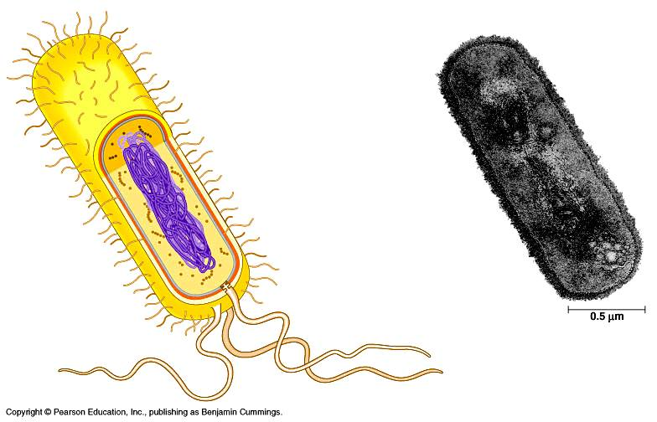
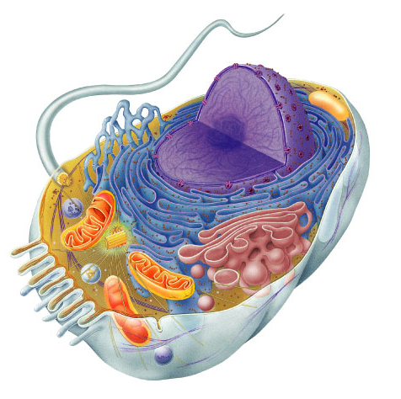
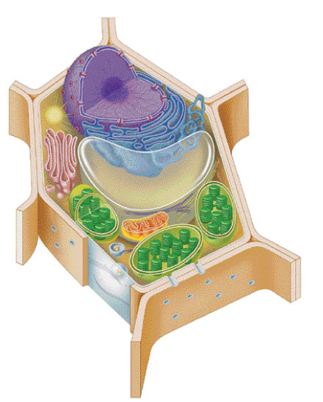
Types of cells
Prokaryote
bacteria cells
- no organelles
- organelles
Eukaryote
animal cells
Eukaryote
plant cells

Slide 3
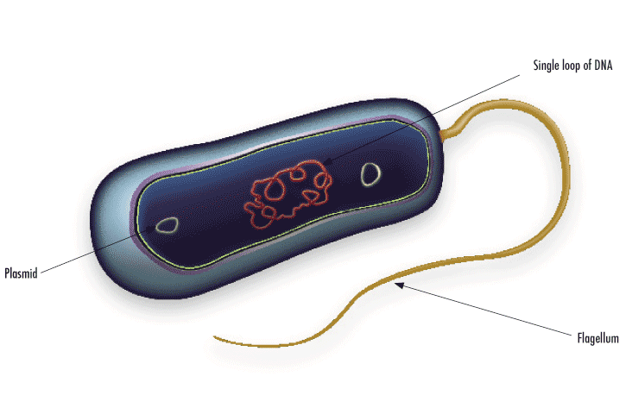
Bacterial Cell=Prokaryote
-have ribosomes, DNA loop + plasmid, cell wall, cell membrane, flagella or cilia

Slide 4
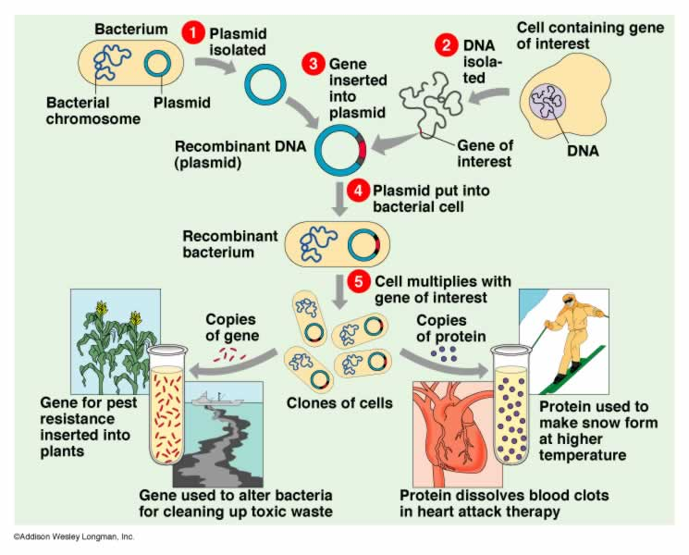
Gene cloning with a plasmid

Slide 5
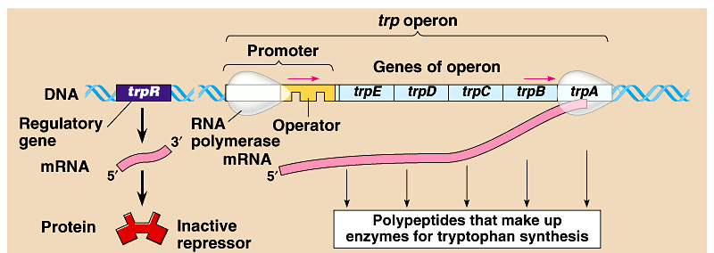
Bacteria group genes together
Operon
  genes grouped together with related functions
    example: all enzymes in a metabolic pathway
  promoter = RNA polymerase binding site
    single promoter controls transcription of all genes in operon
    transcribed as one unit & a single mRNA is made
  operator = DNA binding site of repressor protein

Slide 6
Operon model
When gene is turned ON:
Polymerase binds promoter
Gene is transcribed
RNA
polymerase
gene1
gene2
gene3
gene4
TATA
DNA
mRNA
1
2
3
4
enzyme1
enzyme2
enzyme3
enzyme4
promoter
operator
Slide by Kim Foglia modified

Slide 7
Operon model
GENE is TURNED OFF:
Repressor binds to operator site
Blocks RNA Polymerase
RNA
polymerase
TATA
repressor
gene1
gene2
gene3
gene4
DNA
mRNA
1
2
3
4
enzyme1
enzyme2
enzyme3
enzyme4
promoter
operator
repressor
= repressor protein

Slide 8
REPRESSIBLE OPERONS are ON
Can be turned off
EX: trp operon--makes enzymes used in tryptophan synthesis
INDUCIBLE OPERONS are OFF
Can be turned on
EX: lac operon--makes enzymes used in lactose digestion

Slide 9
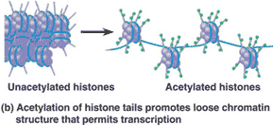
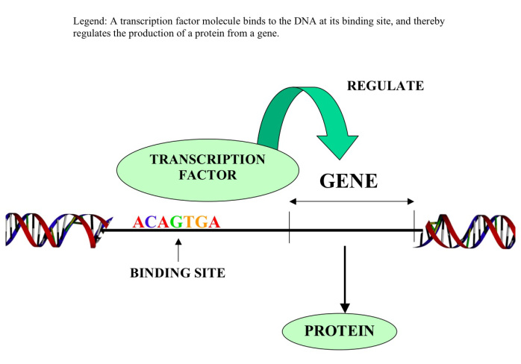
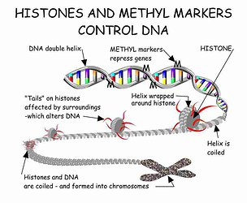
Eukaryotic Gene Regulation

Slide 10
Question 1: Which of the following is true regarding spherical cells?
A. As the diameter decreases, the surface area remains the same.
B. As the diameter decreases, the surface area increases.
C. As the diameter decreases, the surface-to-volume ratio increases.
D. As the diameter increases, the volume decreases.
E. The surface-to-volume ratio is independent of diameter.
Red book #53

Slide 11
Question 1: Which of the following is true regarding spherical cells?
A. As the diameter decreases, the surface area remains the same.
B. As the diameter decreases, the surface area increases.
C. As the diameter decreases, the surface-to-volume ratio increases.
D. As the diameter increases, the volume decreases.
E. The surface-to-volume ratio is independent of diameter.
Red book #53

Slide 12
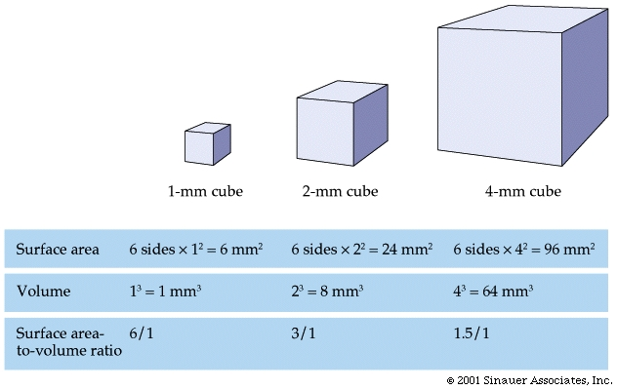
Limits to Cell Size
Diffusion limits cell size
  Movement from higher concentration to lower concentration
  Larger the distance, slower the diffusion rate
  A cell 20 cm would require months for nutrients to get to the center

Slide 13
Cells gotta work to live!
What jobs do cells have to do?
  make proteins
    proteins control every
    cell function
  make energy
    for daily life
    for growth
  make more cells
    growth
    repair
    renewal

Slide 14
Question 2: Which of the following components of the cell membrane is responsible for active transport?
Phospholipid
Protein
Lipid
Phosphate
Cholesterol

Slide 15
Question 2: Which of the following components of the cell membrane is responsible for active transport?
Phospholipid
Protein
Lipid
Phosphate
Cholesterol

Slide 16
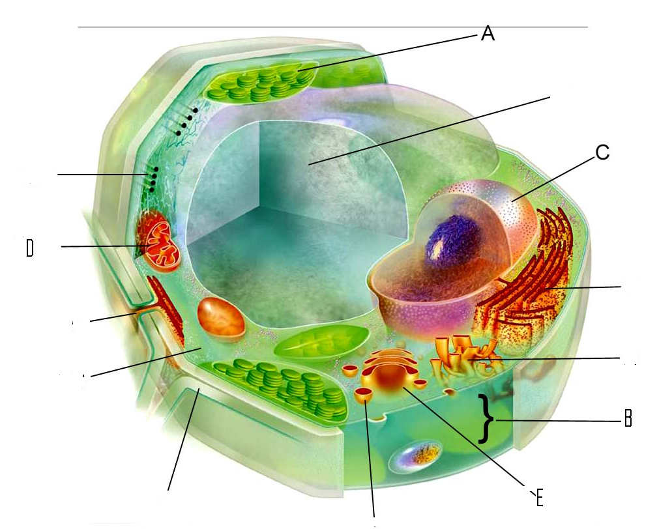
Questions 3-5
3. Site of glucose synthesis
4. Site of conversion of chemical energy of glucose to ATP
5. Site of modification and packaging of proteins and lipids prior to export from the cell

Slide 17
Questions 3-5
3. Site of glucose synthesis--A
4. Site of conversion of chemical energy of glucose to ATP---D
5. Site of modification and packaging of proteins and lipids prior to export from the cell--E

Slide 18
Cell Communication
Communication between cells requires:
ligand: the signaling molecule
receptor protein: the molecule to which the receptor binds
-may be on the plasma membrane or within the cell

Slide 19
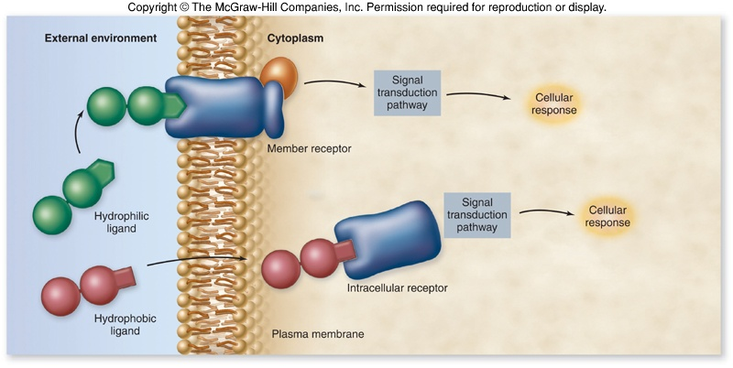

Slide 20
Cell Communication
There are four basic mechanisms for cellular communication:
1. direct contact
2. paracrine signaling
3. endocrine signaling
4. synaptic signaling

Slide 21
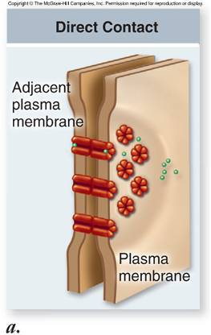
Cell Communication
Direct contact – molecules on the surface of one cell are recognized by receptors on the adjacent cell

Slide 22
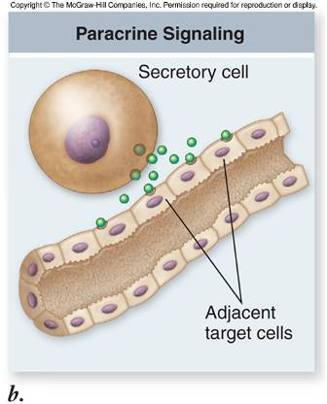
Cell Communication
Paracrine signaling – signal released from a cell has an effect on neighboring cells

Slide 23
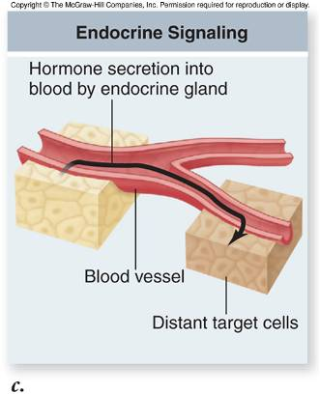
Cell Communication
Endocrine signaling – hormones released from a cell affect other cells throughout the body

Slide 24
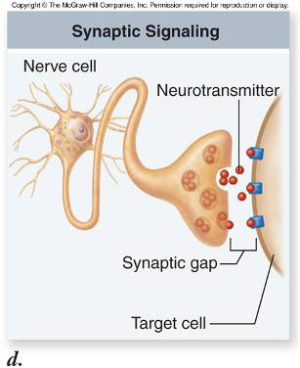
Cell Communication
Synaptic signaling – nerve cells release the signal (neurotransmitter) which binds to receptors on nearby cells

Slide 25
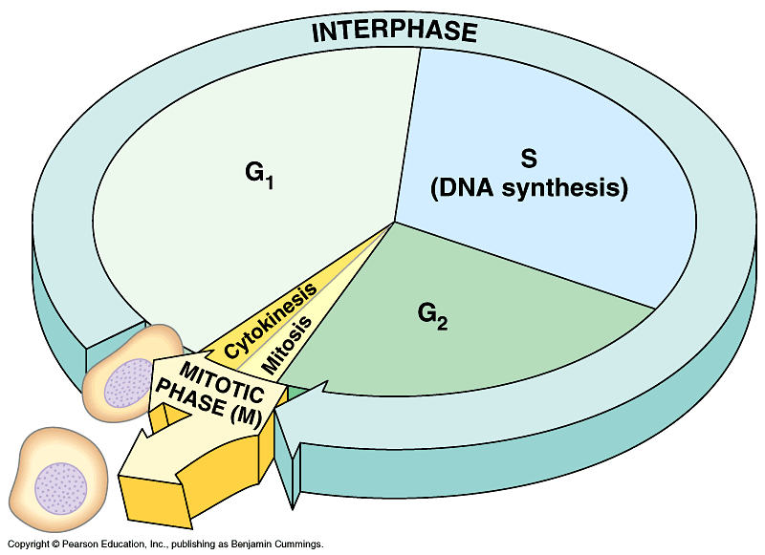

DNA Replication=S phase of the cell cycle
2007-2008
Notes:
25

Slide 26
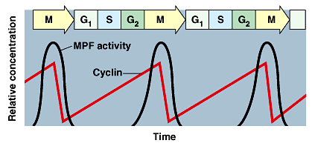
The Cell Cycle Clock: Cyclins and Cyclin-Dependent Kinase
Fluctuations in the abundance and activity of cell cycle control molecules pace the sequential events of the cell cycle.
Protein kinases, give the go-ahead signals at the G1 and G2 checkpoints
The kinases are present at a constant concentration in the growing cell, but much of the time they are in inactive form.
To be active, such a kinase must be attached to a cyclin, a protein that gets its name from its cyclically fluctuating concentration in the cell.
These kinases are called cyclin-dependent kinases, or Cdks. The activity of a Cdk rises and falls with changes in the concentration of its cyclin partner.
Cdks are relatively constant
Cyclins vary in the cycle

Slide 27
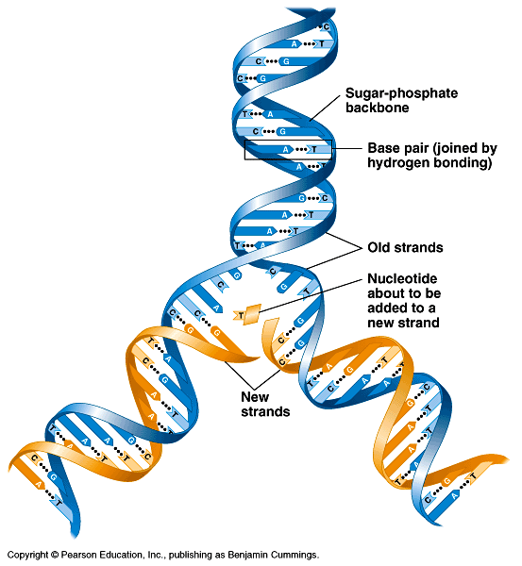
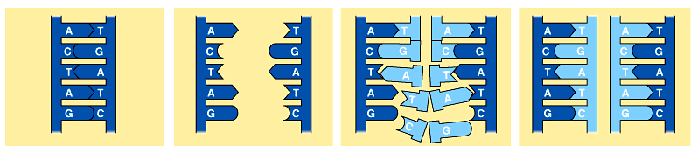
Copying DNA
Replication of DNA
  base pairing allows each strand to serve as a template for a new strand
  new strand is 1/2 parent template &
  1/2 new DNA
    semi-conservative
    copy process
Notes:
27

Slide 28
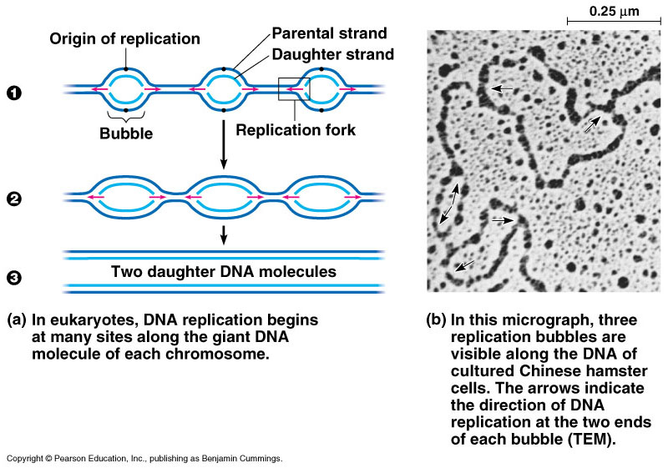
DNA Replication
Large team of enzymes coordinates replication
Notes:
28
Enzymes
more than a dozen enzymes & other proteins participate in DNA replication

Slide 29
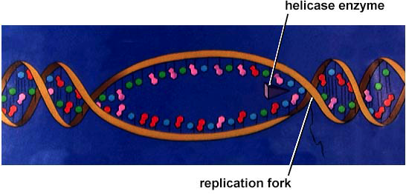
Replication: 1st step
Unwind DNA
  helicase enzyme
    unwinds part of DNA helix
    stabilized by single-stranded binding proteins
helicase
single-stranded binding proteins
replication fork
Notes:
29

Slide 30
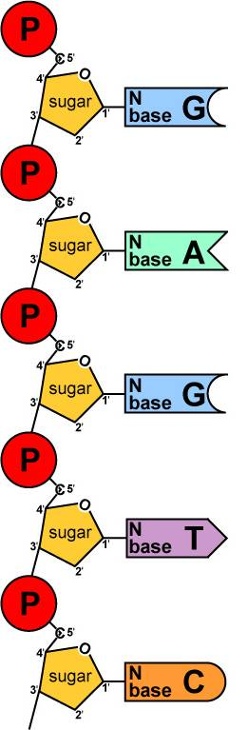
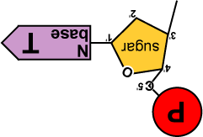
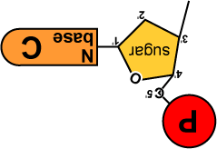
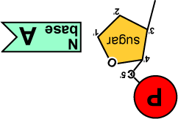
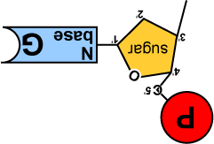
Replication: 2nd step
Build daughter DNA strand
  add new complementary bases
  DNA polymerase III
DNA
Polymerase III
Notes:
30

Slide 31
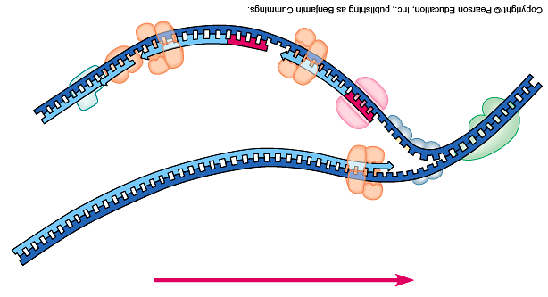
Replication fork
DNA
polymerase III
lagging strand
DNA
polymerase I
3’
Okazaki
fragments
primase
5’
5’
ligase
3’
5’
SSB
3’
helicase
DNA
polymerase III
5’
leading strand
3’
direction of replication
SSB = single-stranded binding proteins
Notes:
31

Slide 32
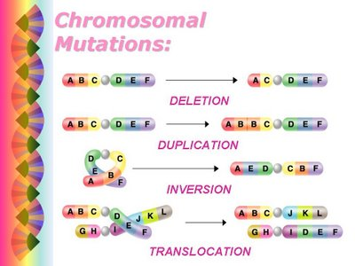

Slide 33
A DNA ligase
B DNA polymerase
C RNA polymerase
D Restriction enzyme
E Reverse Transcriptase
6. Enzyme used in the synthesis of mRNA
7. Enzyme used during replication to attach Okazki fragments to each other
8. Enzyme found in retrovirus that produces DNA from an RNA template
9. Enzyme used to position nucleotides during DNA replication

Slide 34
A DNA ligase
B DNA polymerase
C RNA polymerase
D Restriction enzyme
E Reverse Transcriptase
6. Enzyme used in the synthesis of mRNA C
7. Enzyme used during replication to attach Okazki fragments to each other A
8. Enzyme found in retrovirus that produces DNA from an RNA template E
9. Enzyme used to position nucleotides during DNA replication B

Slide 35
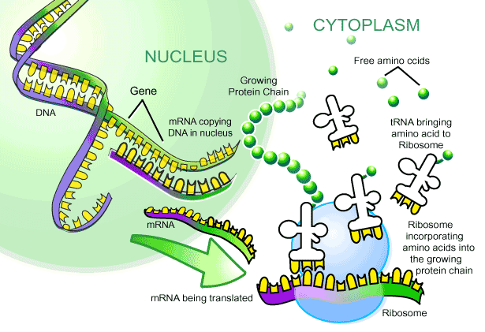
From gene to protein
protein
transcription
translation
Notes:
35

Slide 36
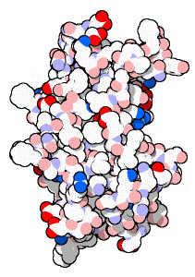
Protein syntheis
transcription
DNA
mRNA
protein
translation
trait
nucleus
cytoplasm
Notes:
36

Slide 37
Matching bases of DNA & RNA
Double stranded DNA unzips
T
G
G
T
A
C
A
G
C
T
A
G
T
C
A
T
C
G
T
A
C
C
G
T
Notes:
37

Slide 38
Matching bases of DNA & RNA
A
Match RNA bases to DNA bases on one of the DNA strands
C
U
G
G
A
U
G
U
C
U
C
G
A
A
C
U
A
G
A
C
U
RNA
polymerase
A
A
C
C
G
T
G
G
T
A
C
A
G
C
T
A
G
T
C
A
T
C
G
T
A
C
C
G
T
Notes:
38

Slide 39
Matching bases of DNA & RNA
U instead of T is matched to A
DNA
TACGCACATTTACGTACGCGG
mRNA
AUGCGUGUAAAUGCAUGCGCC
ribosome
A
C
C
A
U
G
U
C
G
A
U
C
A
G
U
A
G
C
A
U
G
G
C
A
Notes:
39

Slide 40
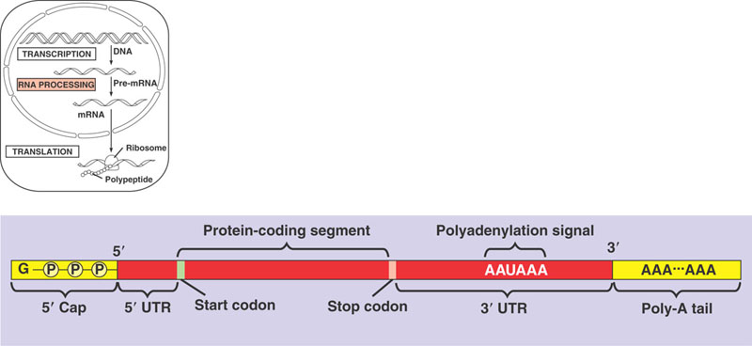
RNA Processing

Slide 41
mRNA codes for proteins in triplets
DNA
TACGCACATTTACGTACGCGG
codon
AUGCGUGUAAAUGCAUGCGCC
AUGCGUGUAAAUGCAUGCGCC
mRNA
ribosome
mRNA
?
protein
Met Arg Val Asn Ala Cys Ala
Codon = block of 3 mRNA bases
Notes:
41

Slide 42
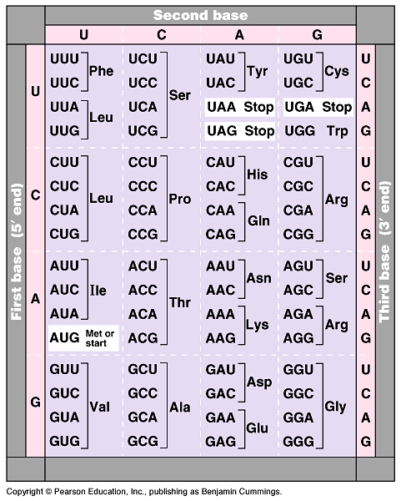
The mRNA code
For ALL life!
  strongest support for a common origin for all life
Code has duplicates
  several codons for each amino acid
  mutation insurance!
Start codon
  AUG
  methionine
Stop codons
  UGA, UAA, UAG
Notes:
42
Strong evidence for a single origin in evolutionary theory.

Slide 43
How are the codons matched to amino acids?
DNA
TACGCACATTTACGTACGCGG
mRNA
AUGCGUGUAAAUGCAUGCGCC
codon
UAC
GCA
tRNA
CAU
anti-codon
Met
amino
acid
Arg
Val
Anti-codon = block of 3 tRNA bases
Notes:
43

Slide 44
mRNA to protein = Translation
The working instructions → mRNA
The reader → ribosome
The transporter → transfer RNA (tRNA)
ribosome
mRNA
A
C
C
A
U
G
U
C
G
A
U
C
A
G
U
A
G
C
A
U
G
G
C
A
U
G
G
aa
U
A
C
tRNA
A
G
C
aa
tRNA
U
A
G
aa
aa
tRNA
aa
tRNA
aa
Notes:
44

Slide 45
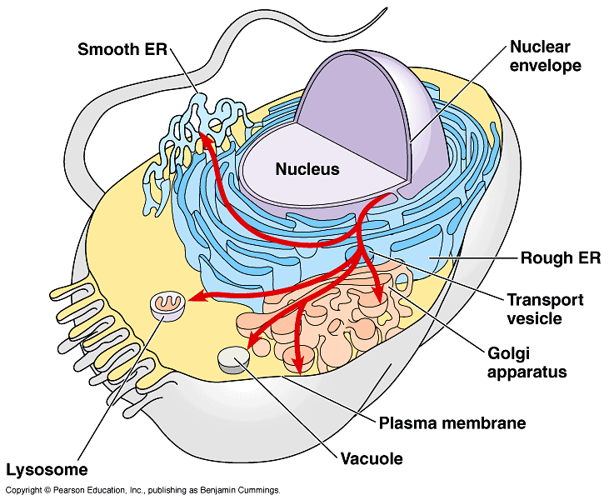
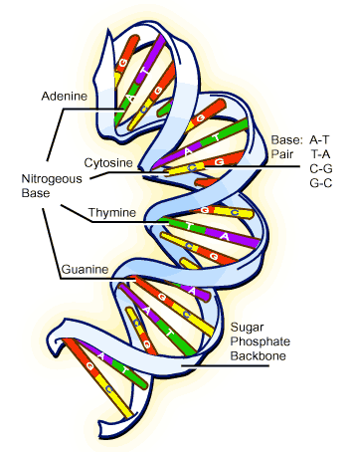
Building Proteins
Organelles involved
  nucleus
  ribosomes
  endoplasmic reticulum
  (ER)
  Golgi apparatus
  vesicles
The Protein Assembly Line
Golgi
apparatus
nucleus
ribosome
ER
vesicles

Slide 46
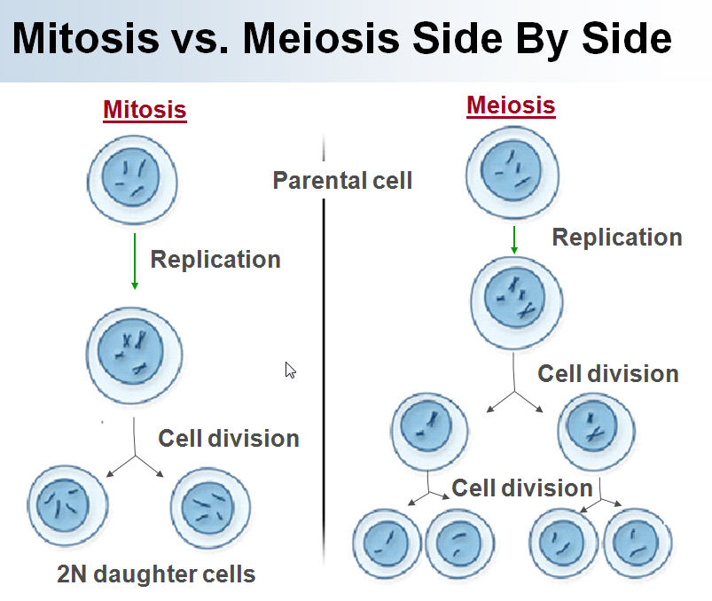

Slide 47
Question 10: Which of the following is true of mitosis?
(A) It is also known as cytokinesis
(B) It maintains the same chromosome number in the daughter cells as in the parent cell.
(C) It is the last phase of interphase.
(D) It regulates the transfer of genetic information from one daughter cell to another.
(E) It moves homologous chromosomes to opposite poles

Slide 48
Question 11: Which of the following is true of mitosis?
(A) It is also known as cytokinesis
(B) It maintains the same chromosome number in the daughter cells as in the parent cell.
(C) It is the last phase of interphase.
(D) It regulates the transfer of genetic information from one daughter cell to another.
(E) It moves homologous chromosomes to opposite poles

Slide 49
QUESTION 12: A biologist counted 2,500 cells from an embryo on a microscope slide and recorded the following data.
Stage Number of Cells
Prophase 125
Metaphase 50
Anaphase 50
Telophase 25
Interphase 2,250
Total 2,500
If these cells had been dividing randomly, it could be reasonably concluded that
The duration of anaphase is approximately one-half that of telophase
prophase is approximately 3 times as long as telophase
Metaphase is the shortest stage of the cell cycle
Interphase is the longest stage of the cell cycle
the chromosome can first be seen in prophase

Slide 50
QUESTION 12: A biologist counted 2,500 cells from an embryo on a microscope slide and recorded the following data.
Stage Number of Cells
Prophase 125
Metaphase 50
Anaphase 50
Telophase 25
Interphase 2,250
Total 2,500
If these cells had been dividing randomly, it could be reasonably concluded that
The duration of anaphase is approximately one-half that of telophase
prophase is approximately 3 times as long as telophase
Metaphase is the shortest stage of the cell cycle
Interphase is the longest stage of the cell cycle
the chromosome can first be seen in prophase

