Slide 1
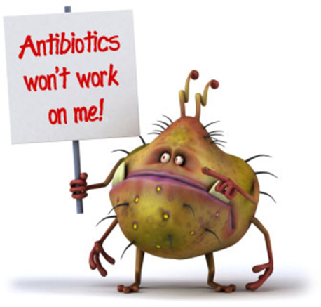
Many antibiotics that are used to kill bacteria which make us sick work because they interfere with the ability of bacterial ribosomes to make proteins.
Use what you know about classification to EXPLAIN WHY these antibiotics don’t kill fungi.
WHY can’t doctors use medicines that affect fungal ribosomes to treat athlete’s foot fungus in humans?

Slide 2
Use what you know about classification to EXPLAIN WHY these antibiotics don’t kill fungi.
Organisms are classified into DOMAINS by the type of ribosomal RNA they have: Eubacteria (DOMAIN: Bacteria) Fungi (DOMAIN: Eukarya) Fungi and bacteria have different ribosomes so antibiotics that target bacterial ribosomes don’t work on Eukaryotic ribosomes.
WHY can’t doctors use medicines that affect fungal ribosomes to treat athlete’s foot fungus in humans?
Humans and fungi are both in the same DOMAIN (Eukarya). They have the same kind of ribosomes so medicines that target fungal ribosomes would also affect the person taking them.

Slide 3
Approximately 70% of the atmosphere is made up of nitrogen (N₂) gas, but the majority of organisms on the planet can NOT take this gas in and break it down.
1. EXPLAIN how nitrogen gas enters the food chains in ecosystems.
2. How do humans get the nitrogen they need?
3. Give examples (3) of some molecules your body needs nitrogen to make.
Image from: http://www.habitatkokomo.com/wordpress1/recycle/

Slide 4
Image from: http://www.habitatkokomo.com/wordpress1/recycle/
1. EXPLAIN how nitrogen gas enters the food chains in ecosystems. Nitrogen fixing bacteria that live symbiotically with the roots of legumes (peas, alfalfa, soybeans. . .) have enzymes to change N₂ gas into ammonia in soil. Other soil bacteria can change ammonia into nitrates/nitrites.
2. How do humans get the nitrogen they need?
Plants can take up these forms of nitrogen and use it to make their molecules (see below). Heterotrophs (like humans) get their nitrogen FROM EATING plants or other heterotrophs.
3. Give examples (3) of some molecules your body needs nitrogen to make.
Proteins (amino group), DNA & RNA (nitrogen bases), ATP

Slide 5
Explain how coupling – ∆ G reactions to reactions that have a + ∆ G allow life to exist.

Slide 6
Hormone signal molecules interact with the surface of their cell targets in in TWO different ways, depending on whether the hormone molecule is hydrophilic or hydrophobic.
EXPLAIN these mechanisms and give an example of each.

Slide 7
Hormone signal molecules interact with the surface of their cell targets in in TWO different ways, depending on whether the hormone molecule is hydrophilic or hydrophobic.
EXPLAIN these mechanisms and give an example of each.

Slide 8
An important cause of the deterioration of flavor, texture, and vitamin content of frozen fruits and vegetables during storage is the action of hydrolytic enzymes released from vacuoles of the cells.
Blanching (a quick dip in boiling water) prior to freezing improves the keeping qualities of produce. EXPLAIN WHY blanching works.
Image from: http://ec.l.thumbs.canstockphoto.com/canstock5880066.jpg

Slide 9
An important cause of the deterioration of flavor, texture, and vitamin content of frozen fruits and vegetables during storage is the action of hydrolytic enzymes released from vacuoles of the cells.
Blanching (a quick dip in boiling water) prior to freezing improves the keeping qualities of produce. EXPLAIN WHY blanching works.
Heating denatures proteins (enzymes) making them lose function so blanching makes the hydrolytic enzymes that break down the foods inactive.
Image from: http://ec.l.thumbs.canstockphoto.com/canstock5880066.jpg

Slide 10
STRUCTURE ~ FUNCTION
Which fatty acid tail is unsaturated?
How can you tell?
What is the relationship between unsaturated fatty acids in cell membranes and membrane fluidity in organisms that live in cold environments?
SP 7: The student is able to connect and relate knowledge across various scales, concepts, and representations in and across domains.
Image from: http://bioweb.wku.edu/courses/BIOL115/wyatt/Biochem/Lipid/P-lipid.gif

Slide 11
STRUCTURE ~ FUNCTION
Which fatty acid tail is unsaturated?
How can you tell?
What is the relationship between unsaturated fatty acids in cell membranes and membrane fluidity in organisms that live in cold environments?
SP 7: The student is able to connect and relate knowledge across various scales, concepts, and representations in and across domains.
Image from: http://bioweb.wku.edu/courses/BIOL115/wyatt/Biochem/Lipid/P-lipid.gif

Slide 12
Draw a diagram of a typical biological membrane including the lipid bilayer and both integral and peripheral proteins.
Label your diagram and give an example of an integral and a peripheral protein you learned about.

Slide 13
Draw a diagram of a typical biological membrane including the lipid bilayer and both integral and peripheral proteins.
Label your diagram and give an example of an integral and a peripheral protein you learned about.

Slide 14
Explain why NADH makes more ATP than FADH₂ when electrons are passed to the ETC during cellular respiration.
Image from: http://study.com/cimages/multimages/16/Electron_Transport_Mitochondrion.png

Slide 15
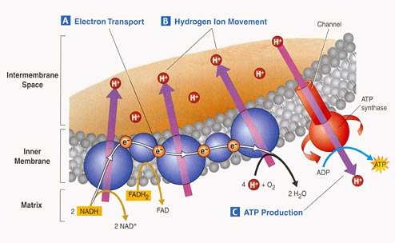
Explain why NADH makes more ATP than FADH₂ when electrons are passed to the ETC during cellular respiration.
NADH drops its electrons at beginning of ETC so as electrons pass down ETC 3 proton pumps move H+ ions into the intermembrane space = 3 ATP when they return through ATP synthase. FADH₂ drops its electrons farther down ETC skipping the 1st proton pump so less H⁺ moved = 2 ATP
Image from: http://study.com/cimages/multimages/16/Electron_Transport_Mitochondrion.png

Slide 16
asfa

Slide 17
asfa

Slide 18
sdfgsdf

Slide 19
asfa

