Slide 1
DRAW ME A PICTURE OF . . .
AP BIOLOGY REVIEW

Slide 2
Draw a diagram of a typical biological membrane including the lipid bilayer and both integral and peripheral proteins.
Label your diagram and GIVE AN EXAMPLE of an integral and a peripheral protein you learned about.

Slide 3
Draw a diagram of a typical biological membrane including the lipid bilayer and both integral and peripheral proteins.
Label your diagram and GIVE AN EXAMPLE of an integral and a peripheral protein you learned about.

Slide 4
Draw a mitochondrion. Label all the places & spaces.
Mark the locations of glycolysis, Krebs Cycle and ETC.
Show where H⁺ ions build up during ETC.
Add some mitochondrial DNA.

Slide 5
Draw a diagram that shows a population undergoing logistic growth.
Label carrying capacity.
Identify 2 biotic and 2 abiotic factors that could impact carrying capacity in this population.

Slide 6
Draw a diagram of a food chain that includes 5 trophic levels.
Label producers/consumers as primary, secondary, etc.
EXPLAIN the impact of a pollutant on the organisms in the different trophic levels. You had a vocab word for this.

Slide 7
Draw a diagram of a food chain that includes 5 trophic levels.
Label producers/consumers as primary, secondary, etc.
EXPLAIN the impact of a pollutant on the organisms in the different trophic levels. You had a vocab word for this.

Slide 8
Draw a diagram showing what happens in a lake undergoing eutrification.
EXPLAIN how this is related to “Dead zones” in the Gulf of Mexico.

Slide 9
Draw a diagram showing what happens in a lake undergoing eutrification.
EXPLAIN how this is related to “Dead zones” in the Gulf of Mexico.

Slide 10
Draw a picture of an amino acid
Show how 2 amino acids could be joined together.
Identify this process and the type of bond formed

Slide 11
Draw a picture of an amino acid
Show how 2 amino acids could be joined together.
Identify this process and the type of bond formed

Slide 12
Draw a chloroplast Label all the places & spaces.
Mark the locations of ETC and Calvin Cycle.
Show where H⁺ ions build up during ETC.

Slide 13
Draw a diagram of a lac operon when lactose is NOT present.
Identify the molecules in your diagram.
Explain what would cause this operon to “turn on”

Slide 14
Draw a diagram of a lac operon when lactose is NOT present.
Identify the molecules in your diagram.
Explain what would cause this operon to “turn on”

Slide 15
Draw a picture of a human red blood cell placed in distilled water.
Use arrows to show how the water will move.
What vocab word describes what will happen to this cell?

Slide 16
Draw a picture of a human red blood cell placed in distilled water.
Use arrows to show how the water will move.
What vocab word describes what will happen to this cell?

Slide 17
Draw a picture of a human red blood cell placed in distilled water.
Use arrows to show how the water will move.
What vocab word describes what will happen to this cell?

Slide 18
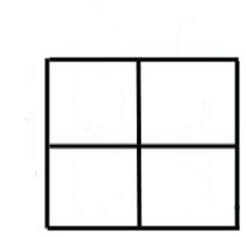
Draw a PUNNETT SQUARE that shows the
offspring of a cross between a father with
colorblindness and a non-colorblind mother whose father had normal vision.
Tell the possible outcomes of this cross.

Slide 19
Diagram the differences between cells that are haploid, diploid, triploid, trisomic, and monosomic
USE 2n=6

Slide 20
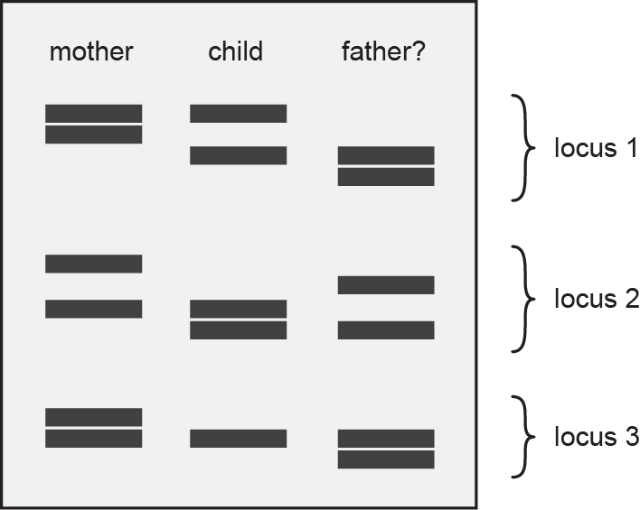
Look at the diagram. Is this the father of this child? EXPLAIN YOUR ANSWER

Slide 21
Draw a diagram showing the glycoproteins on the surface of a blood cell from a person with A negative blood.
WHAT KIND OF ANTIBODIES WOULD THIS PERSON MAKE?

Slide 22
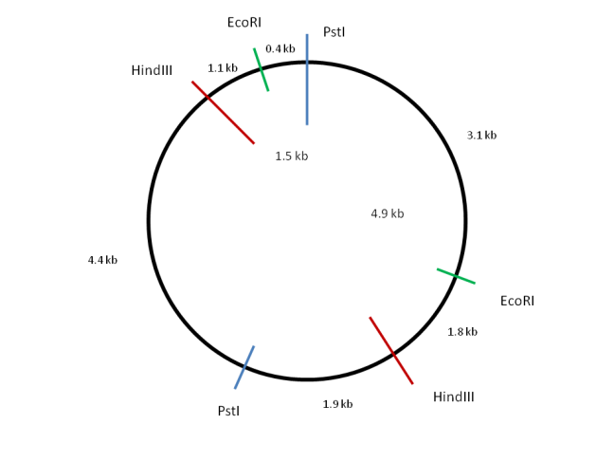
DRAW ME A PICTURE OF . . .
HindIII
EcoR1 + HindIII

Slide 23
DRAW A DIAGRAM showing the molecules in the thylakoid membrane involved in the light reactions and label them.

Slide 24
DRAW a diagram of an interphase chromosome in G₂ and label all the parts

Slide 25
Draw a diagram of a diploid cell with 4 chromosomes in Metaphase I of meiosis

