Slide 1
Madison Pejsa Pd.4
Nervous System

Slide 2
Function of Nervous System
The nervous system allows us to perceive, comprehend, and respond to the world around us. It helps us digest, breath, etc.

Slide 3
Central and Peripheral System
Central- composed of the brain and the spinal cord
Peripheral- composed of several nerves that are connected to the CNS.
Together, they collect information letting the body know how to react

Slide 4
Interactions of 2 neurons

Slide 5
Reflex Arc
Reflex Arc is a pathway that controls the action reflex. It gives a quick response when the spinal motor neurons are activated.

Slide 6
Major Parts
Cerebral Hemisphere - either of the rounded halves of the cerebrum of the brain, divided laterally by a deep fissure and connected at the bottom by the corpus callosum.
Diencephalon- the posterior section of the forebrain.

Slide 7
Major Parts
Brain Stem- The portion of the brain that is continuous with the spinal cord and comprises the medulla oblongata, pons, midbrain, and parts of the hypothalamus, functioning in the control of the reflexes and such essential internal mechanisms as respiration and heartbeat.
Cerebellum- A large portion of the brain, serving to coordinate voluntary movements, posture, and balance in humans, being in back of and below the cerebrum and consisting of two lateral lobes and a central lobe.

Slide 8
Steps for passing the “message” from one neuron to another
First is depolarization which causes the outside of the membrane to be negative and inside to be positive (Na out, K in)
Second is resting potential until a stimulus comes along to make it active.
Third is action potential where the sodium moves inside the membrane.
Fourth is threshold, which once the stimulus goes above the threshold it opens up more ion channels and higher membrane potential
Lastly is the refractory period when the Na and K return back to their sides

Slide 9
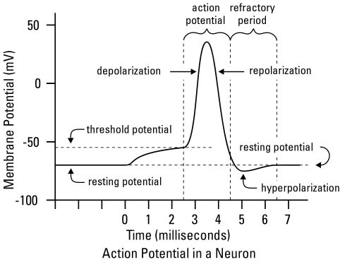

Slide 10
Role of Neurotransmitters
Neurotransmitters is how are information is carried it plays a role in our sleep, feelings, and how we learn and behave.
It influences the next neuron to grab the information coming from the synapse to grab the information with their dendrites and to be processed through the neuron to the next.
IPSP- postsynaptic potential is a kind of synaptic potential that makes a postsynaptic neuron less likely to generate an action potential

Slide 11
Major Disorders
Dopamine- is a neurotransmitter in the brain that sends signals to other nerve cells. Symptoms include depression, mood swings, poor attention, and food cravings. Some stats include 8.7/100,000 person-year for women and 1.4/100,000 person-year for men. Most treatment options for dopamine include doses of medication.
Serotonin- is a chemical produced by nerve cells that produces nerve and brain cells to function. Symptoms may consist of heavy sweating, confusion, rapid heart rate, muscle rigidity, head ache, etc. Depending on how severe treatments range from medication to intensive care treatment. This as arose in over 8187 people in 2004.

Slide 12
Bibliography
http://www.healthline.com/human-body-maps/nervous-system#seoBlock/1
http://en.wikipedia.org/wiki/Reflex_arc
http://www.dummies.com/how-to/content/understanding-the-transmission-of-nerve-impulses.html
http://allpsych.com/psychology101/neurotransmitters.html
www.mayoclinic.org

