Slide 1
Nervous System
Heidi Bien
AP Biology

Slide 2
Functions of Nervous System
A complex network of nerves and cells that carries messages throughout different parts of the body
Controls movement of muscles and the function of internal organs
Made of the central nervous system and the peripheral nervous system

Slide 3
Central Nervous System
Consists the brain and spinal cord
Brain: important role in awareness, sensations, thought, speech, and reflexes
Spinal cord: carries messages back and forth from brain to peripheral nerves
Responsible for sending, receiving, and interpreting signals from all parts of the body

Slide 4
Peripheral Nervous System
Portion of nervous system outside the brain and spinal cord
Two types of cells in the Peripheral Nervous System:
Cells of sensory nervous system: send information to the central nervous system from internal organs or from external stimuli
Cells of motor nervous system: carry information from the central nervous system to organs, muscles, and glands.
Further divided into somatic nervous system and the autonomic nervous system
Somatic: controls skeletal muscle as well as external sensory organs such as the skin
Autonomic: controls involuntary muscles, such as smooth and cardiac muscle. Also called involuntary nervous system

Slide 5
Interaction of Neurons

Slide 6
Simple Reflex Arc
Neural pathway that controls reflex action
Reflex actions can occur quickly by activating spinal motor neurons without the delay of routing signals through the brain

Slide 7
Cerebral Hemispheres
Brain is divided into two hemispheres
The left side of the brain controls the right side of the body and the rights side of the brain controls the left side of the body
Left: more analytic and logical
Right: more artistic and creative

Slide 8
Diencephalon
Above the brainstem and below the cerebrum
“Interbrain” consisting of several structures such as the thalamus, hypothalamus, pituitary gland, and pineal gland
Thalamus: cortical arousal, memory, communicates with cerebral cortex
Hypothalamus: controls basic life functions (thirst, hunger, sleep)
Pituitary gland: reproductive hormones, reproduction of ADH and oxytocin
Pineal gland: secretes melatonin

Slide 9
Brainstem
Posterior part of the brain
Consists of medulla, pons, and midbrain
Motor and sensory neurons travel through the brainstem allowing for the relay of signals between the brain and the spinal cord
Deals with breathing, arousal, alertness, blood pressure, digestion, and heart rate

Slide 10
Cerebellum
Located behind top portion of brainstem
Plays important role in balance, posture, coordination, cognitive functions, and fear and pleasure responses
Accounts for approximately 10% of the brain’s volume but contains over 50% of the total number of neurons in the brain

Slide 11
Pathway of a Nerve Impulse
When a neuron is inactive and receives to stimulus, it is said to have resting potential. This also means that the neuron is polarized because the electrical charge on the outside of the membrane is positive while the inside charge is negative.
The outside of the cell contains Na+ ions and the inside of the membrane contains K+ ions.
As a stimulus reaches the resting neuron, the membrane allows Na+ ions to fill the cell. Now, the neuron has been depolarized.
The inside becomes positive, polarization is removed, and the threshold is reached. Once the threshold level is reached, more Na+ ions are allowed into the cell.

Slide 12
Pathway of a Nerve Impulse
Once complete depolarization occurs, action potential results. Na+ channels are opened all along the membrane.
After Na+ ions flood inside the membrane, K+ ions move to the outside of the membrane causing repolarization.
When K+ channels finally close, the neuron has more K+ ions on the outside of the membrane causing hyperpolarization. The membrane potential drops slightly lower than the resting potential.
The refractory period is when the Na+ and K+ ions are returned to their original locations. During this time of replacement, the neuron doesn’t respond to any stimuli.

Slide 13
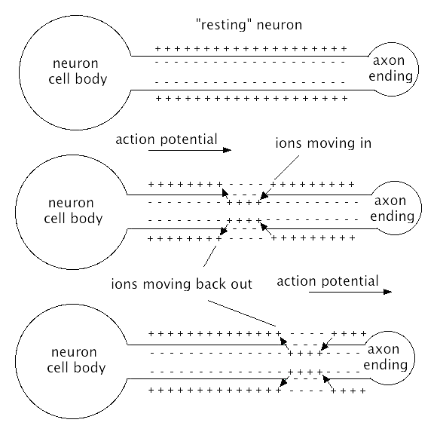
Pathway of a Nerve Impulse
http://www.dummies.com/how-to/content/understanding-the-transmission-of-nerve-impulses.html
http://softdroid.net/neiron-ru

Slide 14
Neurotransmitters
Chemical messengers that transmit signals across a chemical synapse from one neuron to another
Neurotransmitters are released from synaptic vesicles into the synaptic cleft, or gap, and received by receptors on another neuron
Post-synaptic potentials that are caused by neurotransmitter chemicals are:
depolarizing resulting in excitatory postsynaptic potential, or EPSP
hyperpolarizing resulting in inhibitory postsynaptic potential, or IPSP

Slide 15
Poliomyelitis
Highly infectious and viral disease that attacks the central nervous system causing paralysis
Only prevalent in humans
Spread from person to person orally
Three known types of Polio each causing a different strain of disease: subclinical, non-paralytic, and paralytic

Slide 16
Poliomyelitis Symptoms
Symptoms range from a subclinical to paralytic
Subclinical: may not experience any symptoms; doesn’t affect brain and spinal cord
Non-paralytic: mild symptoms; no paralysis
Paralytic: spinal polio (affects spinal cord), bulbar polio (affects brainstem), bulbospinal (affects brain and spine)
Symptoms lasting 2-5 days after contracting virus:
Fever, headache, nausea, stomach pain, tiredness, and sore throat
Some people develop more serious symptoms that affect brain and spinal cord:
Paresthesia- feeling of pins and needles in the legs
Meningitis- infection of the covering of the spinal cord and brain
Paralysis- can’t move parts of the body or weakness in the arms and legs
1 in 200 cases of Polio leads to irreversible paralysis

Slide 17
Poliomyelitis Prevalence
Mainly affects small children (under the age of 5)
Transmitted through places with poor sanitary conditions
Cases have reduced by 99 percent since 1988
from 350,000 cases to 359 cases in 2014
Afghanistan and Pakistan are the countries prone to polio-epidemic

Slide 18
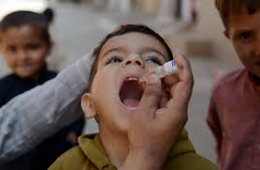
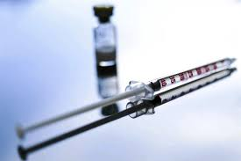
Poliomyelitis Treatment
Can be treated with two types of vaccines:
Oral Poliovirus Vaccine (OPV)- given orally
Inactivated Poliovirus Vaccine (IPV)- given as an injection in the leg or arm, depending on the patient's age
The IPV has only been used in the U.S. since 2000
The OPV is still used throughout much of the world today
http://www.pbs.org/newshour/tag/polio/
http://www.thestar.com.my/Lifestyle/Health/2013/08/25/Keeping-polio-a-thing-of-the-past/

Slide 19
Alzheimer’s Disease
Most common form of dementia
Accounts for 60-80 percent of dementia cases
Causes problems with memory, thinking, and behavior
Sixth leading cause of death in the United States
Toxic changes take place in brain even before disease is noticeable
Abnormal deposits of proteins form amyloid plaques and tau tangles throughout the brain
Once-healthy neurons stop functioning, lose connections with other neurons, and die

Slide 20
Alzheimer’s Symptoms
Symptoms develop slowly and grow worse over time, eventually interfering with everyday tasks
Begins with mild memory loss but can lead into problems with communicating and responding to environment
Usually live on another 8 years after symptoms are noticeable to other people but can survive for another 20 years

Slide 21
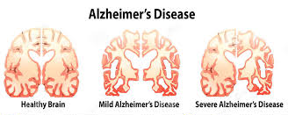
Alzheimer’s Prevalence
Occurs in people over 65 years
Early-onset Alzheimer's- a genetic mutation is usually the cause
Late-onset Alzheimer's- arises from a complex series of brain changes that occur over decades; genetic, environmental, and lifestyle factors
http://columbiasciencereview.com/2015/04/18/a-promising-cure-for-alzheimers-disease/

Slide 22
Alzheimer’s Treatment
No current cure for Alzheimer’s
Treatments are available for slowing the effects of dementia
Research continues to find a cure

Slide 23
References
http://www.healthline.com/health/poliomyelitis#Overview1
http://www.cdc.gov/polio/about/
http://www.alz.org/alzheimers_disease_what_is_alzheimers.asp
http://www.alz.org/alzheimers_disease_know_the_10_signs.asp
http://www.emedicinehealth.com/anatomy_of_the_central_nervous_system/page2_em.htm
http://www.christopherreeve.org/site/c.ddJFKRNoFiG/b.4452157/k.3E9D/What_is_the_Central_Nervous_System.htm
https://en.wikipedia.org/wiki/Reflex_arc
http://biology.about.com/od/organsystems/a/aa061804a.htm
http://www.mhhe.com/biosci/esp/2001_saladin/folder_structure/in/m2/s7/index.htm
http://sites.sinauer.com/neuroscience5e/animations05.02.html
http://www.cerebromente.org.br/n01/arquitet/hemisferios_i.htm
http://biology.about.com/od/anatomy/p/diencephalon.htm
http://www.healthline.com/human-body-maps/cerebellum

