Slide 1
AP Biology Human nervous Systems Project

Slide 2
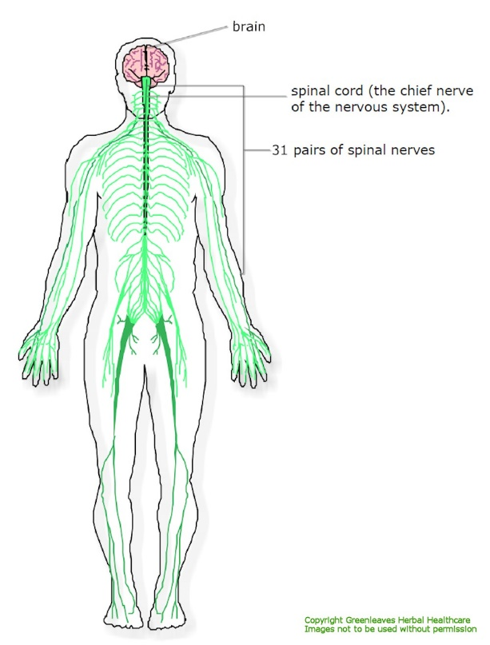
Function
The function of the nervous system is to control and alert the body. It directs actions and alerts through various nerve signals it sends to cells throughout the body. There are 2 types of these cells neurons and axons.

Slide 3
Definitions
Central Nervous System-the complex of nerve tissues that controls the activities of the body. The major parts are the brain and spinal cord. Neurons send the messages
Peripheral Nervous System-The portion of the nervous system that is outside the brain and spinal cord. The major parts include the 12 cranial nerves, the spinal nerve roots, and the autonomic nerves. Nerves send the messages.

Slide 4
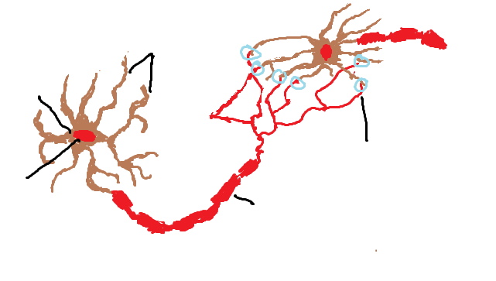
Interaction of 2 neurons
Dendrites
Cell Body
Synapse
Nucleus
Axon

Slide 5
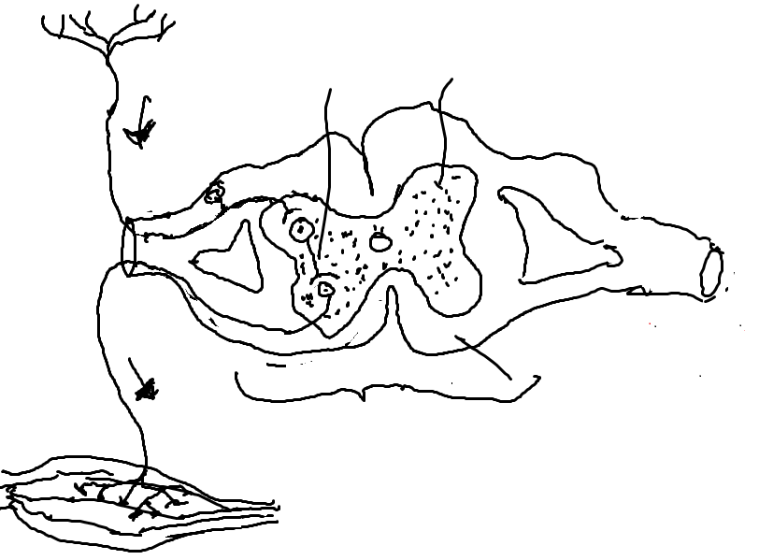
Reflex Arc
Receptor
Interneuron
Grey Matter
Sensory Neuron
Motor Nerve Fiber
White Matter
Transverse Section through spine
Muscle
The route followed by nerve impulses in the production of a reflex act, from the peripheral receptor organ through the afferent nerve to the central nervous system synapse and then through the efferent nerve to the effector organ. It connects peripheral and central nervous systems.

Slide 6
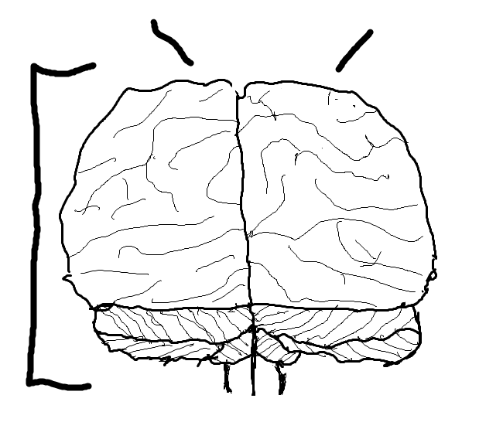
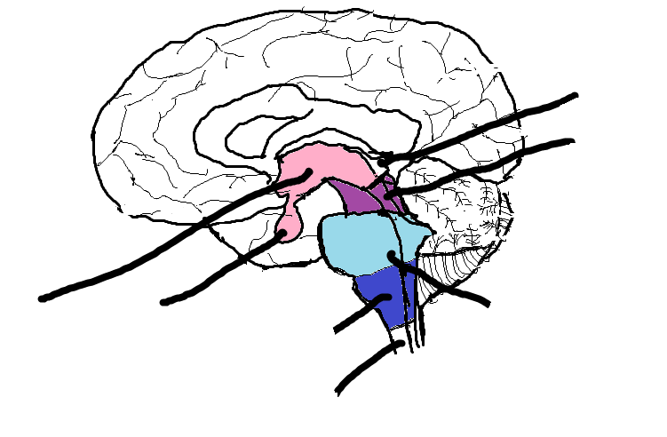
The Brain
Left Cerebral Hemisphere
Right Cerebral Hemisphere
Pineal Glands
Mid-Brain
Cerebrum
Thalamus
Pituitary Gland
Pons
Medulla Oblongata
Cerebellum
Spinal Cord
Functions of Various Parts
Cerebral Hemispheres- Language, Movement, Senses, and visual processing
Diencephalon- Sensing, touch perception, homeostasis, motor function control, endocrine control, and autonomic control.
Brain Stem-Alertness, Arousal, Breathing, Blood Pressure, Digestion, Heart Rate, and autonomic functions. (Relays Information
Cerebellum-Fine Movement Coordination, balance and equilibrium, and muscle tone.

Slide 7
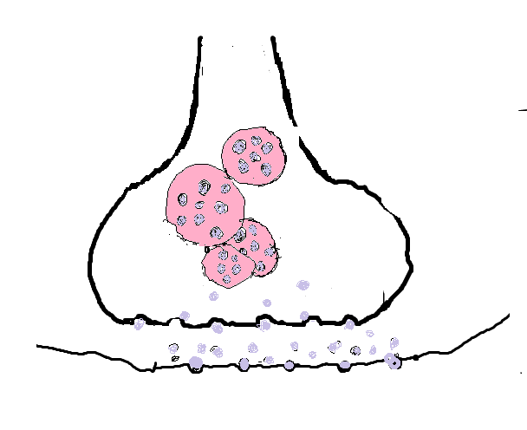
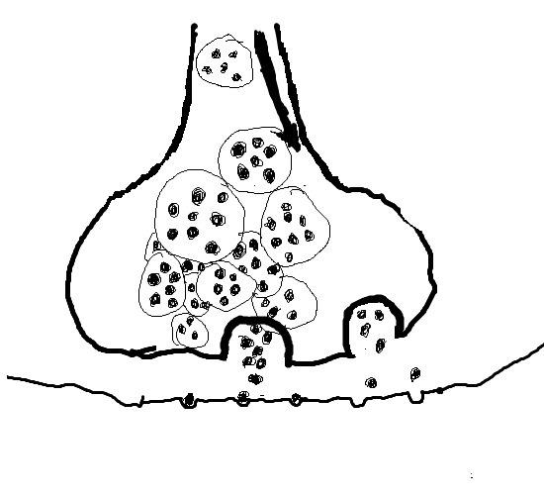
Nerve Impulse
Dendrites
Cell Body
Synapse
Nucleus
Resting Potential
Axon
Resting Potential- outside of nerve cell has high concentration of Na+ and low concentration of K+ and inside has opposite.
Action Potential has the same only the concentration of Na+ is increased inside of nerve cell.
Threshold is the level at which depolarization is complete and action potential can happen
The refractory period happens after Repolarization in which the nerve can regain resting potential

Slide 8
Neurotransmitters signal messages throughout the body by passing through neurons. They change the permeability of ions in neurons and the potential of the membrane.
IPSP- net gain of negative charge when the ion burrow is opened, brings the potential up from it's resting potential (usually -70mV), resulting in the neuron going further away from the firing potential, making it less credible to trigger, hence the word 'inhibitory'.
EPSP- net gain of positive charge when the ion depression is opened, brings the potential of a neuron down from it's resting potential (usually -70mV) closer to it's firing potential (-50mV).

Slide 9
Depression
Depression is a emotional disorder that involves mood, thoughts, and the body. It effects a person’s perception of themselves and how one eats or sleeps.
Signs and symptoms depend on which subtype and severity
- Sadness
- Inappropriate crying
- Feelings of Worthlessness
Prevalence-The leading cause of disability in the U.S. for ages 15 to 44.3 Affects approximately 14.8 million American adults, or about 6.7 percent of the U.S. population age 18 and older in a given year. While major depressive disorder can develop at any age, the median age at onset is 32.5 More prevalent in women than in men
Treatment options
-Psychotherapy
-Mood Stabalizers

Slide 10
Cerebral Palsy
A disorder of movement, muscle tone or posture that is caused by an insult to the immature, developing brain, most often before birth.
Signs and Symptoms
- Variations in muscle tone, such as being either too stiff or too floppy
- Stiff muscles and exaggerated reflexes (spasticity)
- Stiff muscles with normal reflexes (rigidity)
- Lack of muscle coordination (ataxia)
- Tremors or involuntary movements
- Slow, writhing movements (athetosis)
- Delays in reaching motor skills milestones, such as pushing up on arms, sitting up alone or crawling
- Favoring one side of the body, such as reaching with only one hand or dragging a leg while crawling
- Difficulty walking, such as walking on toes, a crouched gait, a scissors-like gait with knees crossing or a wide gait
- Excessive drooling or problems with swallowing
Prevalence
Population-based studies from around the world report prevalence estimates of CP ranging from 1.5 to more than 4 per 1,000 live births or children of a defined age range
Treatment
-Medical Care Team
- Generalized spasticity
- Therapy
- Surgery

Slide 11
http://biology.about.com/od/anatomy/p/diencephalon.htm
http://www.livestrong.com/article/142538-cerebral-hemisphere-functions/
http://www.medilexicon.com/medicaldictionary.php?t=5931
http://biology.about.com/od/anatomy/p/Brainstem.htm
http://www.medicinefreefaq.com/medicine/medicine-2-1378.html
http://www.rightdiagnosis.com/d/depressive_disorders/prognosis.htm
http://www.rightdiagnosis.com/d/depressive_disorders/intro.htm
http://www.adaa.org/about-adaa/press-room/facts-statistics
http://www.mayoclinic.org/diseases-conditions/cerebral-palsy/basics/treatment/con-20030502
http://www.cdc.gov/ncbddd/cp/data.html

