Slide 1
Activity 1.3.1a Solar Hydrogen Automobile Assembly Guide
VEX Platform

Slide 2
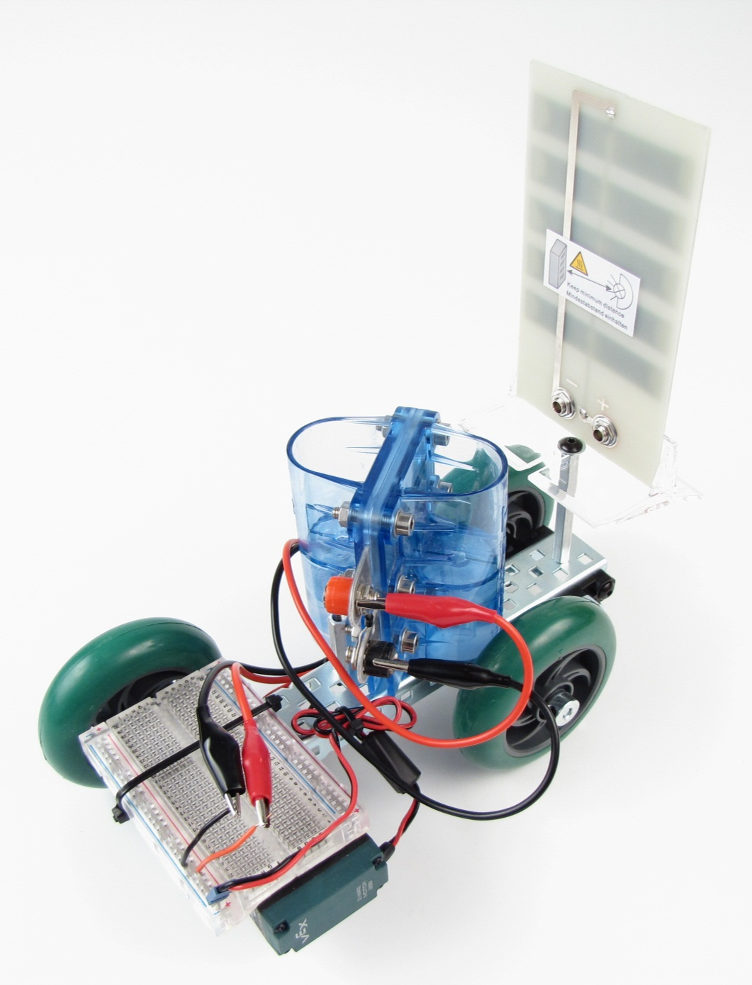
POE VEX Kit
Hydrogen fuel cell
Distilled water
Solar module
120 Watt PAR30 bulb
Bulb holder
Wires
Hookup wires (red and black)

Slide 3
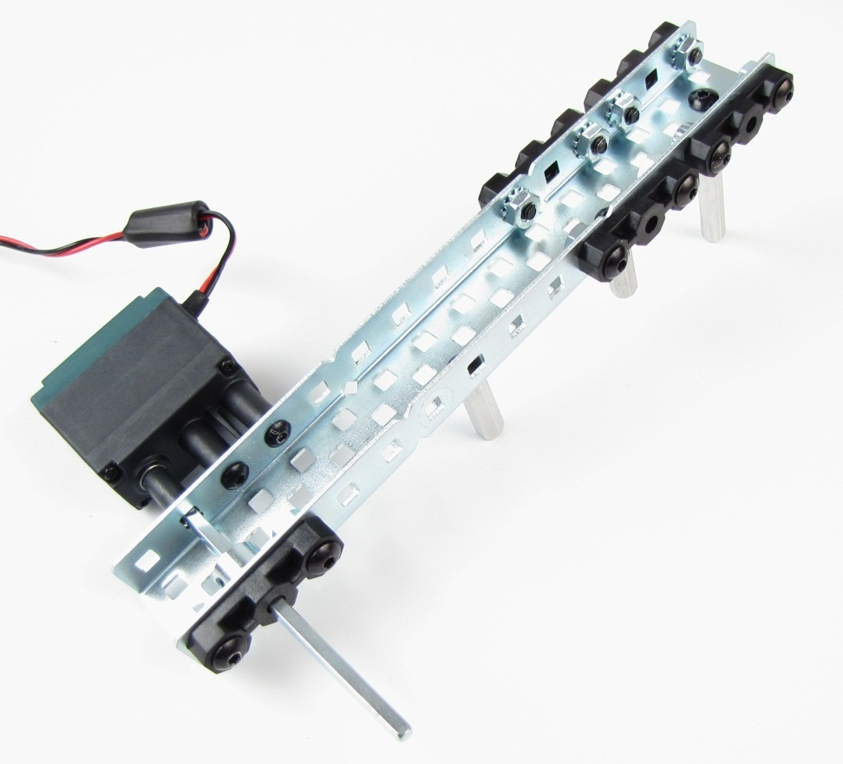
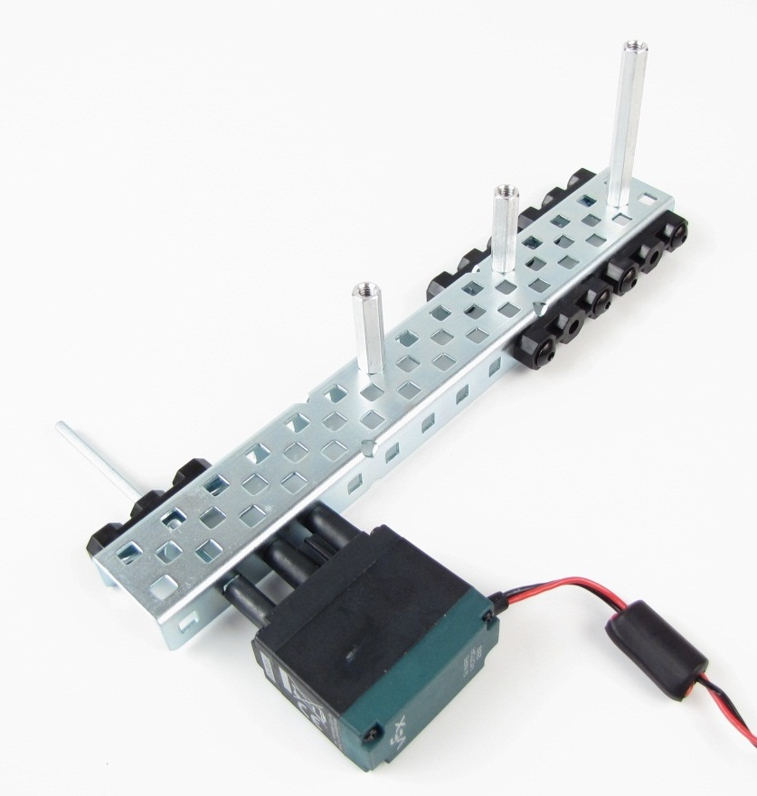
Step 1: Build Chassis
269 Motor
2 in coupler
1 in couplers
Shaft Coupler
Allow small gap so
axel spins freely
3 in shaft

Slide 4
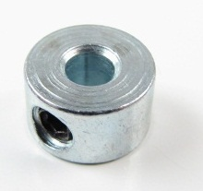

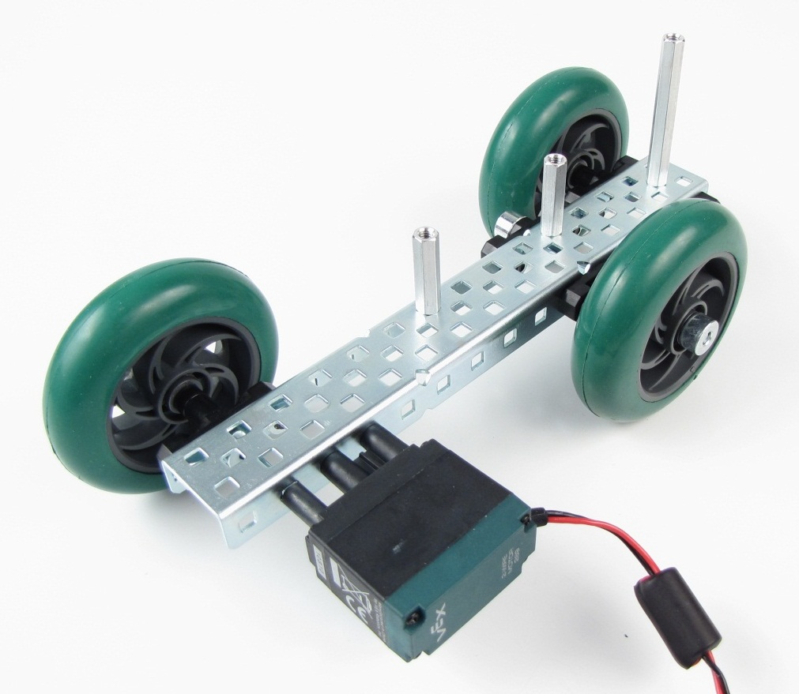
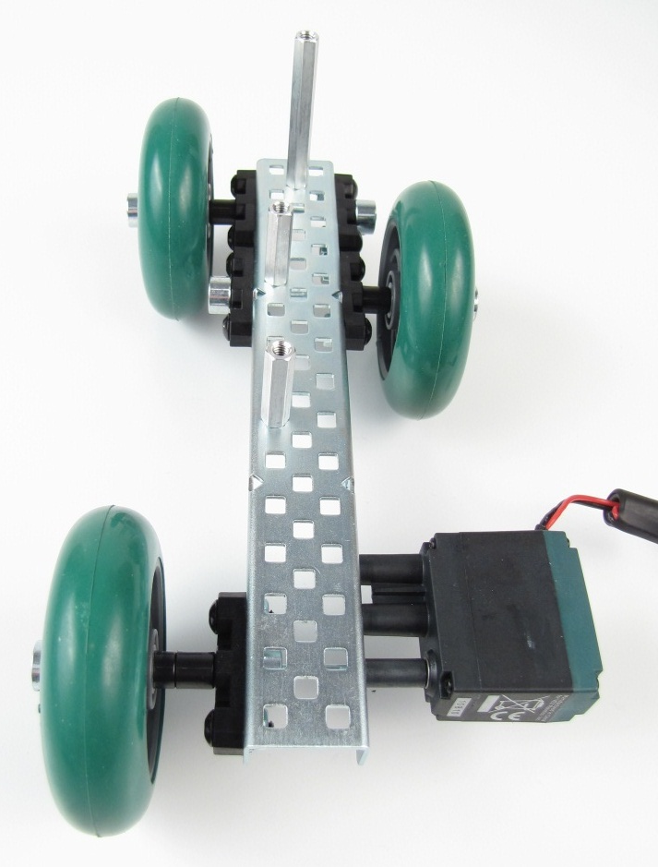
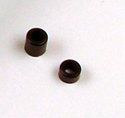
Step 2: Attach Wheels
X2 wheels
Allow small gaps so
wheels spin freely
3 in shaft
3 in shaft

Slide 5
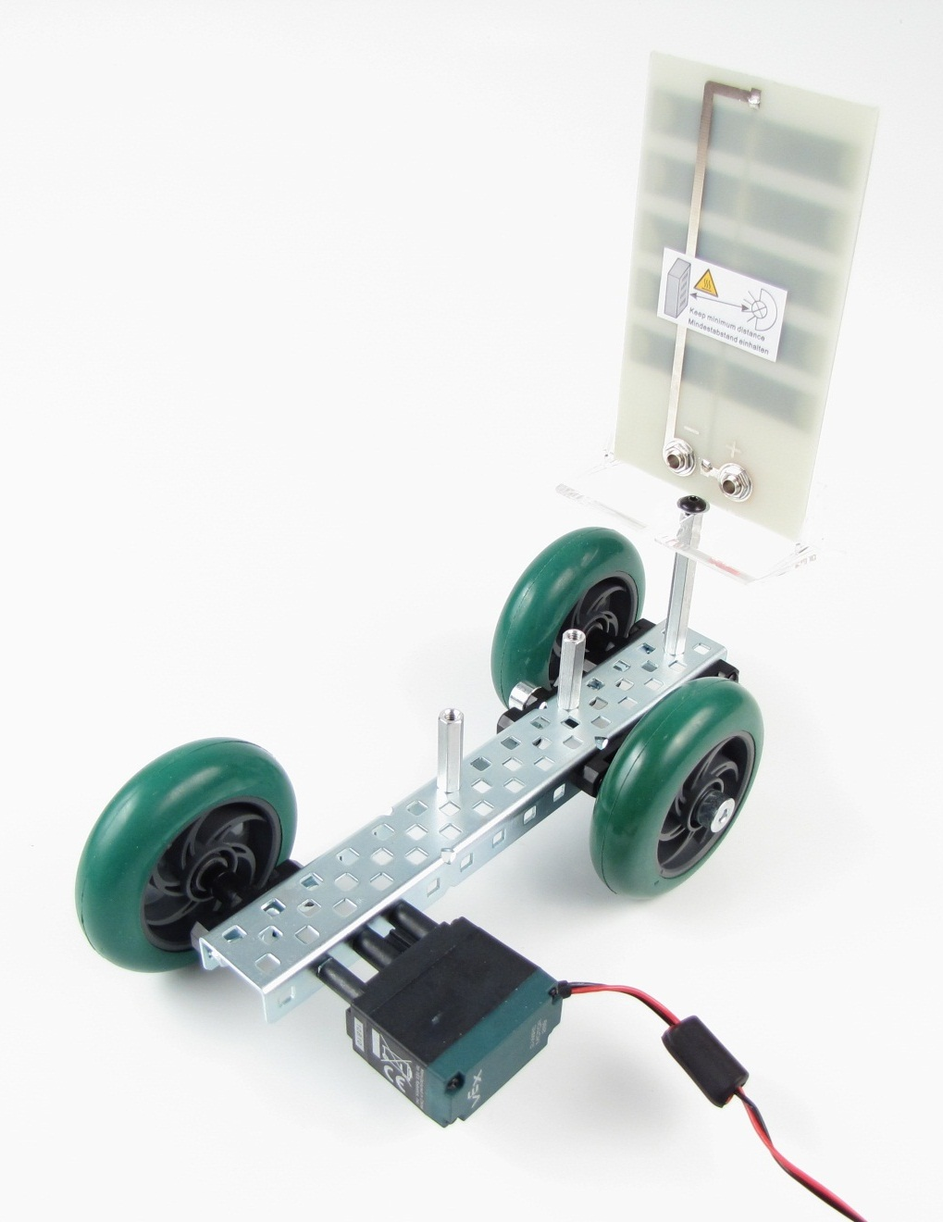
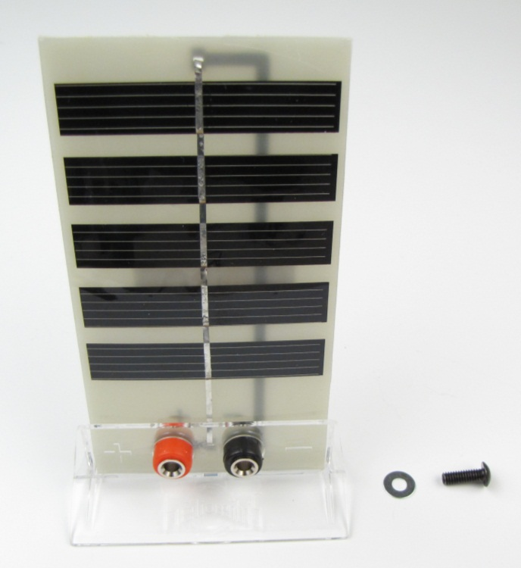
Step 3: Attach Solar Module

Slide 6
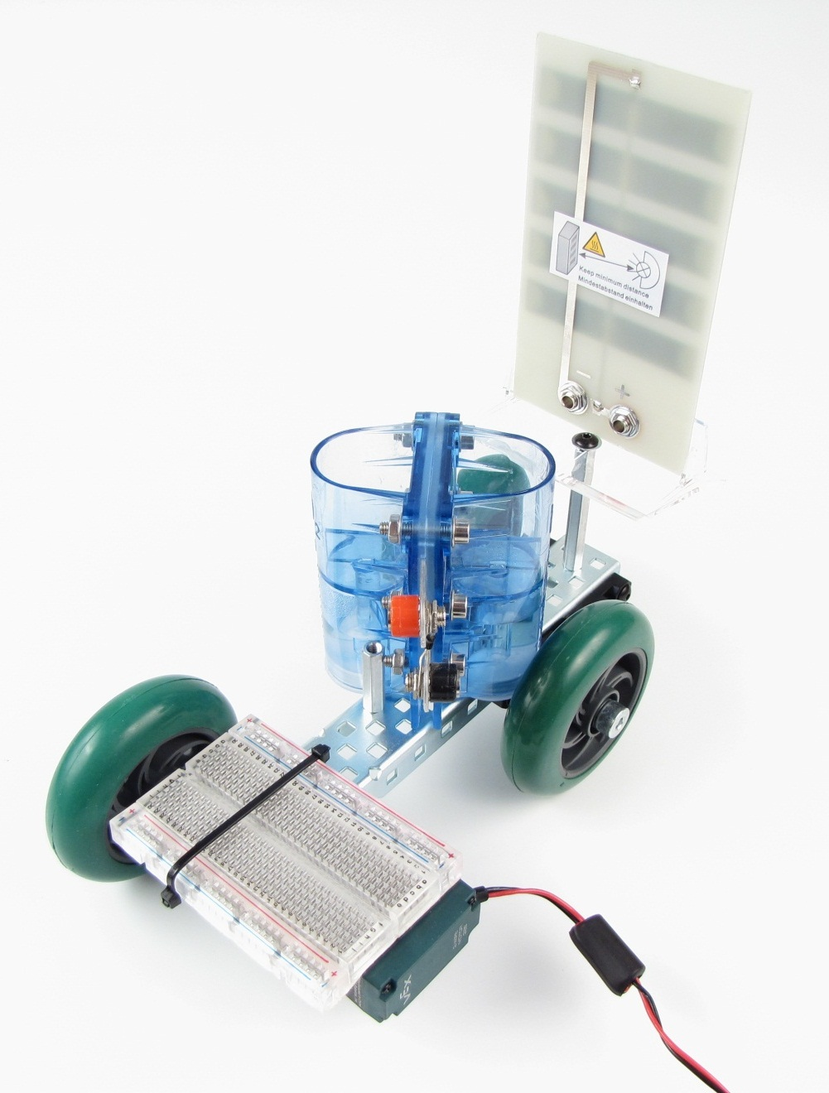
Step 4: Attach Fuel Cell and Breadboard
No wheel to
breadboard contact
Tie allow free
Movement of axel

Slide 7
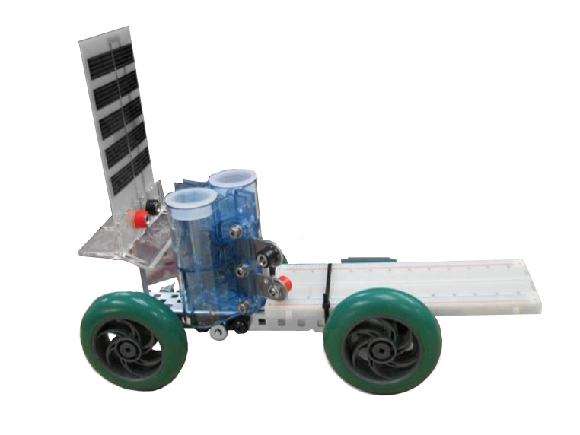
Step 4a: Alternate Breadboard Configuration
Adapt your vehicle for
available breadboard
as needed

Slide 8
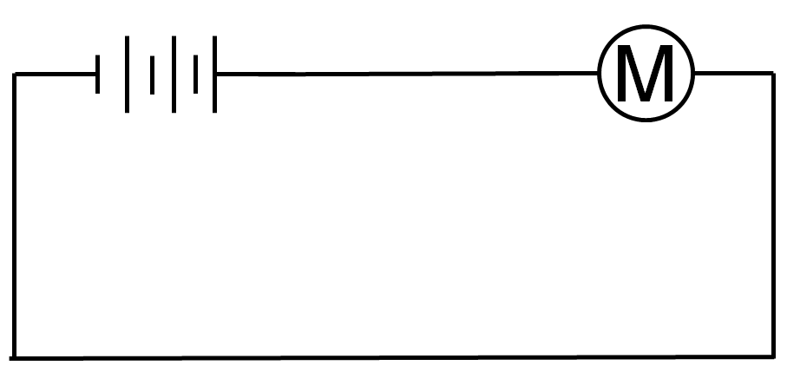
Step 5a: Electrically Connect Motor and Hook Up Wires
Note: Next slides will show steps to create this circuit

Slide 9
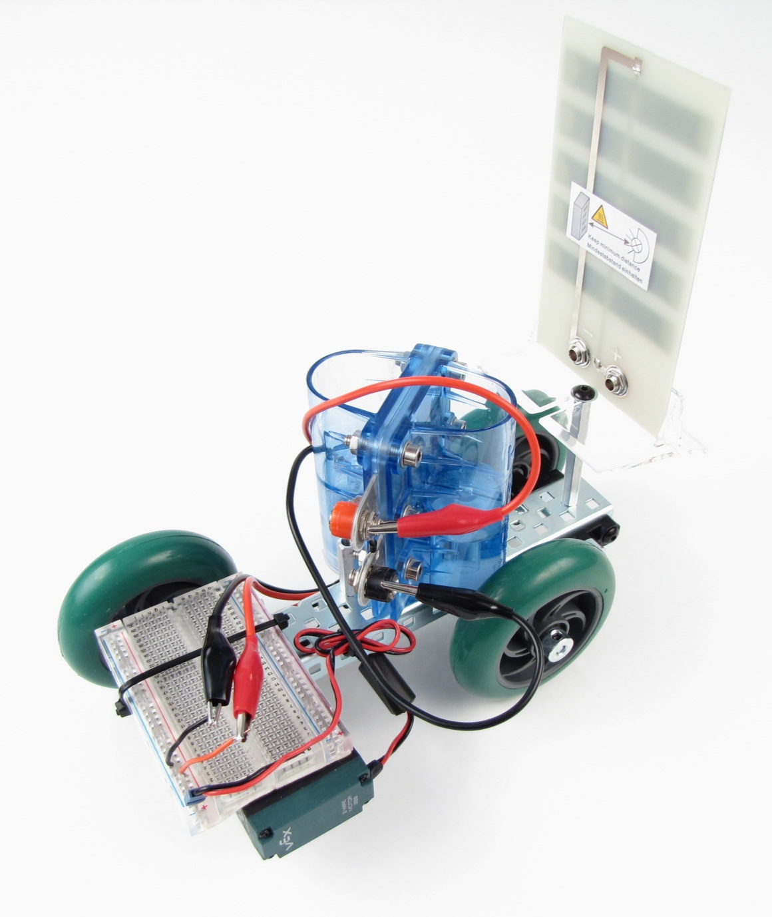
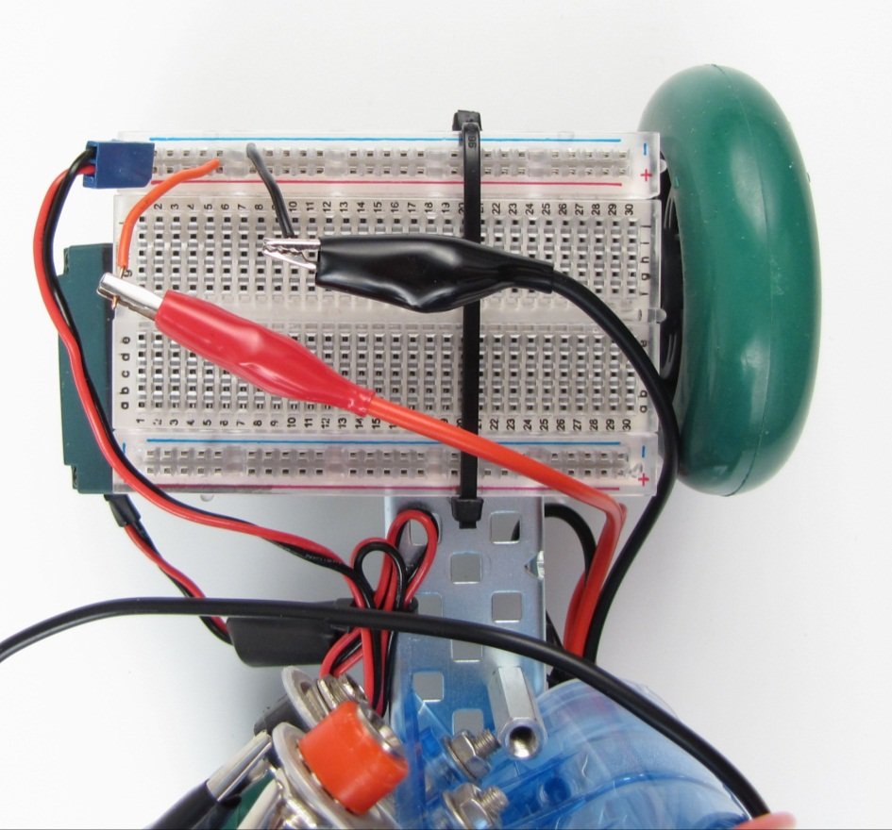
Step 5b: Physical Circuit

Slide 10
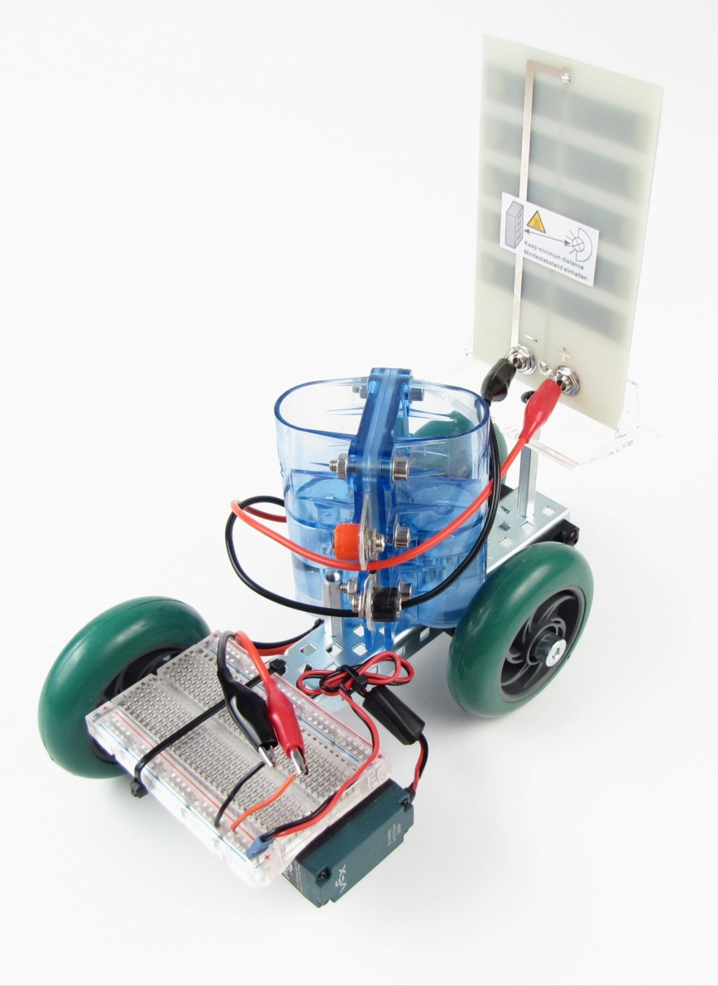
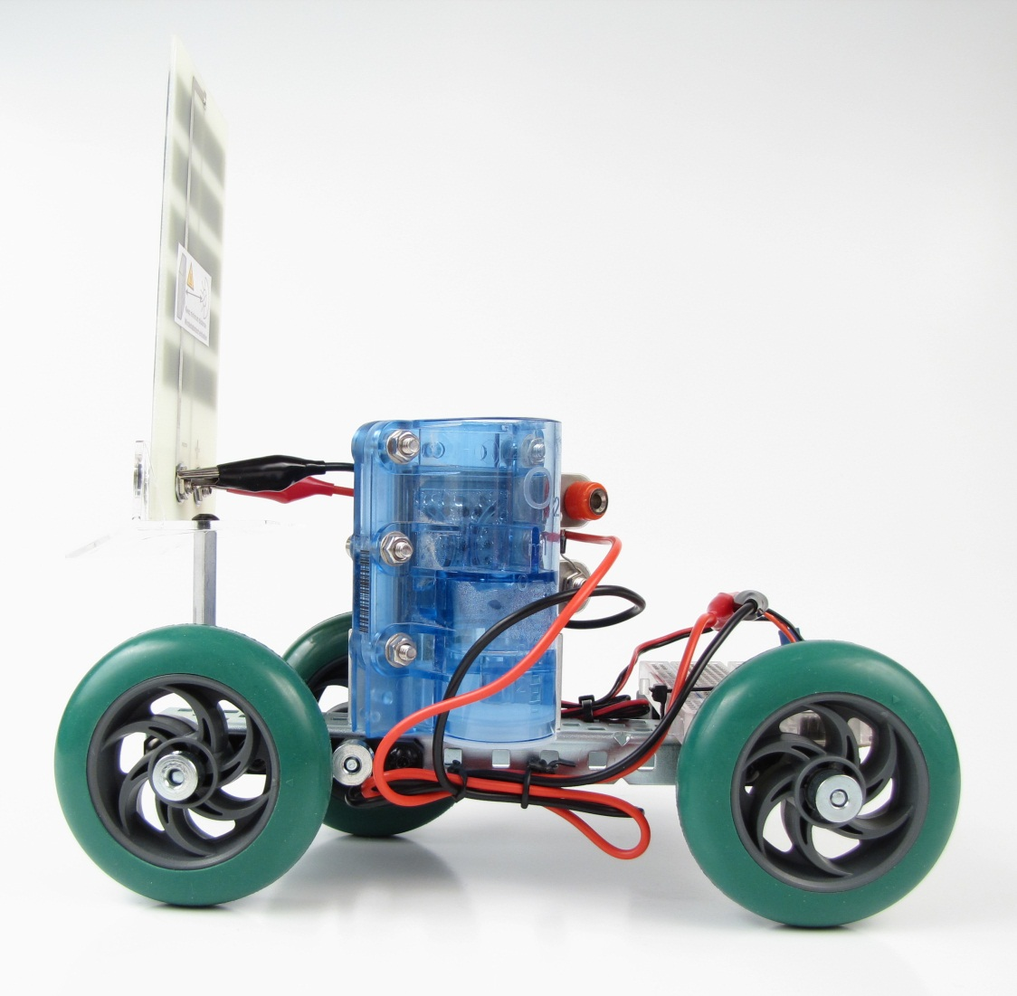
Step 5c: Physical Wiring Recommendations
Wires must reach
solar cell and fuel cell
Route and secure wires to allow
free vehicle movement

Slide 11

Stop
Use Next Steps to Complete
Activity 1.2.6 Solar Hydrogen System

Slide 12

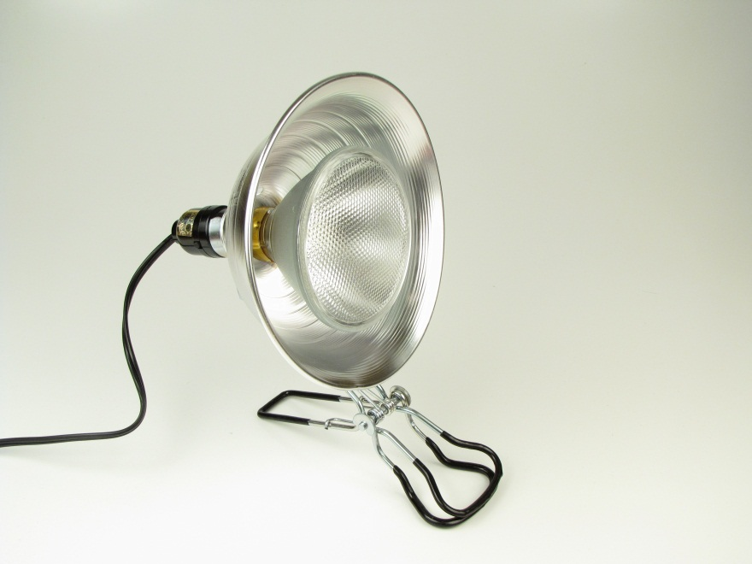
Step 7: Power Using Solar Cell
75 W PAR (Parabolic) bulb in holder
Connect wires to solar cell

Slide 13

Step 8: Power Using Fuel Cell
Connect wires to fuel cell

